Slide 1
ROLLING

Slide 2
1
START WITH FEET TOGETHER

Slide 3
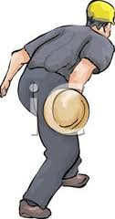
2
SWING ARM BACK

Slide 4
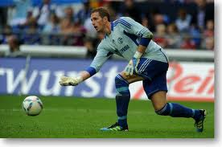
3
SWING ARM FORWARD
BEND AT THE WAIST
STEP WITH OPPOSITION

Slide 5
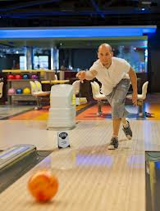
4
RELEASE
FOLLOW THROUGH

