Slide 1
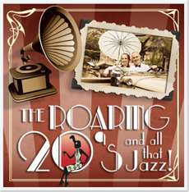
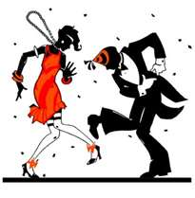
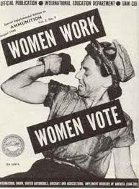
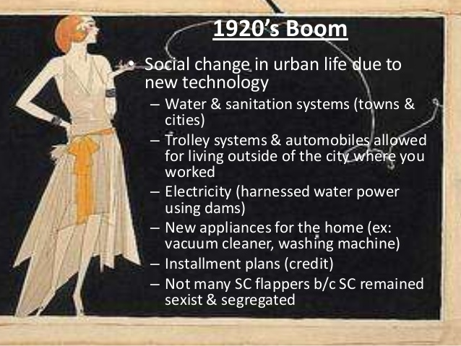
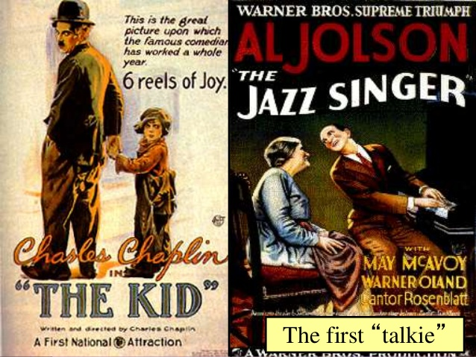
CHANGES IN AMERICAN SOCIETY 22-2

Slide 2
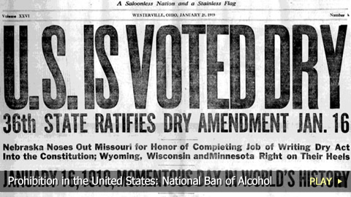
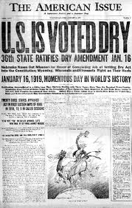
PROHIBITION
During the 1800s, many reformers had worked to reduce alcohol use in the United States.
PROHIBITION
A total ban on alcoholic drinks.
During World War I, support for prohibition grew.
Many Americans saw it as a way to conserve grains during the war.
18th AMENDMENT
Prohibited the making, selling, or transportation of alcohol.

Slide 3
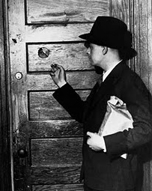
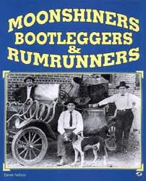
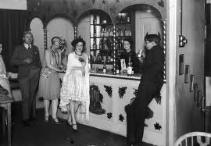
WHAT A CHALLENGE
The law proved impossible to enforce.
It was easy to smuggle liquor across the border from Canada and the Caribbean.
Bootleggers made huge profits by importing illegal alcohol.
BOOTLEGGERS
Liquor smugglers
Every large town had its speakeasies.
SPEAKEASIES
Illegal taverns that served liquor.

Slide 4
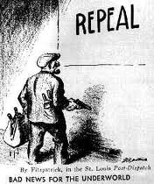
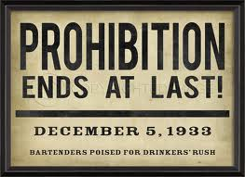
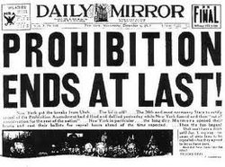
THE EXPERIMENT FAILS
By the end of the decade, it was clear that Prohibition had failed.
Many people called for the repeal of the Eighteenth Amendment.
In February 1933, Congress approved the (21st) Twenty-first Amendment, repelling Prohibition.
Before the year was out, states had ratified the amendment and Prohibition was over.

Slide 5
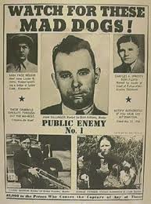
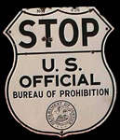
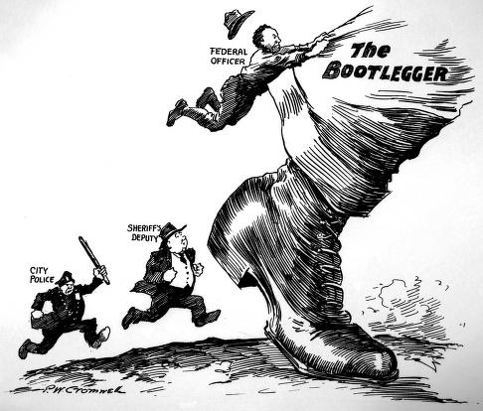
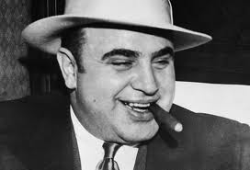
THE GROWTH OF ORGANIZED CRIME
The money to be made through bootlegging encouraged the growth of organized crime.

Slide 6
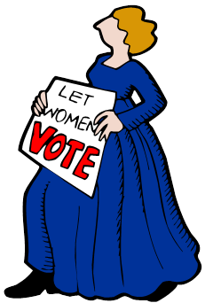
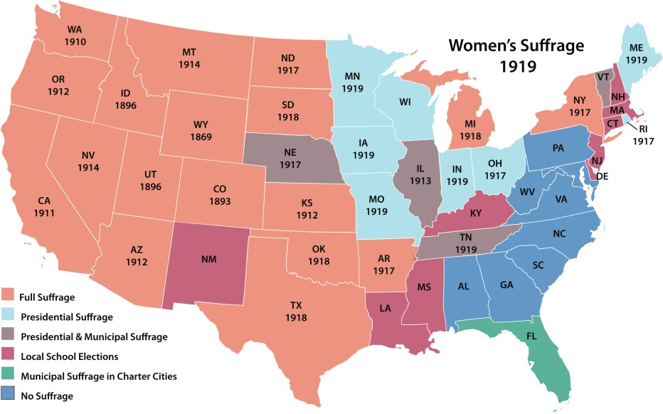
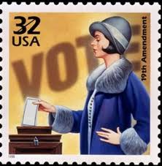
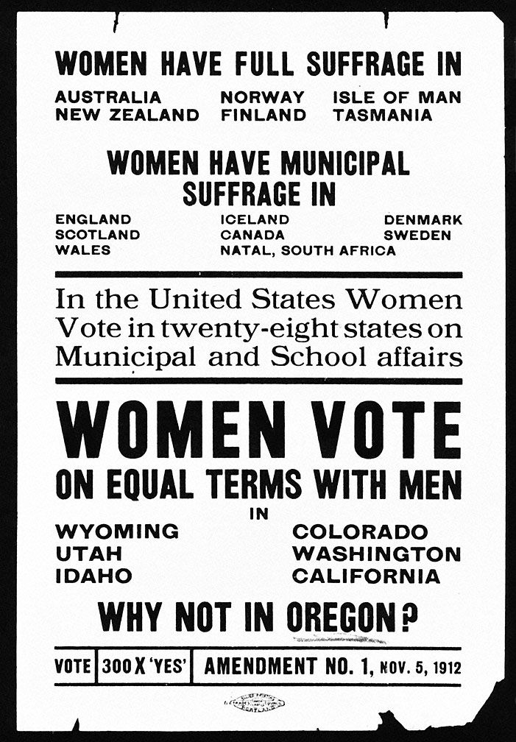
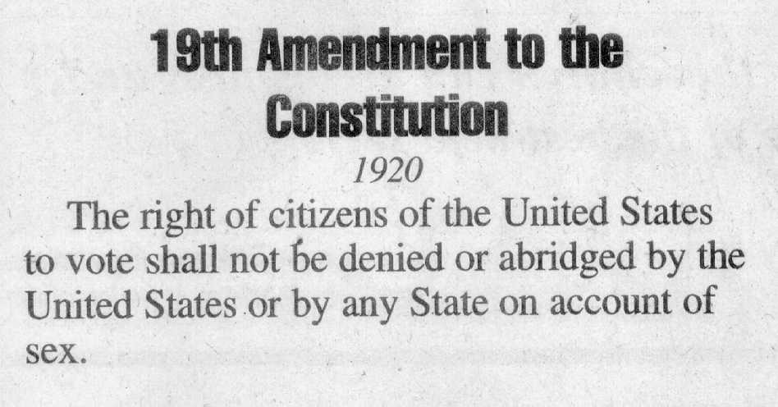
CHANGING LIVES OF WOMEN
Due to the Nineteenth Amendment, American women can now vote.
They voted in their first presidential election in 1920.
They also joined political parties and were elected to offices previously closed to them.

Slide 8
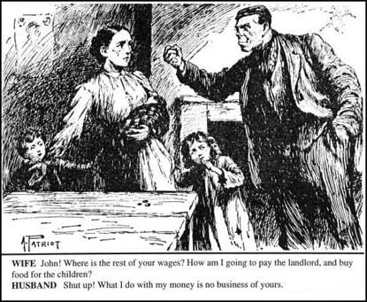
NOT A CHANCE
Other areas of life remained more restricted.
Many universities and professional schools stilled barred women from admission.
In some states, women still could not serve on juries or keep their own earnings.

Slide 9
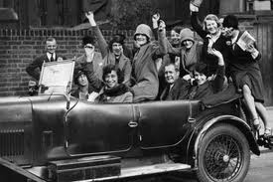
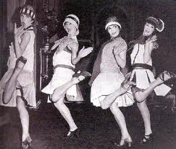
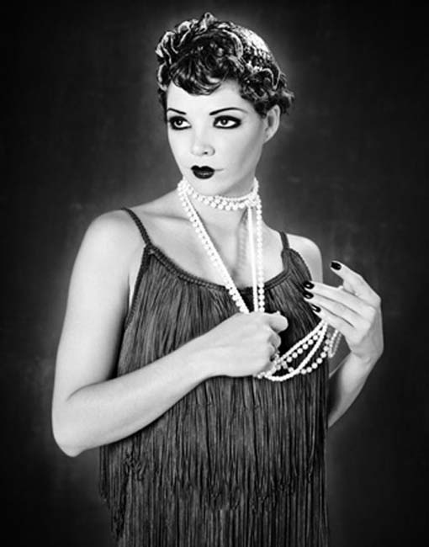
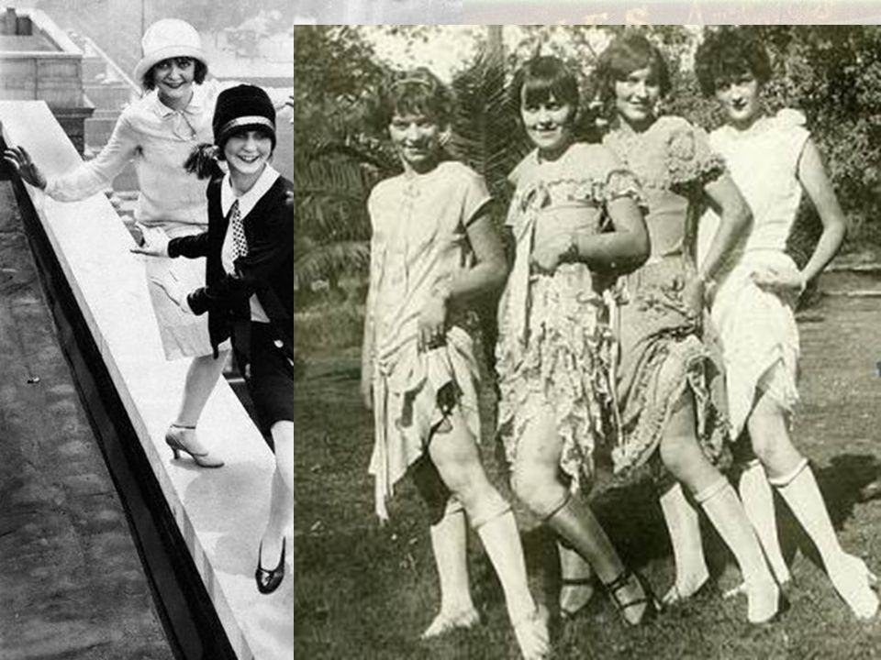
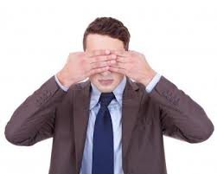
A NEW ATTITUDE
“Flappers” as they were called, were the young women of the 1920s that shocked the older generation.
Even though their numbers were small, the flappers became the symbol of women during the “Roaring Twenties.”

Slide 10
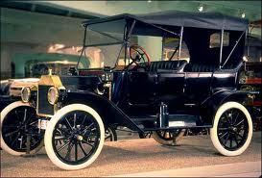
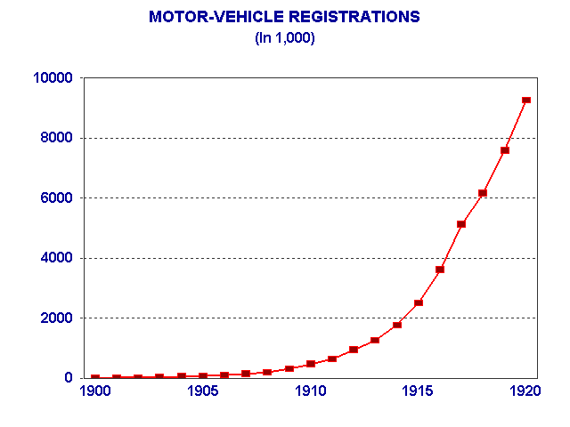
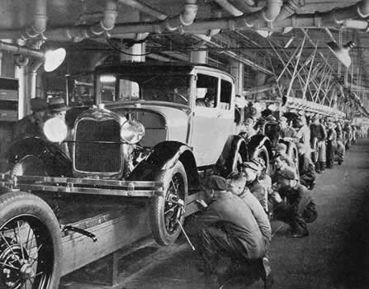
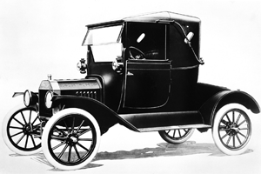
A NEW MASS CULTURE
The automobile became the symbol of the 1920s.
Henry Ford perfected the assembly line for making cars.
This reduced the time in making cars from about 12 hours to about 1 and a half hours.
Middle class families could now afford to buy a car since prices dropped.

Slide 11
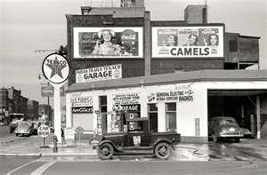
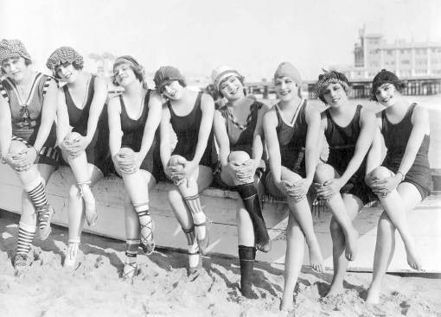
IMPACT OF THE AUTOMOBILE
How did the automobile change the life of American’s?
In a restless age, it became the symbol of individual freedom and independence.
The automobile created new businesses.
Gas stations, roadside restaurants, and cabins sprang up along newly built highways.
Cars and new roads made it easier for many families to move to the suburbs.
Cars made the rural areas less isolated.
Cars encouraged tourism.
What is tourism?
A tourist is a person who travels for pleasure
Traveling for pleasure

Slide 12
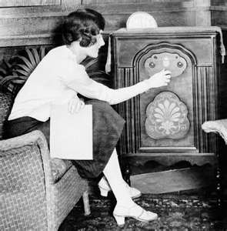
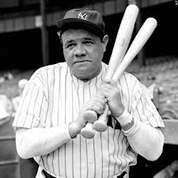
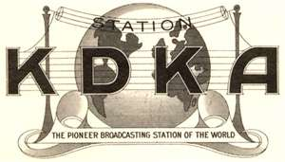
THE RADIO
The radio was introduced in the 1920s.
Commercial radio was an instant success.
Almost every family could afford to buy a radio.
The radio became the leading supplier of entertainment.
The radio put Americans in the stands of baseball games.
It turned band leaders, singers, and comedians into household names.
The first commercial radio station, KDKA, began broadcasting in Pittsburg in 1920.
By 1926, there were more than 700 radio stations and a national radio network, NBC.

Slide 13
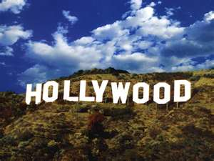
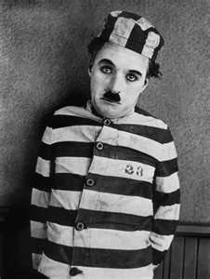
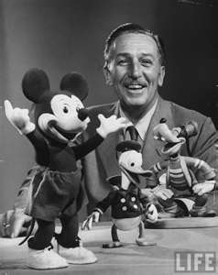
THE MOVIES
Movies were another new form of entertainment.
They provided an escape from everyday life.
Millions of Americans went to the movies at least once a week.
The movie industry grew up in Hollywood.
Why was Hollywood, California , a great location for filming?
Ideal climate (warm and sunny)
The first films were silent.
A pianist or small musical group performed in each theater.
Charlie Chaplin was the most popular actor during the twenties.
Animated movies began in the 1920s, and the Walt Disney company was founded in 1923.

Slide 14
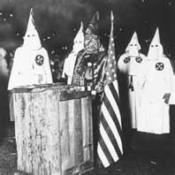
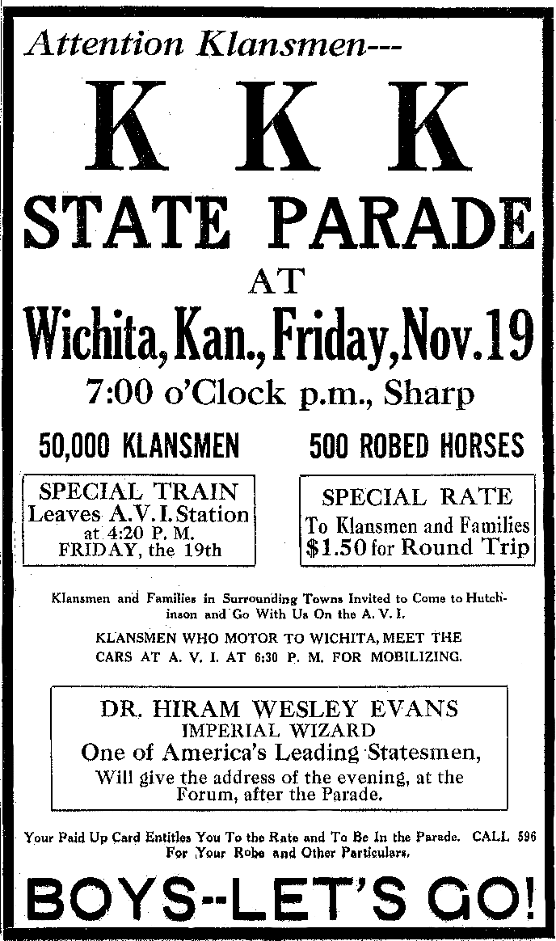
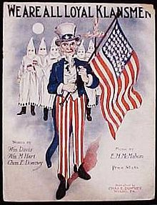
SOCIAL CONFLICT
Not everyone shared in the postwar social values.
Some were offended by what they saw.
They feared that rapid social and economic changes would destroy a treasured way of life.

Slide 15
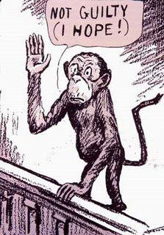
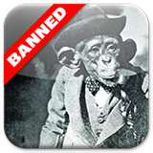
THE SCOPES TRIAL
John Scopes was a high school biology teacher in Dayton, Tennessee.
He was accused of violating Tennessee law by teaching the theory of evolution to his students.
Evolution is the scientific theory devised by Charles Darwin in the nineteenth century.
Darwin claimed that all life evolved, or developed, from simpler forms over a long period of time.
Some religious leaders rejected evolution, saying it denied the word of the Bible.
The trial became a national sensation.
The prosecutor was William Jennings Bryan.
The defense attorney was Clarence Darrow
The trial seemed to pit modern, urban Americans against traditional, rural Americans.
Was his freedom of speech violated?
American Civil Liberties Union

Slide 17
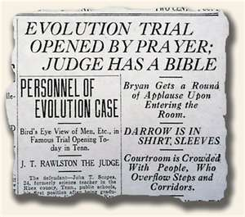
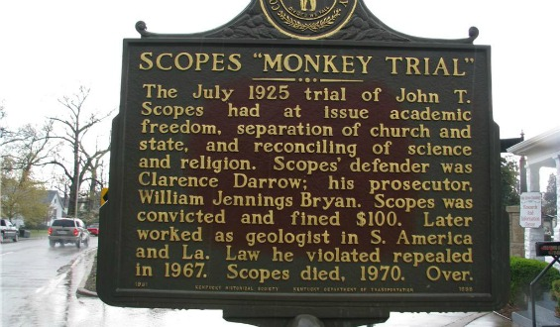
GUILTY
Guilty
Scopes was convicted and lost his job.
Laws against teaching evolution remained but were rarely enforced.

Slide 18
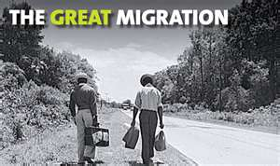
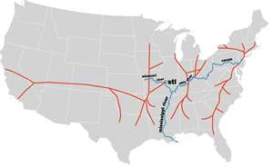
RACIAL CONFLICT
African Americans returned from service in World War I with new hope for equality at home.
They tried to get better jobs and to move to better neighborhoods.
The 1920s saw large numbers of African Americans move north in what was called the Great Migration.
Leaving the South, they headed for cities such as Chicago, Detroit, and New York.
They crowded into the few neighborhoods that allowed black residents.
Racial tensions mounted, and race riots broke out in several cities

Slide 19
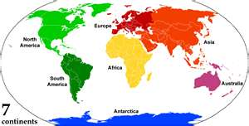
UNIA
Jamaican immigrant, Marcus Garvey, gained a wide following due to the racial tensions of the 1920s.
Garvey was a spellbinding speaker who created the Universal Negro Improvement Association (UNIA).
The UNIA sponsored activities to promote black pride and black unity.
It also encouraged African Americans to move permanently to Africa.
Why do you think many African Americans stayed in the U.S. and did not listen to Garvey’s suggestion?

Slide 20
KKK
The social tensions of the 1920s were also expressed in the growth of the Ku Klux Klan.
Ku Klux Klan
A terrorist organization that formed during the Reconstruction Era in American history.
The whites-only Klan scorned not just blacks but also immigrants, Catholics, and Jews.
The organization’s power spread from the South to the Midwest and the West.
However, several public scandals at the end of the 1920s cost the Klan much of its support.
The general economic prosperity also contributed to the organization’s decline.

