Slide 1
Fields, Isolines, Gradients

Slide 2
Fields
What is a field?
A field is an area you can measure.
Ex. Temp fields in a room.
Scientists take measurements in their field.

Slide 3
Isolines
What is an Isoline?
Isolines – line of equal value
(iso=same) lines. (isosceles triangle)
They connect points of equal value in a given field.
Ex. Contour lines.

Slide 4
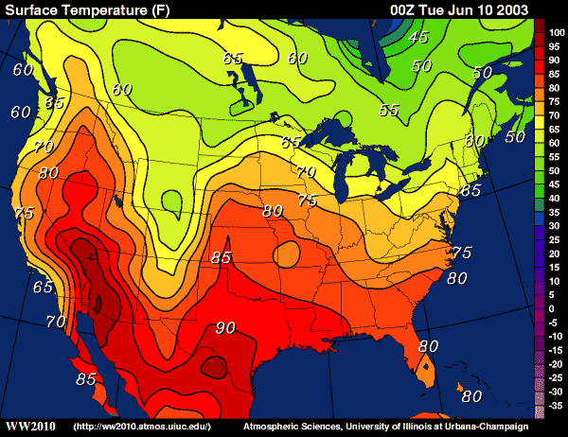
Common examples of isolines are:
Isotherms – Same temperature

Slide 5
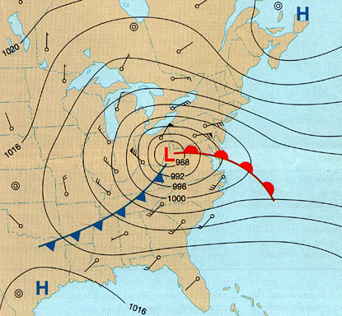
Common examples of isolines are:
Isobars – Same (Bar) atmospheric pressure

Slide 6
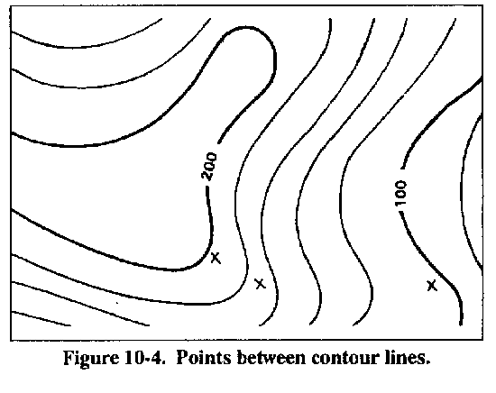
Common examples of isolines are:
Contour lines – Same elevation

Slide 7
Gradients
What does it mean when isolines
are closer together?
The closer the isoline the faster the value changes,
Ex. Steeper gradient.

Slide 8
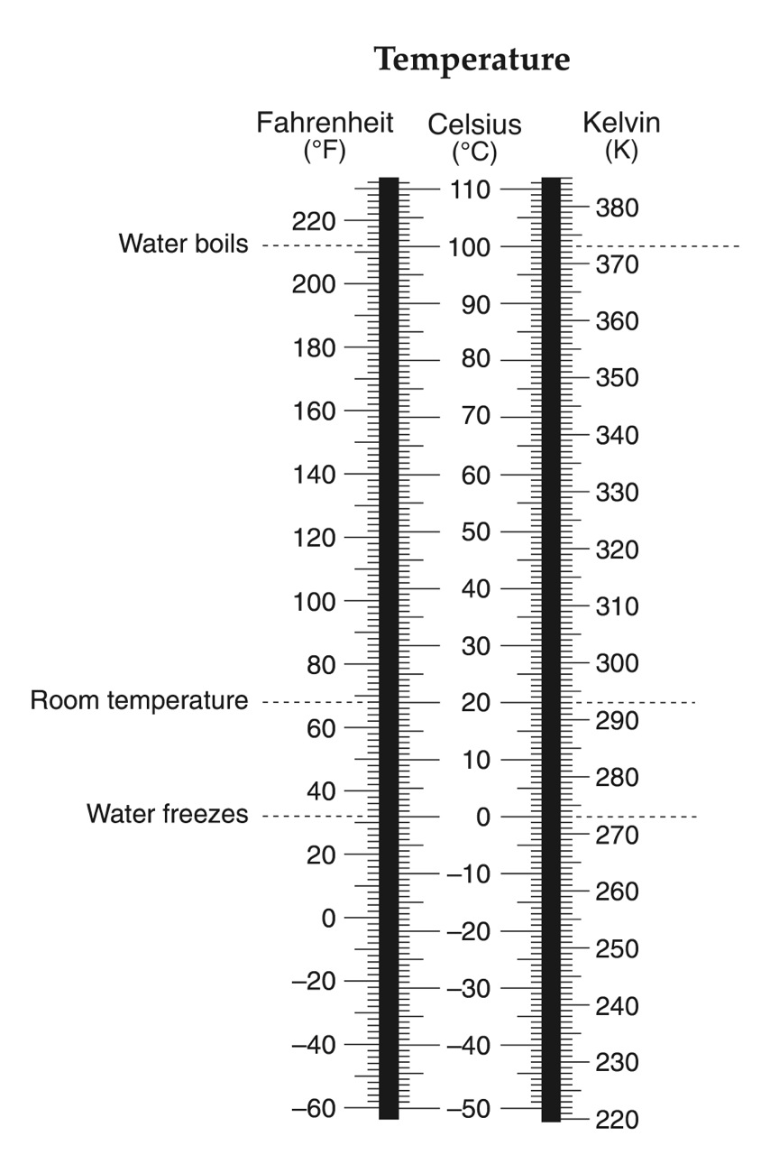

Slide 12
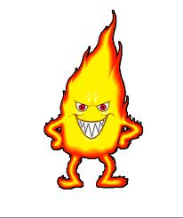
How heat travels
Why does hot air rise?
Hot air rises due to differences in density.
How does heat travel horizontally?
Heat travels from Hot to Cold.
(More) speed to (less) speed
What is something that adds heat called?
Heat source adds heat.
What is an area where heat leaves called?
Heat sink is where heat leaves.

Slide 13
Heat Lab Conclusion
What does a thermometer measure?
Heat is a measure of?
How does heat travel horizontally?
What 2 things create heat differences?
Heat Source? (3 examples)
Heat Sink? (3 examples)
Why does hot air rise? (explain)

