Slide 1
Expository Writing
Hooks, Transitions, Conclusions

Slide 2
What is Expository Writing?
Provides an explanation of a specific topic.
Gives facts, reasons, explanations, or examples with supporting details about the topic.
Should always include a main idea, logical reasons, sufficient supporting details, and a conclusion.

Slide 3
Text Structure
The framework of a text’s beginning, middle, and end.
Beginnings and endings help link the text into a coherent whole.

Slide 4
Beginnings: Hooking Your Reader
Lead or Hook
Orients the reader to the purpose of the writing by introducing topic, thesis, or argument
Use techniques such as dialogue, flashback, description, inner thoughts, and jumping right into the action
Thesis: main point or focus of your writing (Subject + Opinion)

Slide 5
What’s in the middle?
Sequence: uses time or spatial order as organizing structure
Description: used to describe the characteristics of a specific subject
Cause and Effect: used to show causal relationships between events
Comparison and Contrast: used to explain how two or more objects are similar or different
Problem and Solution: requires writers to state a problem and come up with a solution

Slide 6
Endings: Beyond “Happily Ever After”
Signals the end
Restate the Thesis
Leaves the reader with something important to remember
DO NOT introduce new information
Forecast the future
Call for Action
Discuss implications

Slide 7
Transition Words
There are six categories of transition words:
Spatial order. Words used in descriptive writing to signal spatial relationships, such as above, below, beside, nearby, beyond, inside, and outside.
Time order. Words used in writing narratives, and instructions to signal chronological sequence, such as before, after, first, next, then, when, finally, while, as, during, earlier, later, and meanwhile.
Numerical order. Words used in expository writing to signal order of importance, such as first, second, also, finally, in addition, equally important, and more or less importantly.
Cause/effect order. Words used in expository writing to signal causal relationships, such as because, since, for, so, as a result, consequently, thus, and hence.
Comparison/contrast order. Words used in expository writing to signal similarities and differences, such as (for similarities) also, additionally, just as, as if, as though, like, and similarly; and (for differences) but, yet, only, although, whereas, in contrast, conversely, however, on the other hand, rather, instead, in spite of, and nevertheless.
General/specific order. Words used in descriptive reports and arguments to signal more specific elaboration on an idea, such as for example, such as, like, namely, for instance, that is, in fact, in other words, and indeed.

Slide 8
Organizing Your Writing
Does your piece have a clear beginning, middle, and end?
Does your piece have a strong beginning that hooks the reader?
Does your piece have a strong ending that fits the focus?
Are the ideas and actions connected to each other?
Can your reader follow the piece logically from beginning to end?
Is it complete? Does it feel finished?

Slide 9
Sample Expository Prompt
Read: Everyone loves to do the things that they do well, and this love usually applies to hobbies and sports.
Think: Think of your favorite hobby or sport and why it is an important part of your life.
Write: Write an expository essay to inform an interested adult about your favorite hobby or sport. Be sure to include reasons and/or examples that explain how this hobby or sport is important to your life. Support your ideas with specific details.

Slide 10
Sample Expository Introduction
During the fall and winter months, it is a ritual for many fathers and sons to gather around the television on Sunday afternoon to watch NFL football games. Or for many of us in high school, we gather with our friends on Friday nights to cheer on our own high school football team. Why are so many drawn to the sport of football? Football is the all-American sport that unites its fans and has the ability to bring family and friends closer together. For these reasons, it is my favorite sport.

Slide 11
The writer of this paragraph has chosen football as his favorite sport.
The paragraph is clearly informative because it gives the general reasons for this sport being the writer’s favorite.
In the paragraphs to follow, the writer will give specific examples to show how football “unites its fans and brings family and friends closer together.”

Slide 12
Topic Sentences
A topic sentence tells the subject of your paragraph and the purpose for it. It introduces what you will talk about in your paragraph. The topic sentence lets the reader know what to expect.
An effective topic sentence is broad enough so that you can include details about it. It should not be so narrow that you have nothing else to say about the topic.

Slide 13
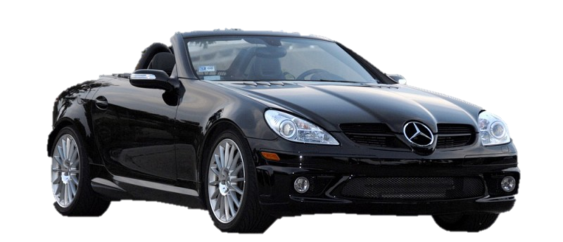
Good Topic Sentences
Example 1: My favorite car is the Toyota Corolla for several reasons.
Example 2: The greatest sports car on the market today is the Mercedes Benz SLK 230 convertible.

Slide 14
Example 1
This topic sentence is simple, but it addresses the subject and conveys the writer’s purpose. This topic sentence tells the reader that the writer’s favorite car is the Toyota Corolla and that the writer has several reasons for it being her favorite. This topic sentence is broad enough to be explained in the sentences to follow. The reader knows that the rest of the paragraph will give the reasons for the Toyota Corolla being the writer’s favorite car.

Slide 15
Example 2
This topic sentence isn’t quite as simple as the first one. Even though the sentence doesn’t say that the Benzo convertible is the writer’s favorite car, the writer implies it by saying it is the greatest car on the market today. This topic sentence tells the reader that the paragraph is about the Mercedes convertible and implies that it will explain why it is the greatest car on the market today. Again, this is a good topic sentence for the prompt given.

Slide 16
Bad Topic Sentences
Example 3: Today I am going to write about the Toyota Corolla. It is a boss.
This sentence is not a good topic sentence. It doesn’t specifically address the subject and purpose, which is to write about your favorite car and explain why. This sentence doesn’t say anything about how the Toyota Corolla is the writer’s favorite car. Rarely in life should you ever write a sentence like this one. Never start a paragraph by writing “I’m going to write about . . .” It is elementary, it gives no direction to the paragraph, and it gives the reader no sense of purpose for the paragraph.

