Slide 1
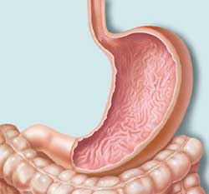
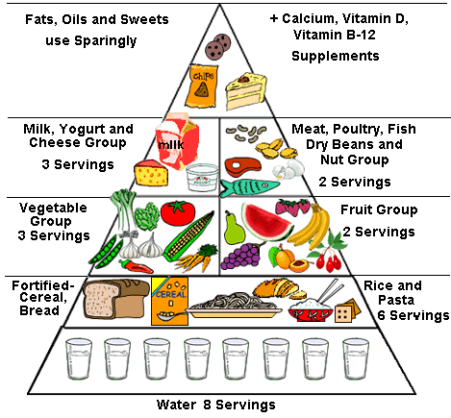
Chapter 38: The Digestive and Excretory Systems
CONCEPTS
- Nutrition
- Structures and functions
- Enzymes used by the body

Slide 2
What is Nutrition?
Definition: The process by which organisms get food and break it down to use for their metabolism
The nutrients that the body needs every day are: water, fats, proteins, vitamins, and minerals.

Slide 3
Vitamins and Minerals
Vitamins
Organic molecules that help regulate body processes
Can be fat soluble (A,D,E,K) or water soluble (rest)
Minerals
Inorganic nutrients that the body needs, usually in small amounts

Slide 4
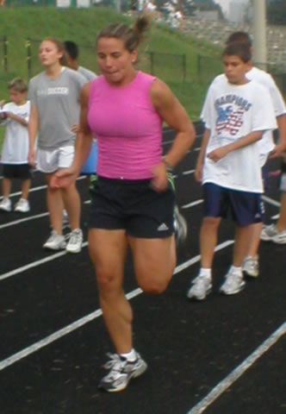
The Human Diet
The average human should ingest about 2,000 Calories/day. This is less than you may think…
Age, sex, lifestyle, weight,
and body condition all affect
daily Caloric needs.

Slide 5
The Food Pyramid

Slide 6
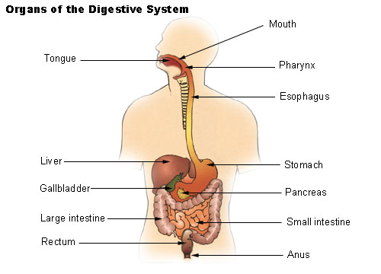

Slide 7
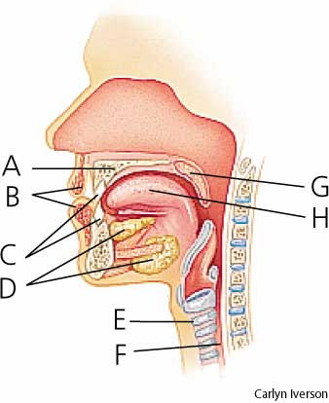
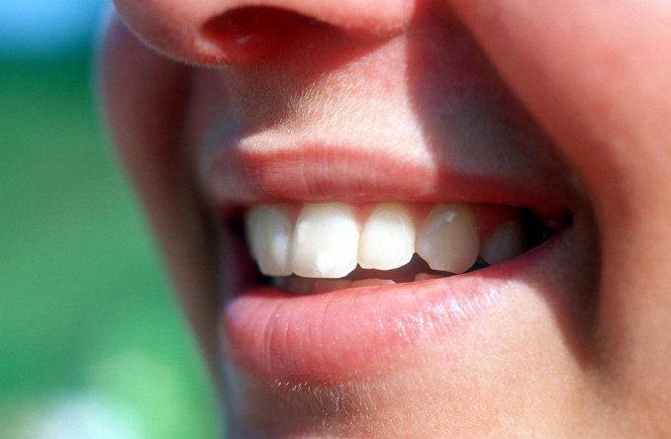
Organs: The Mouth
Breakdown of food begins in the mouth.
Teeth increase surface area of food
Starches are broken down by an enzyme called salivary amylase.

Slide 8
Organs: The Esophagus
The tube that connects the mouth to the stomach and also begins the process of peristalsis.
Peristalsis: The movement of food
down the digestive tract by waves of muscle contractions

Slide 9
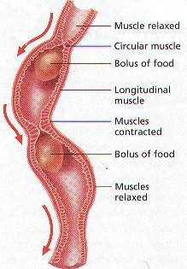
Peristalsis
Muscle Contractions
That push food from
Mouth to stomach
Involuntary movement

Slide 10
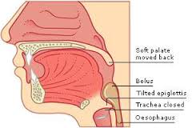
Epiglottis- flap of tissue covering the trachea. Prevents coking.

Slide 11
Organs: The Stomach
A thick-walled muscular sac that contains enzymes and gastric juices (HCl).
Mechanical digestion---Solids are broken down into a thin, soupy liquid called chyme.
Chemical Digestion---The enzyme Pepsin breaks down proteins in the stomach

Slide 12
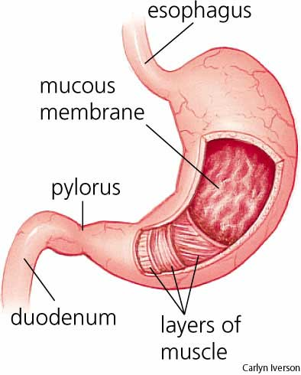
The Stomach
ULCERS- sores on
The lining of the
Stomach
Intestine
Or Esophagus

Slide 13
Other Important Organs
Liver: Produces bile which breaks down fat in the small intestine
Gall Bladder: Stores bile
Pancreas: Releases enzymes into the small intestine.

Slide 14
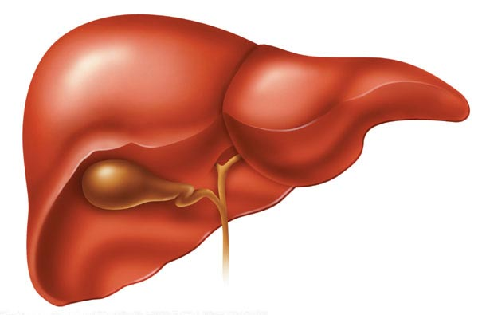
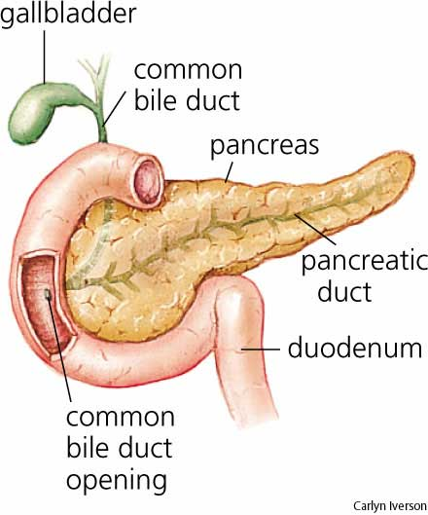
Liver and Gallbladder

Slide 15
Organs: Small Intestine
Coiled tube about 20 ft. long and 2.5 cm. in diameter.
Most digestion and ALL nutrient absorption is completed here.
Lined with millions of tiny “fingers” called villi which increase surface area and aide in absorption of nutrients.

Slide 16
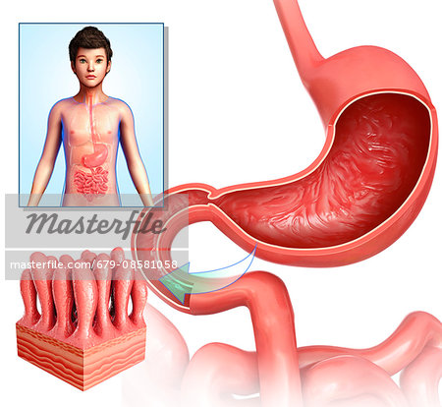

Slide 17
Small Intestinal Enzymes
Amylase, Maltase, Sucrase, Lactase
Continued breakdown of starches
Trypsin, Peptidase
Continued breakdown of proteins
Lipase
Breakdown of fats

Slide 18
Organs: Large Intestine
Tube about 5 ft. long and 6 cm. in diameter…No digestion occurs here!
Functions:
Reabsorption of water
Reabsorption of vitamins (K and B) created by E. coli bacteria!
Elimination of feces through the anus (stored in rectum)

Slide 19
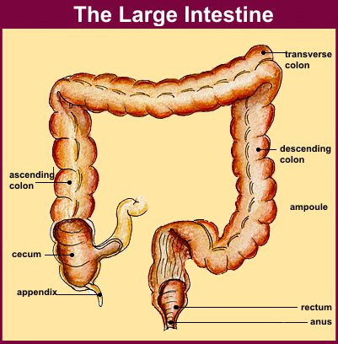

Slide 20
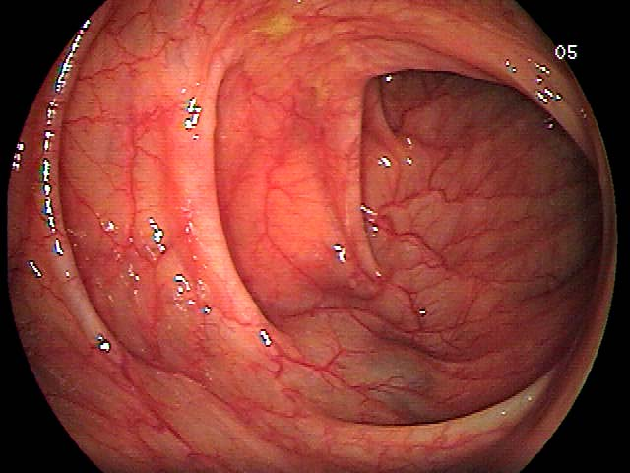
Inside the Large Intestine

Slide 21
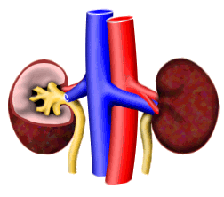
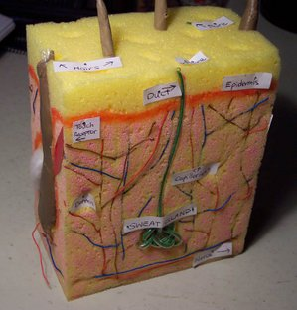
Chapter 38 – Part 2: Excretion
CONCEPTS
- Structures and Functions
- Importance to the Body

Slide 22
Excretion - Defined
Excretion:
The process by which the skin, lungs, and kidneys remove metabolic wastes and other excess substances from the body
Humans excrete: water, urea, salts, proteins, sugars, etc…

Slide 23
The Role of the Liver
The liver not only produces bile, but has two other major functions:
1) Detoxification
Usually of alcohol and drugs
2) Formation of Urea
Amino acids from broken down proteins

Slide 24
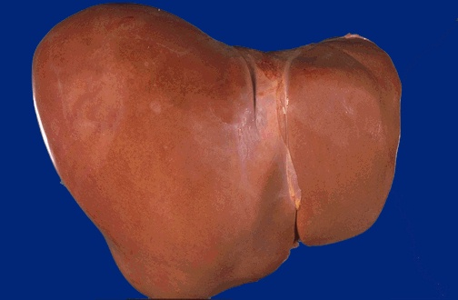
A Normal Liver

Slide 25
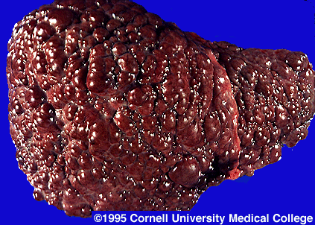
Cirrhosis of the Liver

Slide 26
The Urinary System
Kidneys: Produce urine
Ureters: Tubes that carry the urine
down to the…
Bladder: Storage chamber for urine
Urethra: Tube that urine travels
through to exit the body

Slide 27
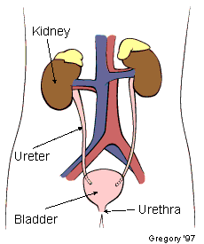
The Urinary System

Slide 28
Kidney Function
The kidney’s play an important role in maintaining homeostasis…
They regulate the blood’s:
Water Content
Volume
pH
Waste Products

Slide 29
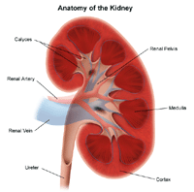
Kidney Structure
Two major parts:
The outer region is the Cortex
The inner region is the Medulla
The real work of the kidneys (the filtering of blood) is done by structures called nephrons.
Each kidney has about 1.25 million!

Slide 30
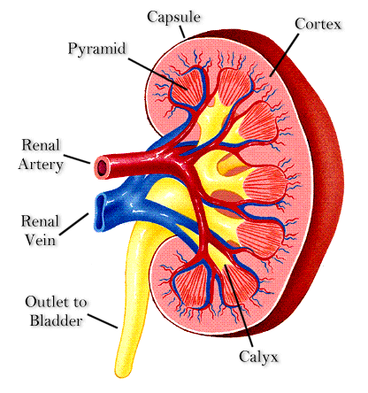
Structure of the Kidney

Slide 31
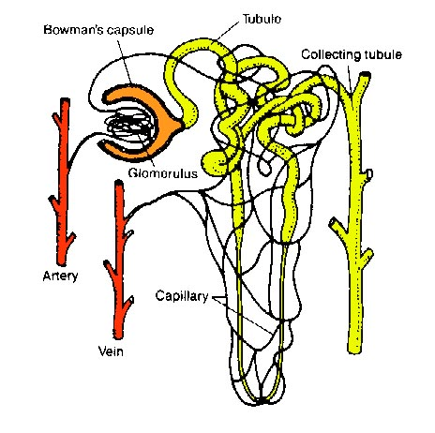
The Nephron
The nephron is composed of a group of capillaries called the Glomerulus surrounded by the Bowman’s capsule.

Slide 32
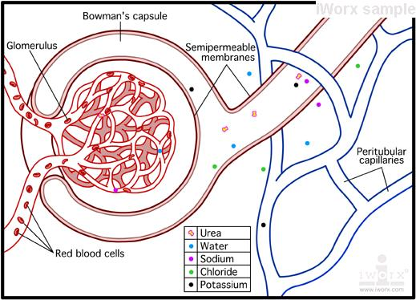
Glomerulus/Bowman’s capsule

Slide 33
The Nephron, con’t
Wastes are filtered through the glomerulus into the Bowman’s capsule, down the loop of Henle, and eventually out of the kidney…

Slide 34
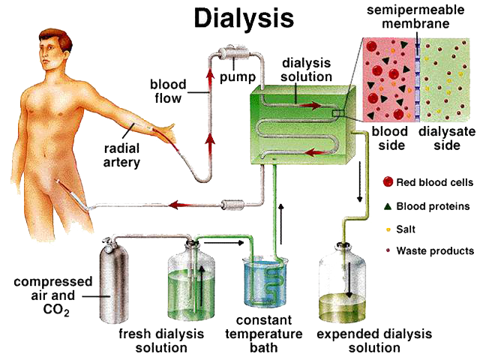
What if the Kidneys don’t function properly!

Slide 35
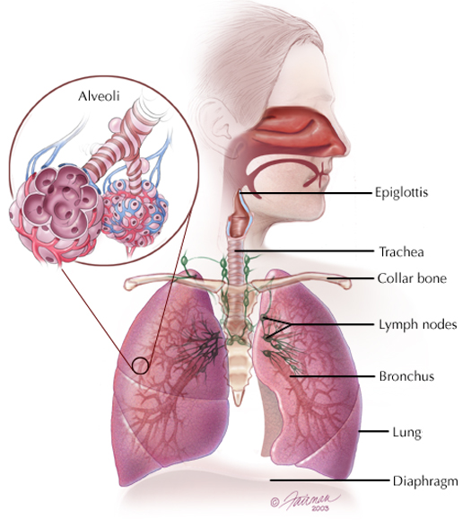
The Role of the Lungs
Considered excretory organs because they remove carbon dioxide and water from the body…

Slide 36
The Role of the Skin
The skin has two layers that contain:
Sweat and oil glands, hair, blood vessels, and fatty tissue…
Functions include:
Protection
Excretion of water, urea, salts, and heat

Slide 37
