Slide 1
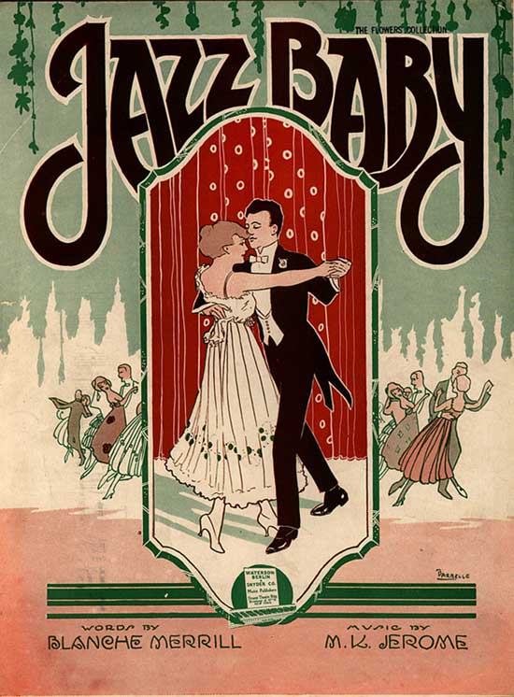
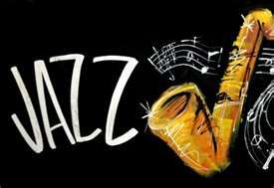
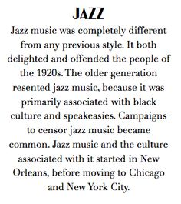
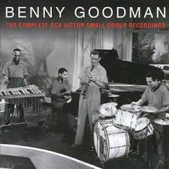
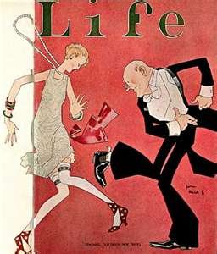
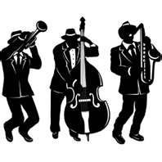
THE JAZZ AGE 22-3
Artistic and cultural change

Slide 2
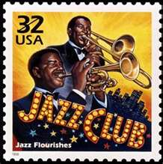
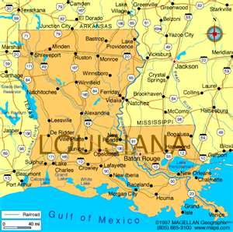
AN AMERICAN SOUND
During the 1920s, a new musical sound achieved wide popularity.
Jazz was created by black musicians in the nightclubs and dance halls of New Orleans.
New Orleans was a major port city, where people and cultures from around the world came together.
Jazz combined rhythms from West Africa and the Caribbean, work chants and spirituals from the rural South, and harmonies from Europe into an original new style of music.

Slide 3
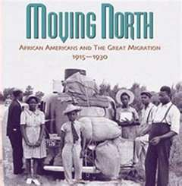
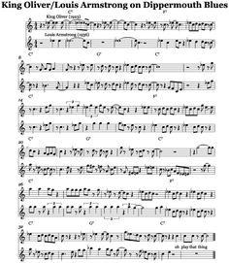
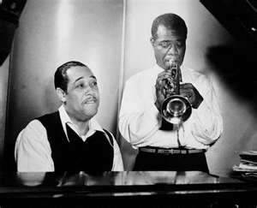
JAZZ ON THE MOVE
Jazz quickly spread to other American cities, following along with the Great Migration.
African American musicians also found eager audiences for their music in St. Louis, New York, Chicago, Kansas City, and Detroit.
Among the most famous of the new jazz artists were trumpet player and singer Louis Armstrong, singer Bessie Smith, and band leader Duke Ellington.

Slide 4
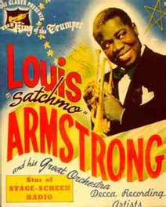
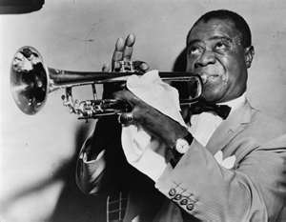
LOUIS ARMSTRONG
Armstrong, who was known as Satchmo, learned to play the trumpet while growing up in New Orleans orphanage.
He was a well-known musician.
Like other jazz players, he developed the ability to take a simple melody and recombine the notes and rhythms in new ways to produce a cascade of rich and exciting sounds.
Because jazz ‘s emphasis on improvisation and experimentation, listeners heard many different versions of the basic tune.

Slide 5
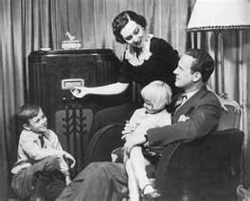
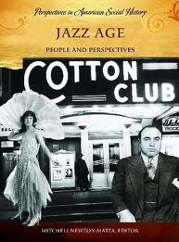
AN IMPORTANT CONTRIBUTION
Radio helped to spread jazz beyond the African American community.
Jazz became one of the most important American contributions to world culture.
It was so popular that the decade of the 1920s became know as the Jazz Age.
Popular all-white nightclub in Harlem

Slide 6
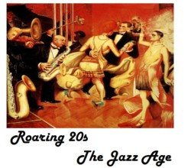
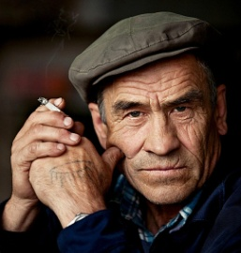
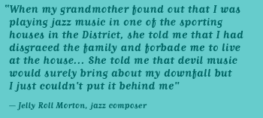
JAZZ IS NOT FOR EVERYONE
Jazz did not set everyone’s feet tapping.
The rhythms of the new music were jarring to many older Americans.
Jazz alarmed people who thought it encouraged an overemphasis on pleasure and undermined the morals of America’s young people.
I’m NOT a fan of Jazz
Jazz is too DIFFERENT!!!!!!!!!!

Slide 7
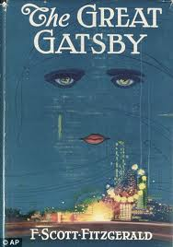
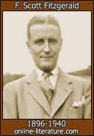
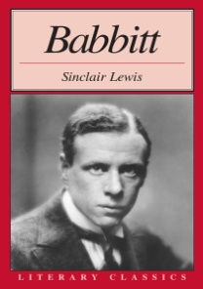
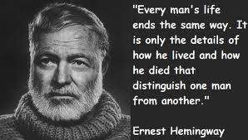
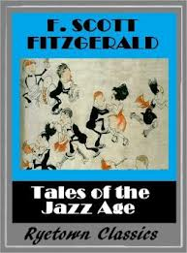
LITERATURE OF THE 1920S
American literature flourished during the 1920s.
Writers both reflected the excitement of the era and criticized its extremes.
Writers complained that Americans had turned from international idealism to greedy selfishness.
F. Scott Fitzgerald: The Great Gatsby (Emptiness of rich peoples lives).
Ernest Hemingway: A Farewell to Arms (Captures the growing anti-war sentiments of his generation).
Sinclair Lewis: Babbitt (Criticized American society).

Slide 9
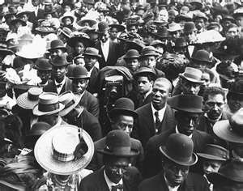
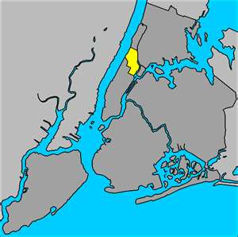
Harlem Renaissance
During the 1920s, a vibrant African American culture grew in Harlem, a part of New York City that attracted thousands of migrants from the South.
Writers, musicians, and poets reacted against the prejudice they faced while expressing the hopes of black Americans.
African Americans produced noteworthy works of art and literature.

Slide 10
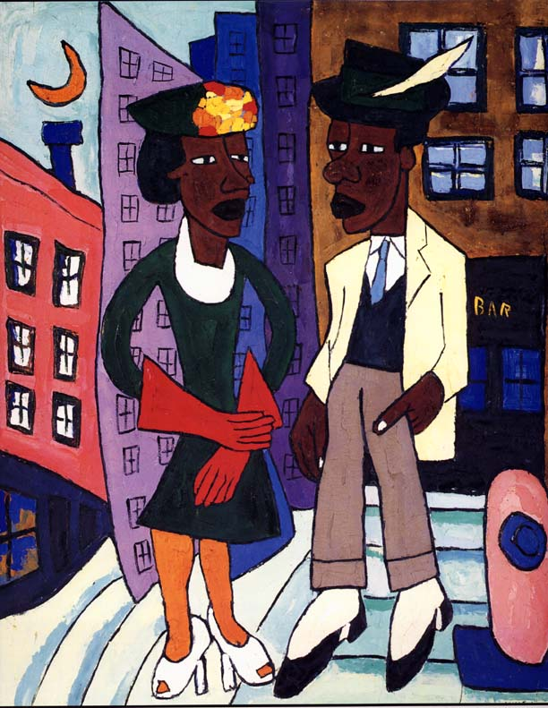
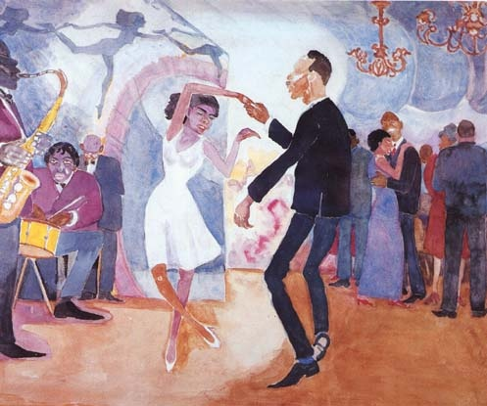
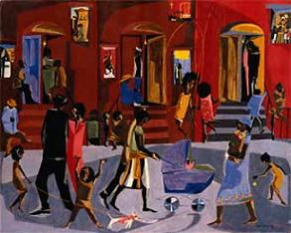
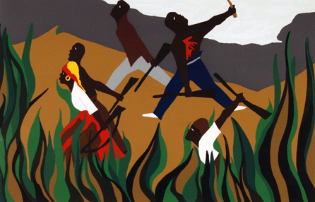
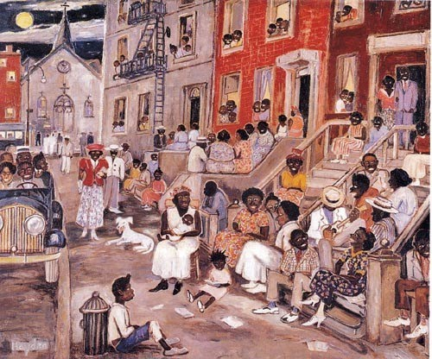
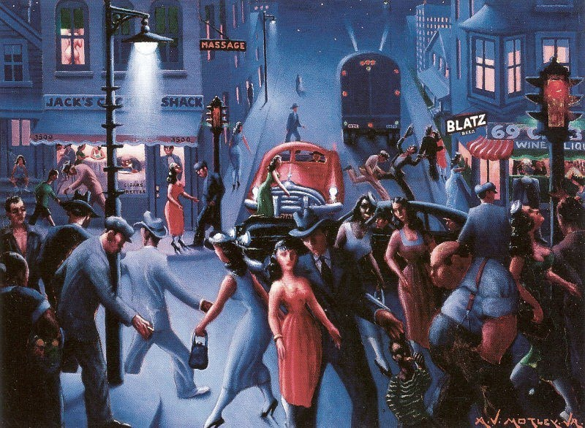
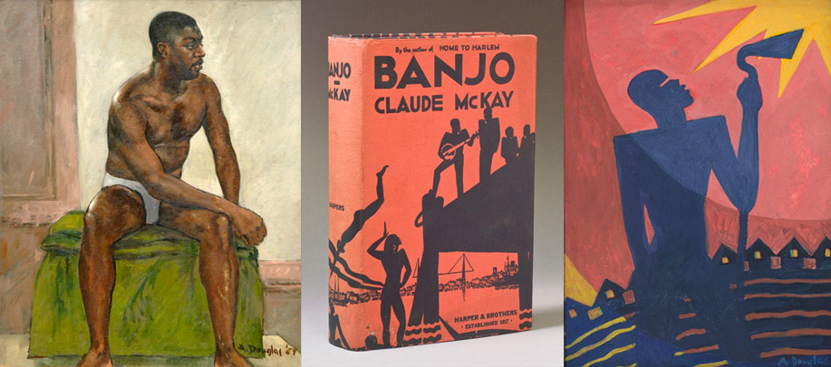

Slide 11
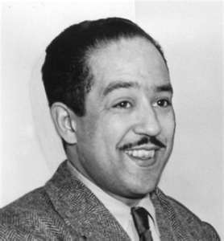
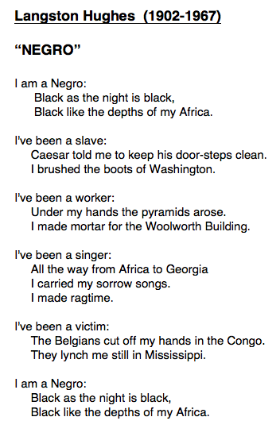
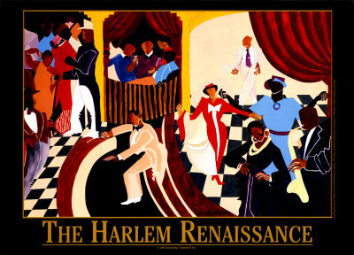
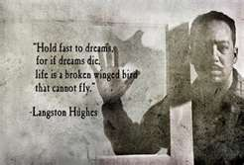
Langston Hughes
Langston Hughes was a poet who won praise not only for the beauty of his poems but also for his moving expressions of racial pride.
He wanted his poems to sound like jazz music.

Slide 12
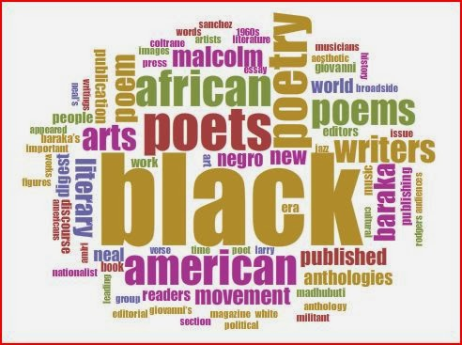
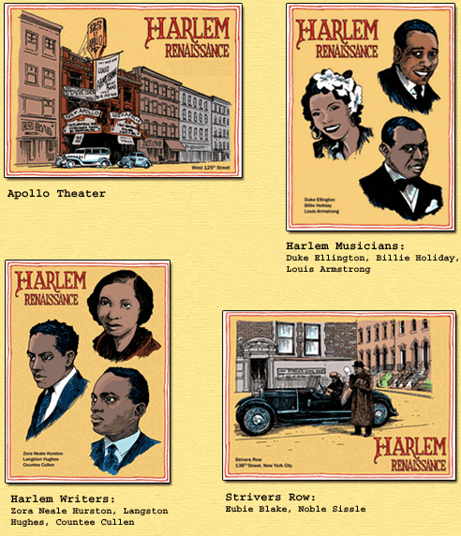

Slide 13
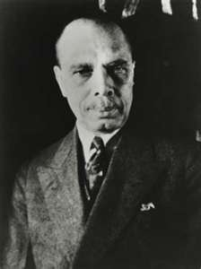
JAMES WELDON JOHNSON
Johnson was another Harlem Renaissance figure who combined poetry and politics.
He wrote editorials for the New York Age, one of the most important black-owned newspapers in the country.
He also worked as an organizer for the NAACP.

Slide 14
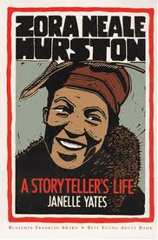
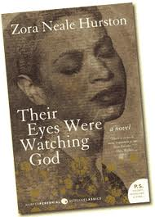
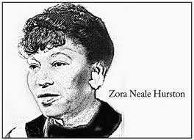
ZORA NEALE HURSTON
Hurston recorded folk songs and folk tales to both preserve and analyze them.
She was an accomplished writer and is most remembered today for her novel Their Eyes Were Watching God.

Slide 15
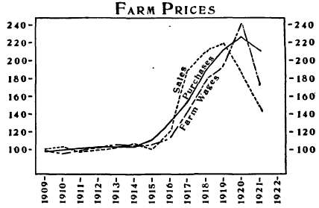
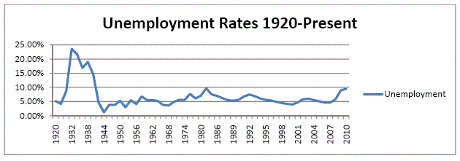
LOOKING BACK AND AHEAD
While Americans benefited from the general prosperity of the 1920s, it was easy to overlook a number of disturbing economic trends.
Signs of trouble:
Stock market-the stock market was overvalued.
Farmers-agricultural depression (overproduction) {Small farms suffer}
Too much competition
Workers- unemployment continues to climb.

