Slide 1
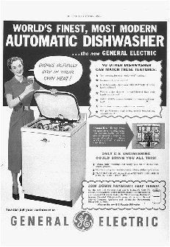
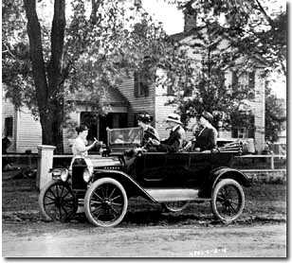
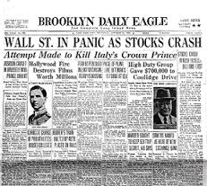
THE ECONOMY OF THE 1920S
22-4

Slide 2
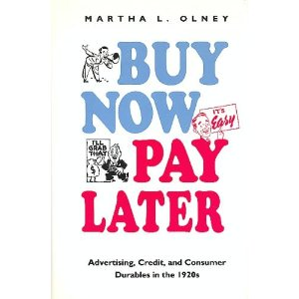
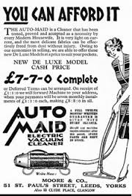
INDUSTRIAL GROWTH
The end of World War I was followed by a severe recession in agriculture and industry.
For industry, that downturn did not last long.
Industrial production recovered, and from 1922 to 1928 it climbed 70%.
To encourage spending, businesses offered installment buying.

Slide 3
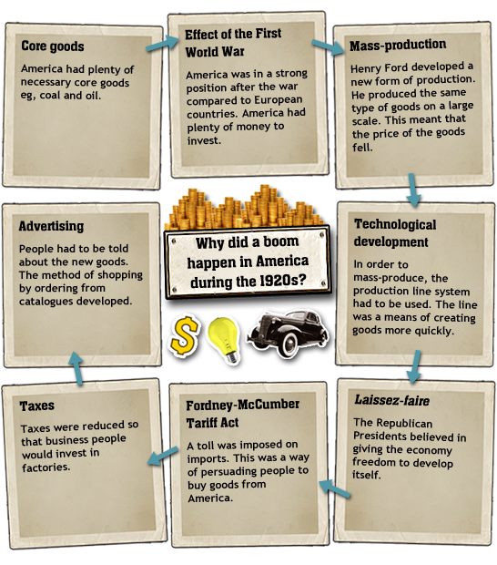

Slide 6
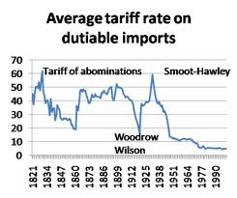
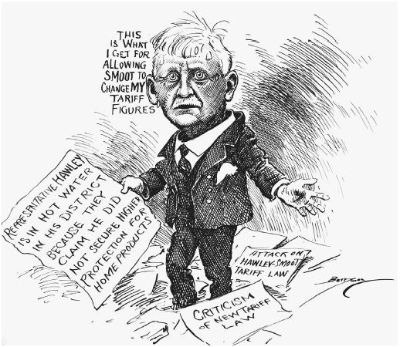
THE GOVERNMENT ASSISTS
Government policies helped boost the economy.
High tariffs on imports kept out goods that might compete with domestic products.
Taxes on the wealthy were cut to encourage greater spending.
Goods produced in the country

Slide 7
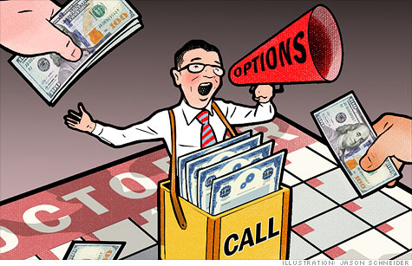
A BOOMING STOCK MARKET
With a strong economy, more people chose to invest in the stock market.
Stocks were so profitable that many people began buying on margin.
Borrowing money in order to buy stocks.
Many Americans grew wealthy buying and selling stocks.

Slide 8
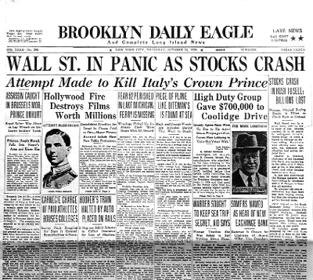
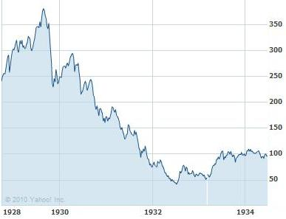
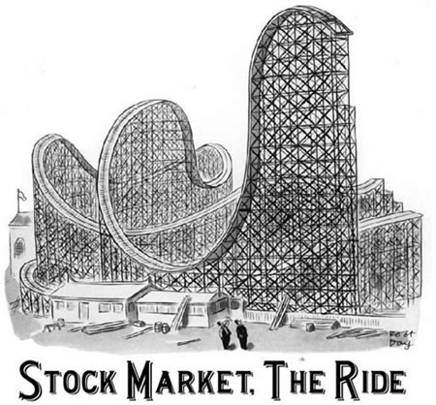
TIME TO PAY CLOSE ATTENTION
By 1928, some economists began to worry about the market.
High stocks prices seemed to have little to do with the actual value of the company that issued them.
A few experts warned that the stock market was overvalued.
Many investors ignored the warnings.
Why did people ignore the warnings?

Slide 9
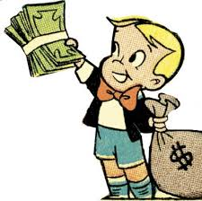
DID EVERYONE PROPSER IN THE 1920S?
People who felt the benefits of the boom:
Owners of consumer goods factories
Assembly line workers
White people in cities
Speculators on the stock market
Middle-class women
Builders
People who didn’t benefit from the boom:
Farmers
Sharecroppers
Black people
People in rural areas
Coal miners
Textile workers
New immigrants

Slide 10
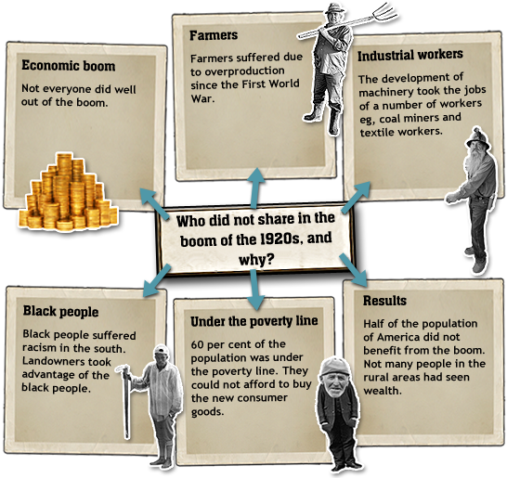

Slide 11
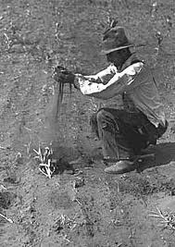
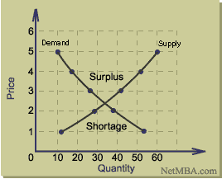
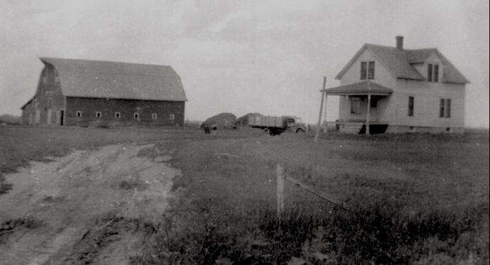
FARMERS
Farmers were among the groups that did not participate in the good times.
About 1/5 Americans made their living on the land and many of them lived in serious poverty (20%).
There were several reasons for the agricultural depression.
Overproduction
Demand declined
High debt

Slide 13
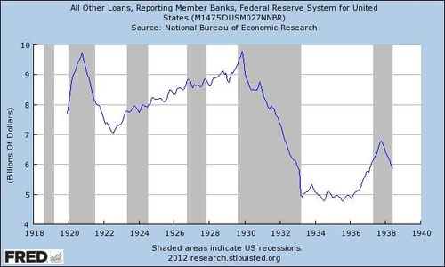
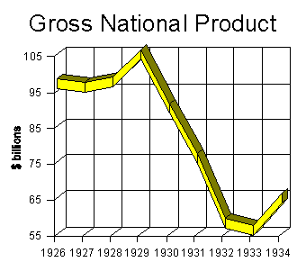

Slide 14
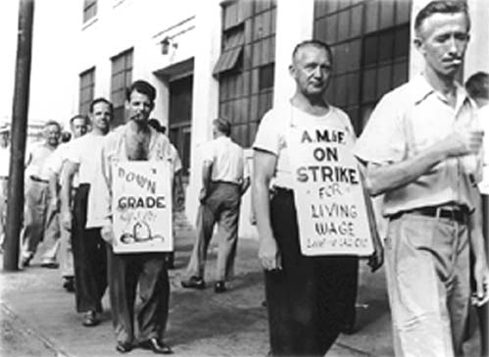
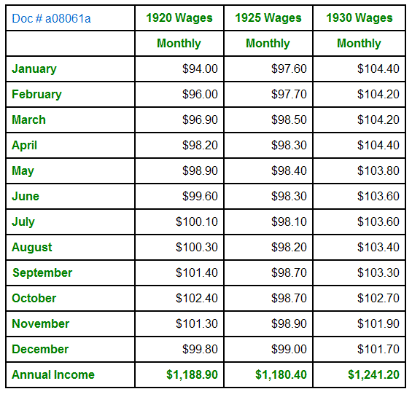
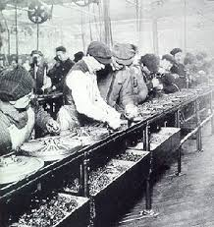
WORKERS
The 1920s were years of mixed results for American workers.
On one hand:
Wages were rising.
Companies began offering new benefits, such as pensions and paid vacations, in an attempt to keep their workers from joining unions.
On the other hand:
Unemployment was on the rise.
Jobs were changing.
The assembly line was squeezing out skilled labor.

Slide 15
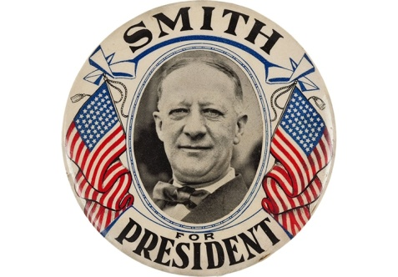
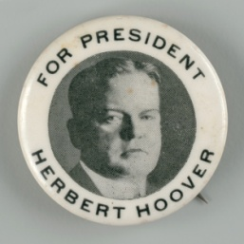
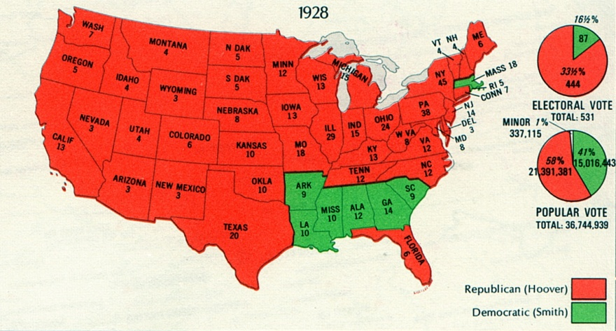
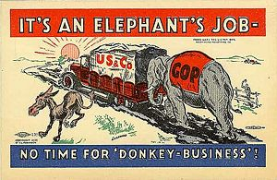
THE ELECTION OF 1928
The Republicans had held the presidency throughout the 1920s and they claimed responsibility for the decade’s prosperity.
Herbert Hoover-Republican (Iowa/Secretary of Commerce)
Alfred E. Smith-Democrat (NY /Governor)
-----------------------------------------------------------------------------------
The campaign highlighted some of the continuing divisions in American society.
Smith was the first Catholic ever to run for President.
Religion became one of the issues.

Slide 16
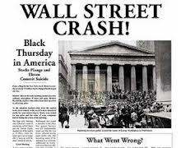
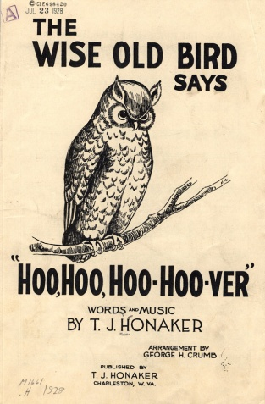
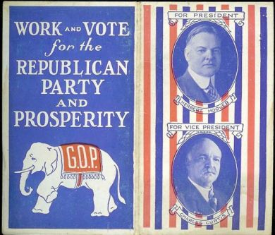
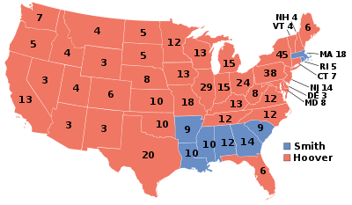
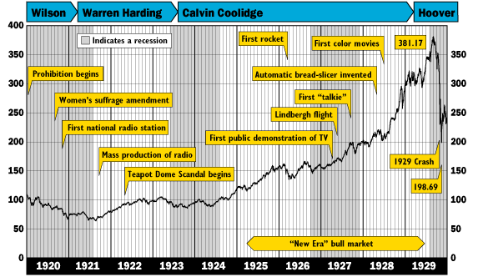
“The final triumph over poverty” H.H
Herbert Hoover wins the presidency.

Slide 17
