Slide 1
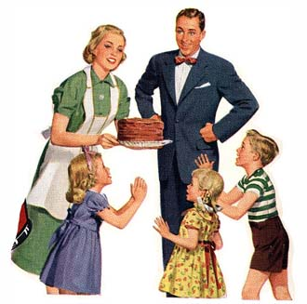
A Time of Prosperity
Life During the 1950’s

Slide 2
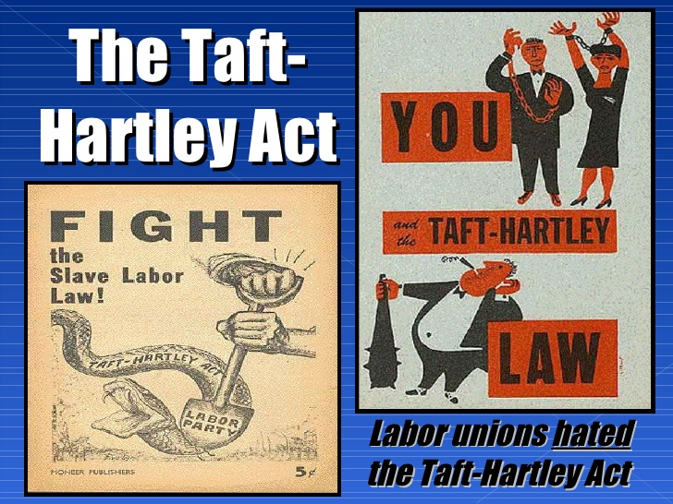
Adjusting to Life After WWII
Millions of soldiers came home and needed jobs
GI Bill of Rights: Gave soldiers money to spend on business, homes, schooling, etc.
Factories switched back to consumer goods
Inflation: High demand for these goods led to high prices
Workers in unions went on strike for higher pay
Taft-Hartley Act: banned closed shops (workplace where only union members can be hired)

Slide 3
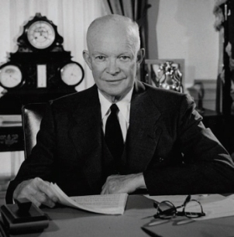
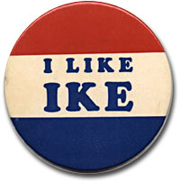
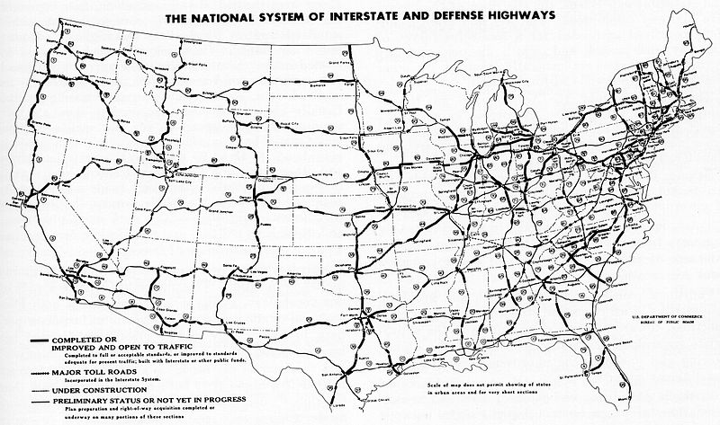
We Like Ike!
Republican nominee Dwight D. Eisenhower won the election of 1952
He becomes the 34th President of the US
Middle-of-the-road policy where government played a small but supportive role
“Peace, Progress, and Prosperity”

Slide 4
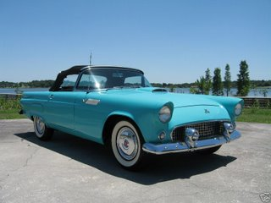
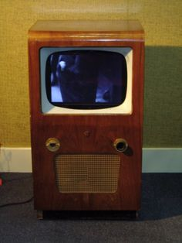
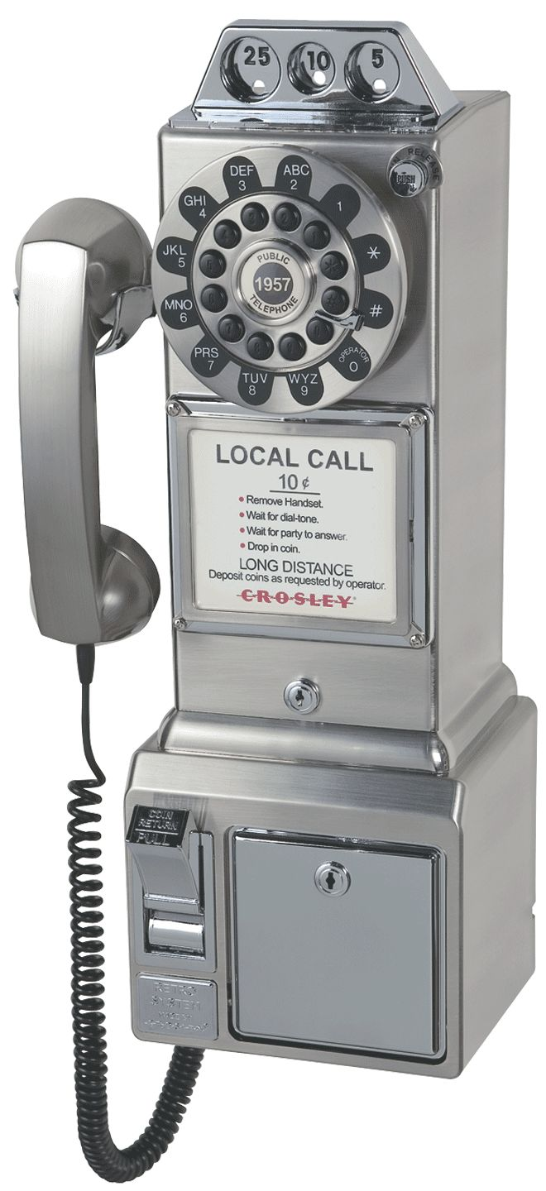
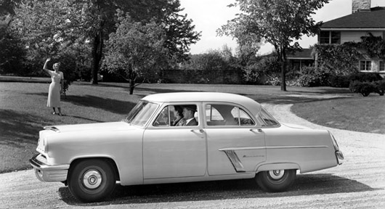
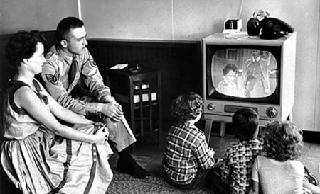
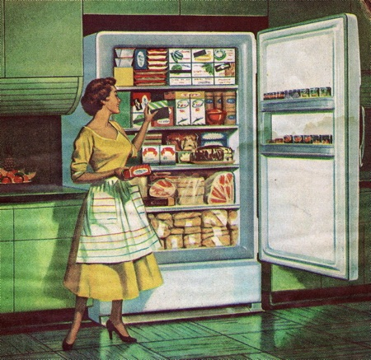
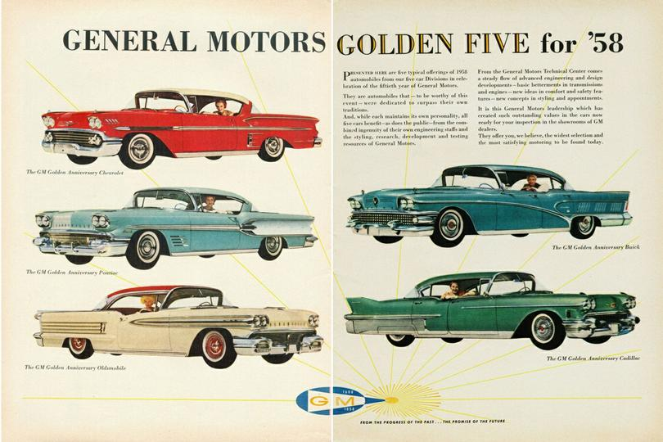
A Time of Prosperity!
New Technology, New Jobs, New Products!
Freezers, clothes dryers, air conditioners, televisions.
Throughout the 1950’s the standard of living rose: Americans were more comfortable and economically secure

Slide 5
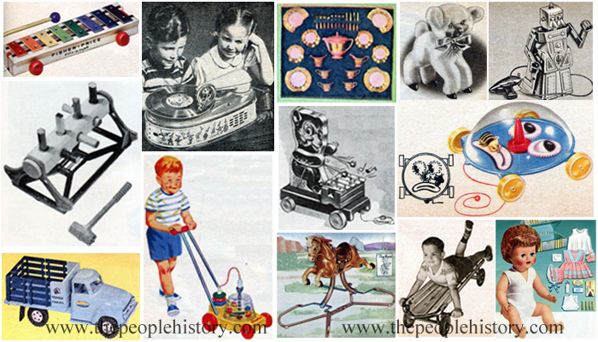

Slide 6
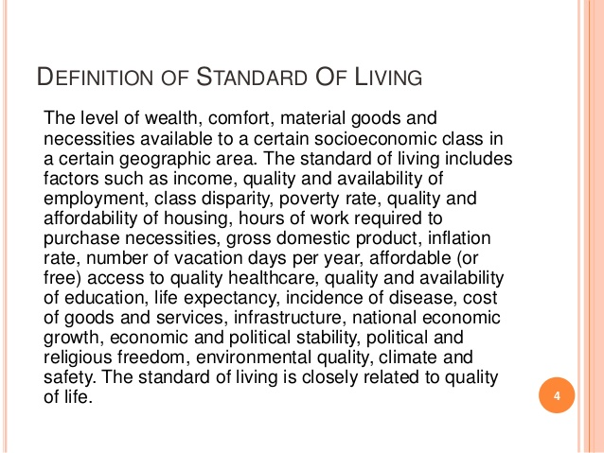

Slide 7
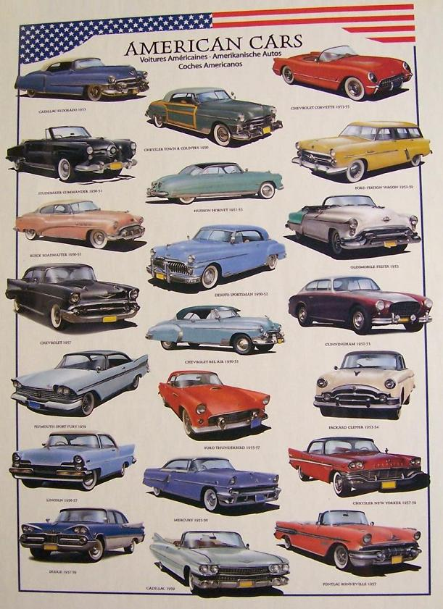
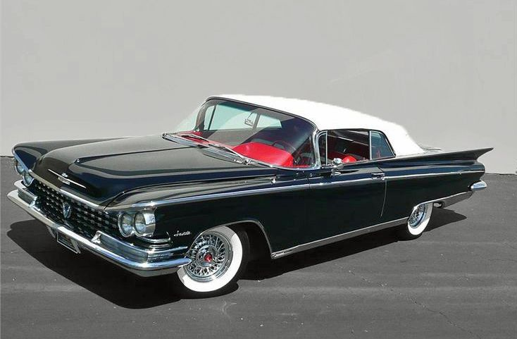
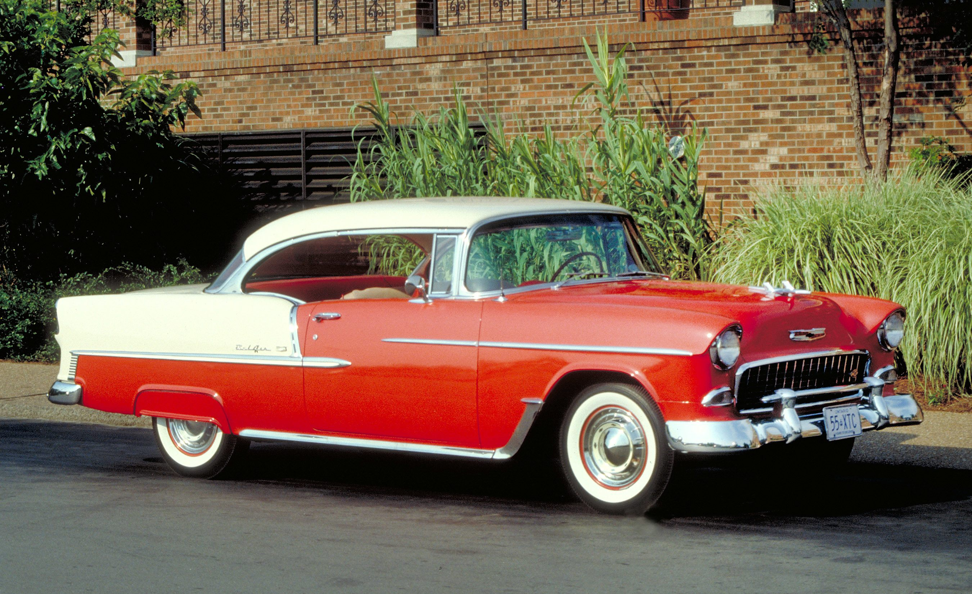

Slide 8
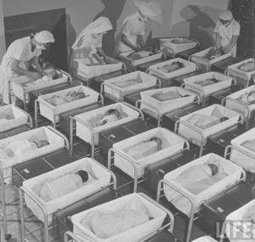
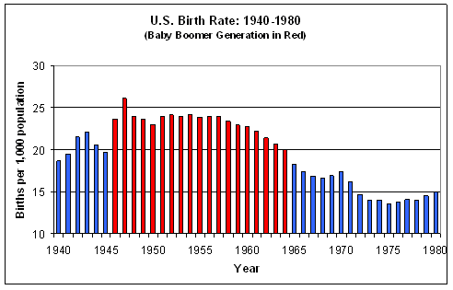
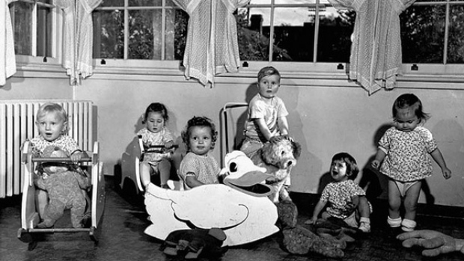
Baby BOOM
Americans married earlier and had larger families
Increased demand for food, housing, manufactured goods, medicines, vaccines, etc

Slide 9
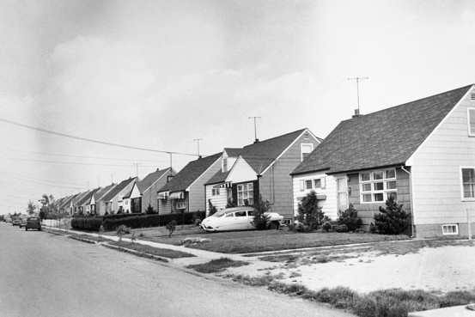
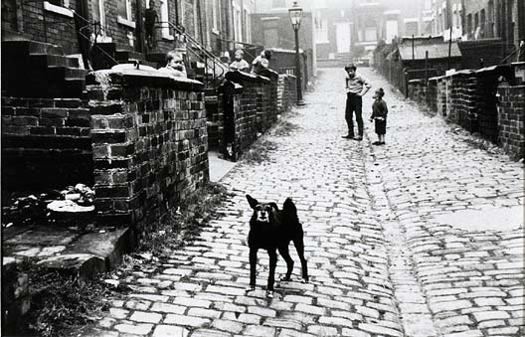
Escape to Suburbia
Thanks to the widespread use of automobiles and highways, Americans moved to bigger homes in the suburbs around major cities
As a result, poorer and less educated people moved to the cities
Cities became run down and crime rose

Slide 10
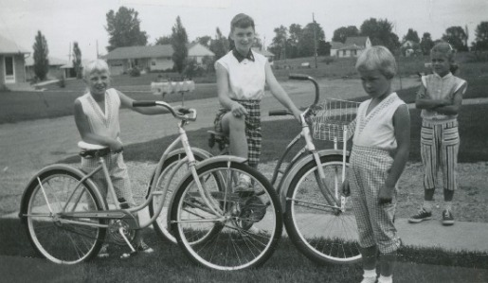
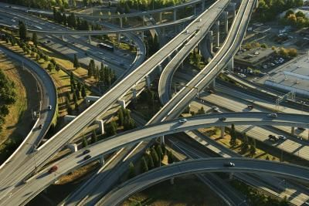
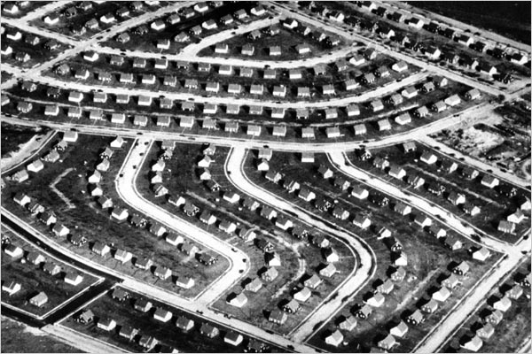
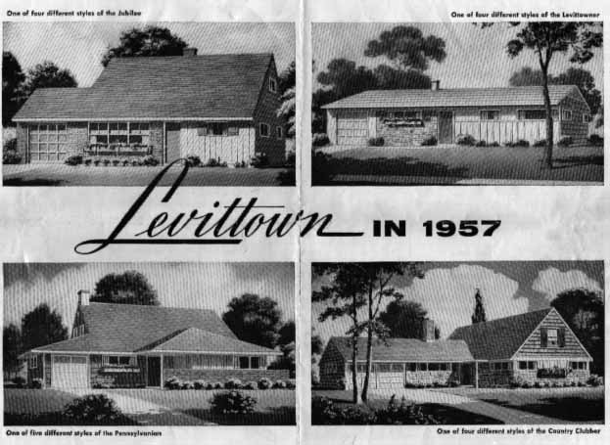
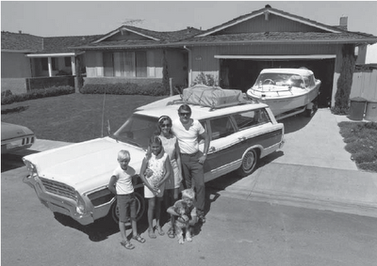

Slide 11
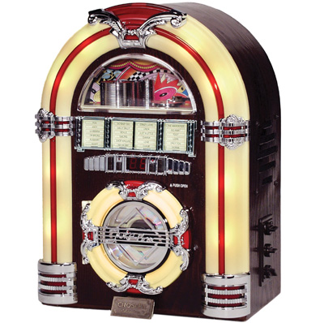
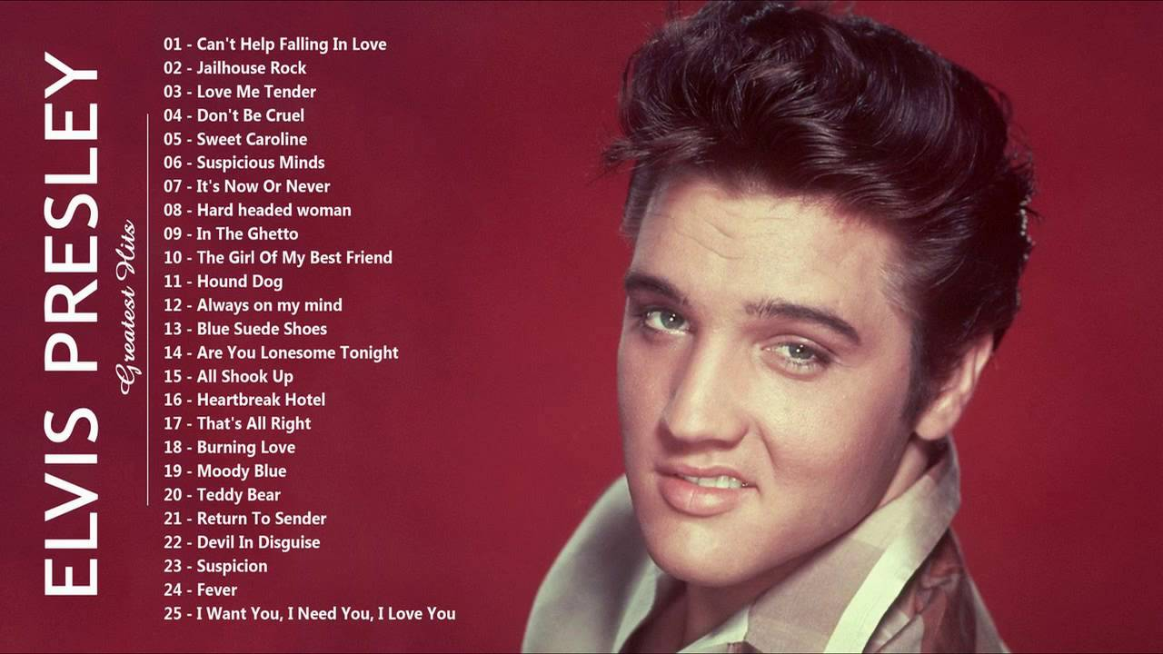
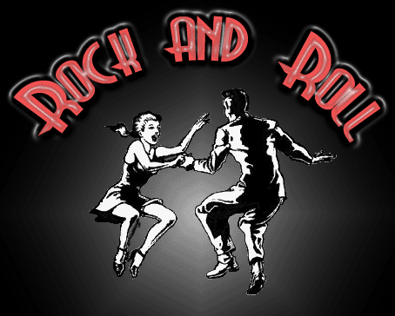
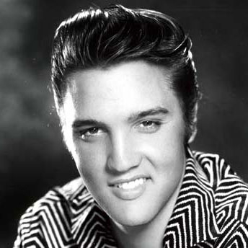
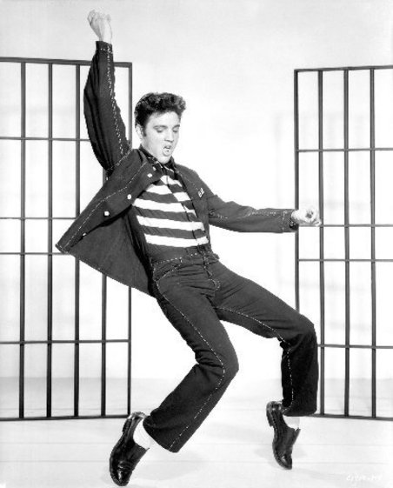
Rock-N-Roll
Thanks to the television, rock-and-roll music became more popular
Hip-shaking, knee-bending ELVIS PRESLEY was the most popular rock-and-roll singer

Slide 12
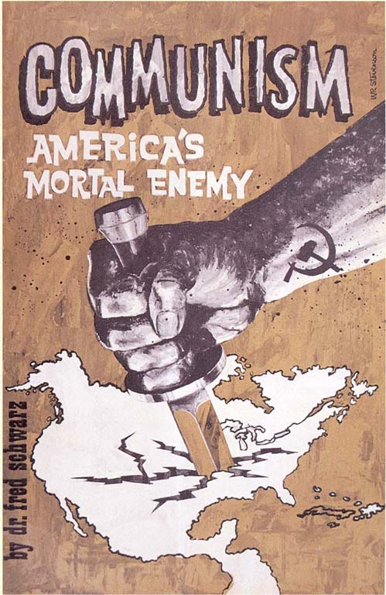
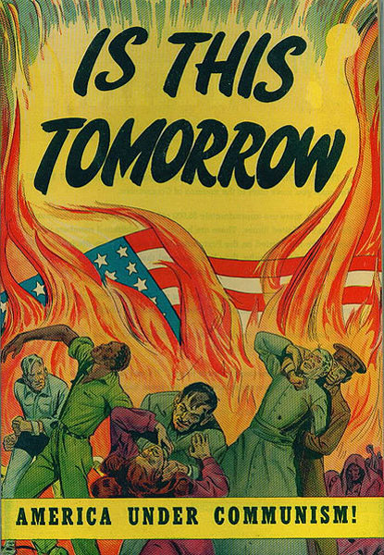
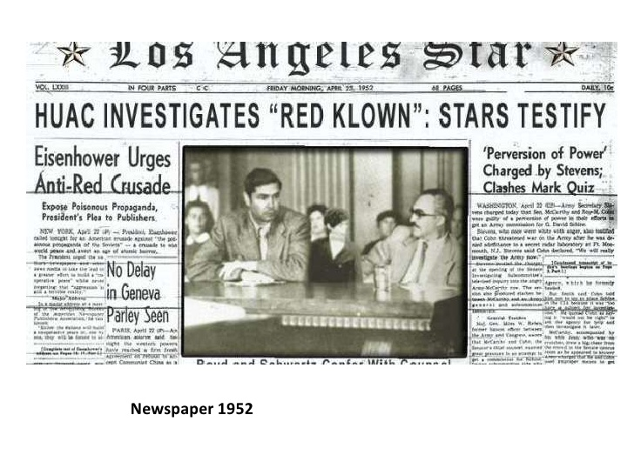
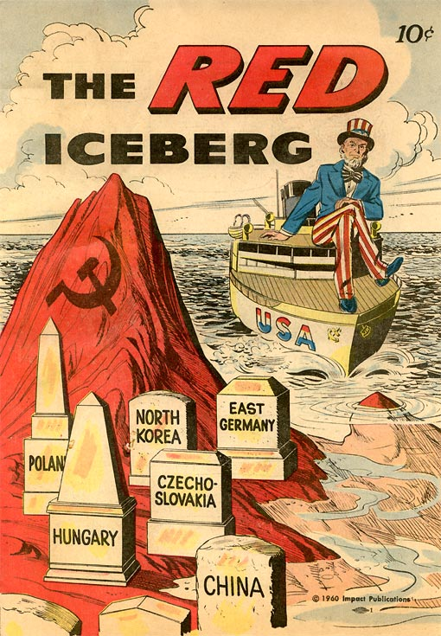
Are There COMMIES in the U.S.???
Many Americans worried that there were Communist SPIES working to overthrow the U.S. government
Government officials were put on trial
Julius and Ethel Rosenberg found guilty of passing information on the atomic bomb to Soviet Union

Slide 13
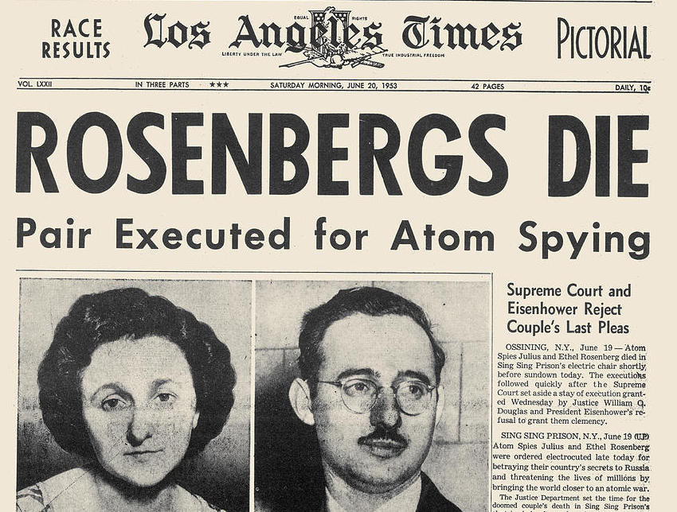

Slide 14
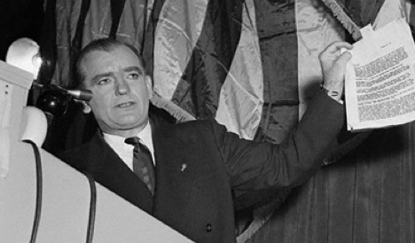
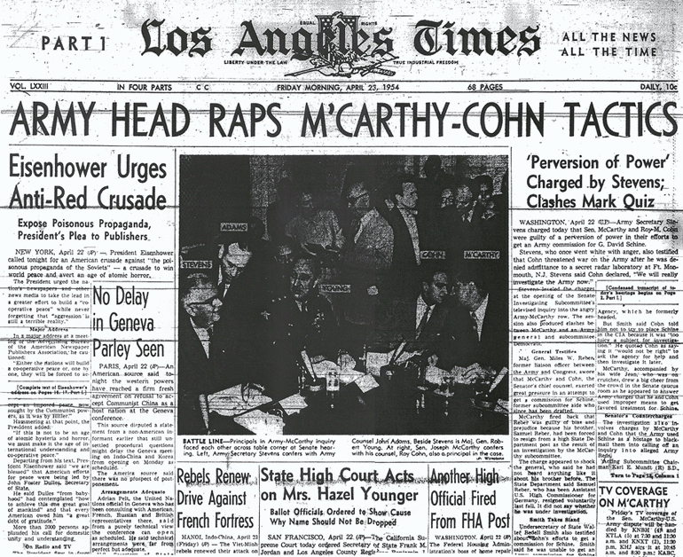
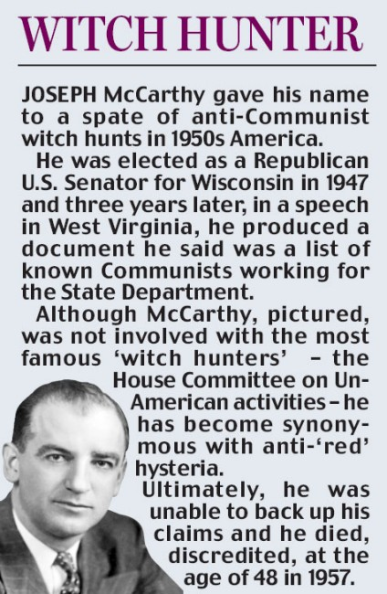
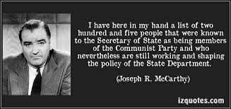
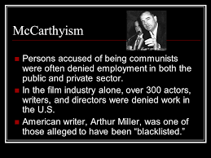
McCarthyism
Wisconsin Senator Joseph McCarthy claimed to have a secret list of 205 Communists who worked in the State Department
Gained a large following and led to a RED SCARE during the 1950’s
McCarthy made false claims against the U.S. Army
He lost his following
U.S. Senate voted to censure him

