Slide 1
Narrative Text Structure
What Students Should Know

Slide 2
Plot consists of 4 parts
Every plot consists of four major parts. It is important for students to be able to identify these parts.
Problem: What main problem is character(s) facing? Generally found during the exposition of a story.
This can take on many forms- see notes on Conflict.

Slide 3
Response: How do the characters respond to the problem?
These responses make up what are called episodes.
Most short stories will have a minimum of 3 episodes.
Each episode builds in tension as story reaches/leads to climax.

Slide 4
Action: What do characters do about the problem?
What actions do they take to solve the problem.
The actions tend to escalate in sophistication as prior actions have not worked.
Think, “dragon, dragon.”

Slide 5
Outcome: What is the outcome of story?
How is problem solved? This is usually the last episode of the story.
The other actions that follow are the falling action/resolution.

Slide 6
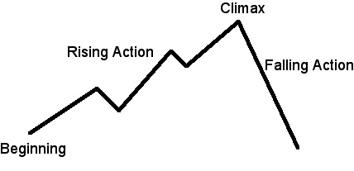
Story Graph

Slide 7
Episodes
Episodes: Every story has episodes to move the plot along.
Each episode, or “roadblock” will increase in tension as story moves forward.
This helps build character and lays foundation for identifying theme.
Last episode is usually the climax. This is where character has solved the problem and has learned a lesson.

