Slide 1
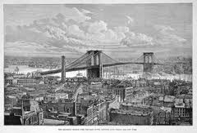
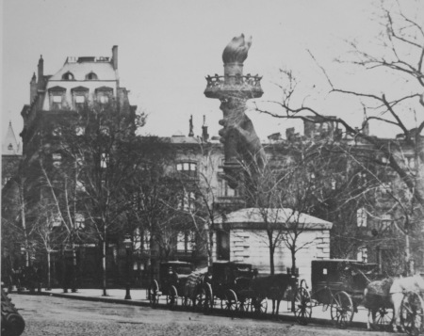
CITIES GROW AND CHANGE THE GILDED AGE
Brooklyn Bridge NYC
SECTION 3
LOOK…. It’s the hand and torch of Lady Liberty in Madison Square Park. What’s it doing there? The hand and torch was placed in the park to get donations to complete the pedestal (1876-1882).

Slide 2
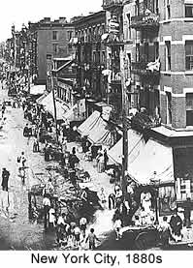
URBANIZATION
Urbanization is the rapid growth of city populations.
In 1860, only one American in five was a city dweller.
By 1890, one in three lived in the city.
What was the reason for this rapid urbanization?
It was simple, cities attracted industry, and industry attracted people.
Farmers, immigrants, and African-Americans from the South all migrated to cities in search of JOBS and EXCITEMENT.
Many fast-growing cities were located near waterways.
Why was this?

Slide 3
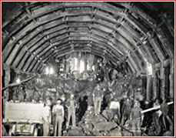
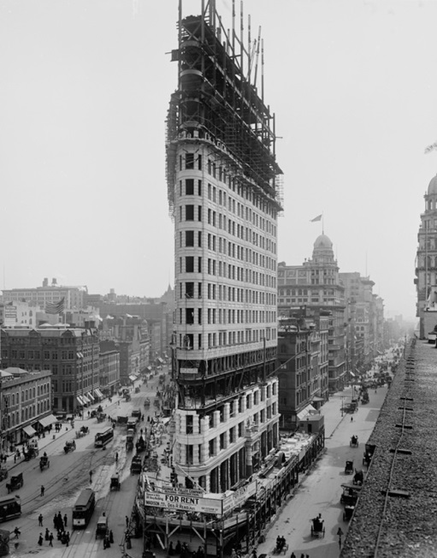
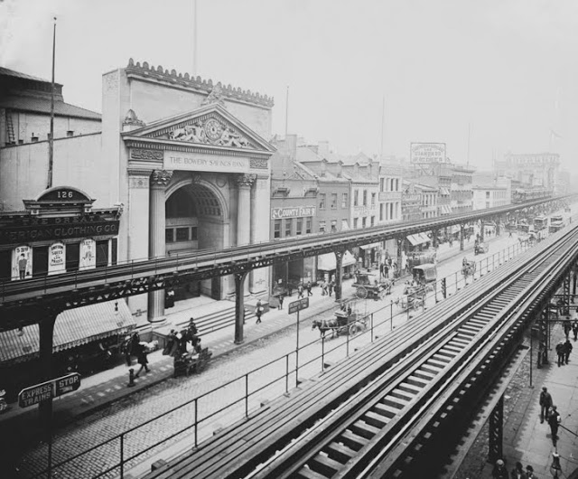
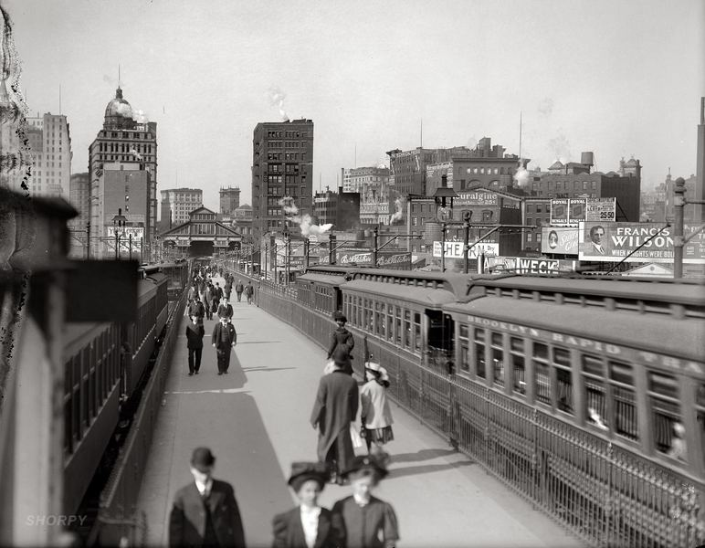
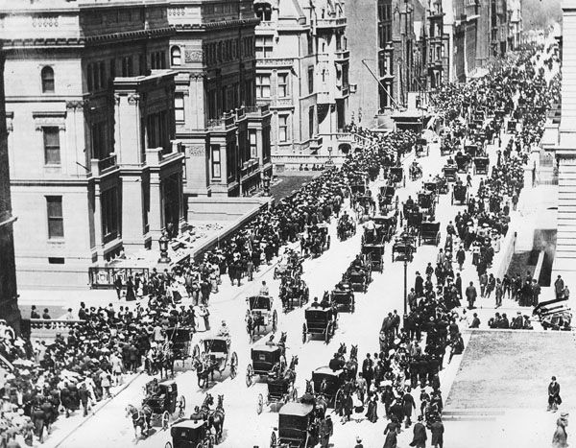
GROWING UP AND OUT
New technology helped cities grow.
Elevated trains carried passengers over crowded streets.
Subways carried passengers under the streets.
Public transportation and steel bridges gave rise to suburbs, living areas on the outskirts of a city.
Brooklyn Bridge (1883).
Skyscrapers- Cities began to expand upward as well as outward.
elevators

Slide 4
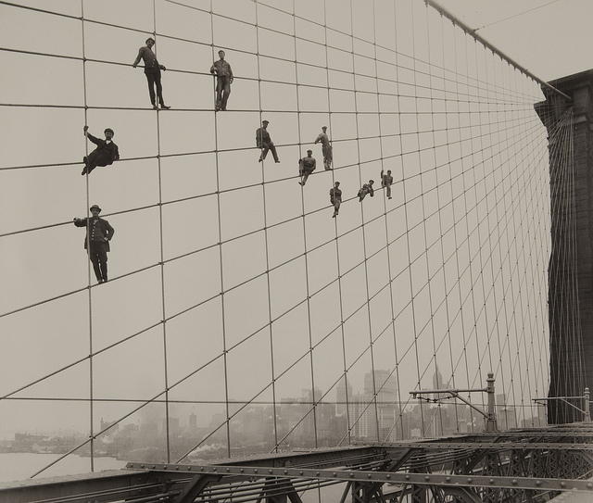
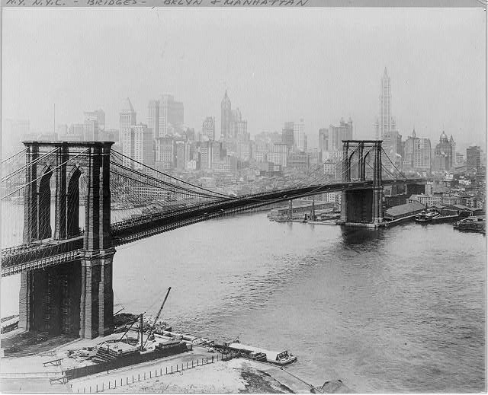
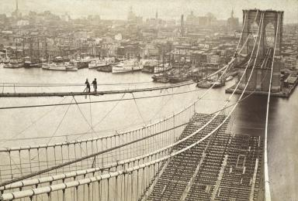
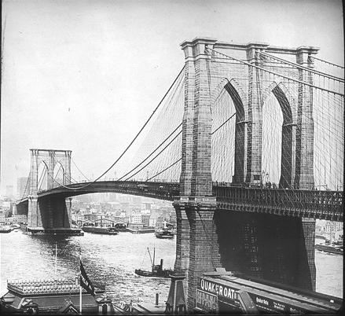
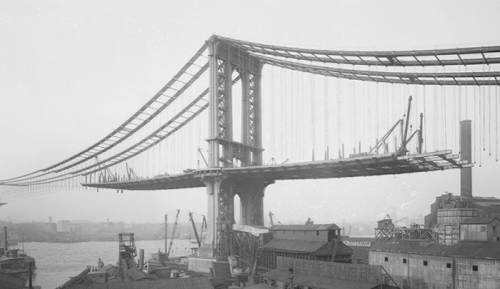
BROOKLYN BRIDGE
The Brooklyn Bridge connected Manhattan to Brooklyn.
It was the first suspension bridge with steel cable wires.
Building the Brooklyn Bridge was a challenge.
Many workers, including Washington Roebling, the chief engineer, were crippled by the effects of high pressure on the body.
About 27 people died during the construction of the bridge.

Slide 5
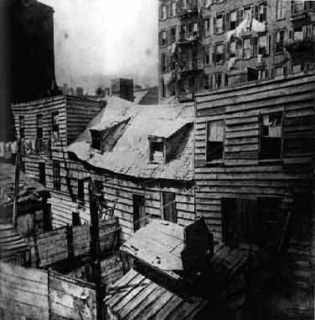
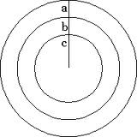
LIVING PATTERNS CHANGE
Why did rich people want to live on the outskirts?
(a) The rich
built fine homes on the outskirts of the city.
(b) Middle-class people
lived farther out in row houses or new apartment buildings.
© Poor families
crowded into the oldest sections at the city’s center.
Diseases, crime, filth, tenements
Who do you think lives in these houses? Why?

Slide 6
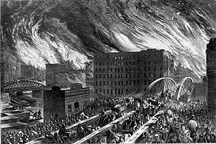
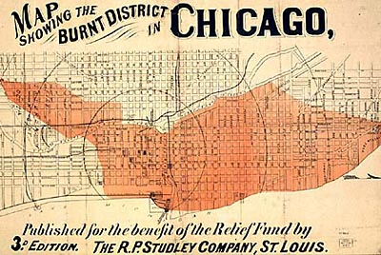
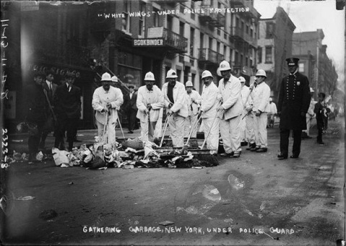
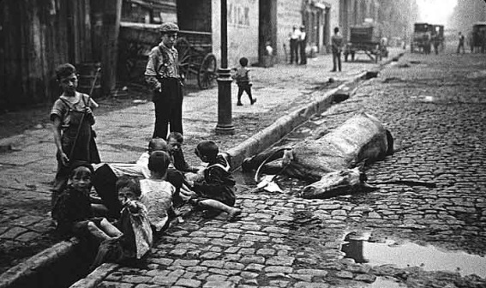
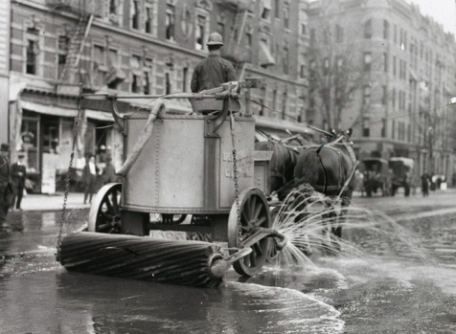
PROBLEMS OF URBAN LIFE
Rapid urbanization brought many problems.
Sanitation concerns
Garbage littered the streets
Diseases
Fire was a constant threat in tightly packed neighborhoods.
1871 Chicago Fire
Leveled 3 square miles of downtown and killed 300 people

Slide 7
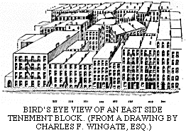
What would be some of your concerns about living in one of these tenements?

Slide 8
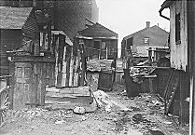
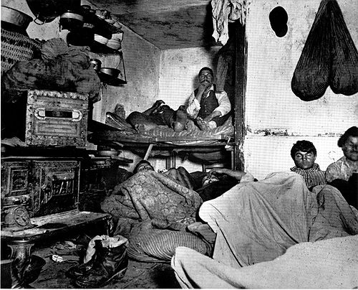
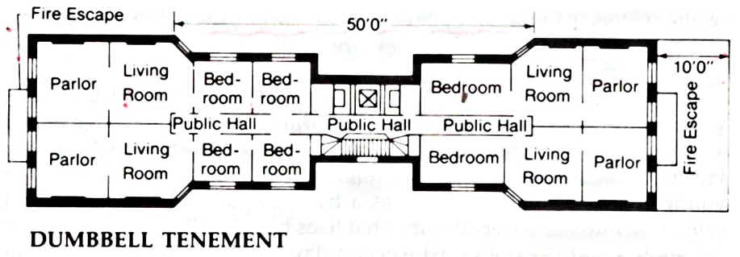
TENEMENT LIFE
Tenements are buildings divided into many tiny apartments.
In downtown slums, the poor lived in bleak conditions.
Many apartments had NO windows, heat, or indoor plumbing.
The streets were littered with garbage.
Outbreaks of cholera and other diseases were common.

Slide 9
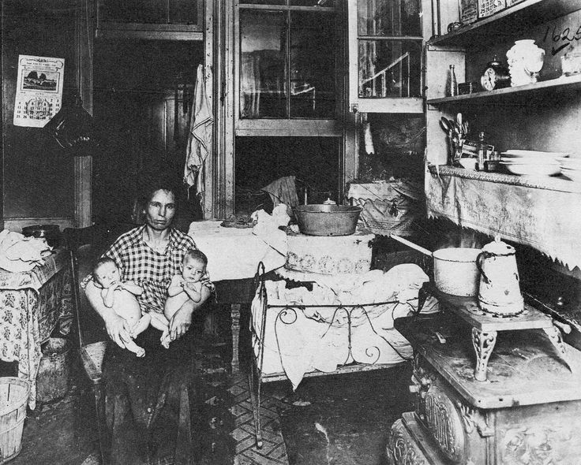
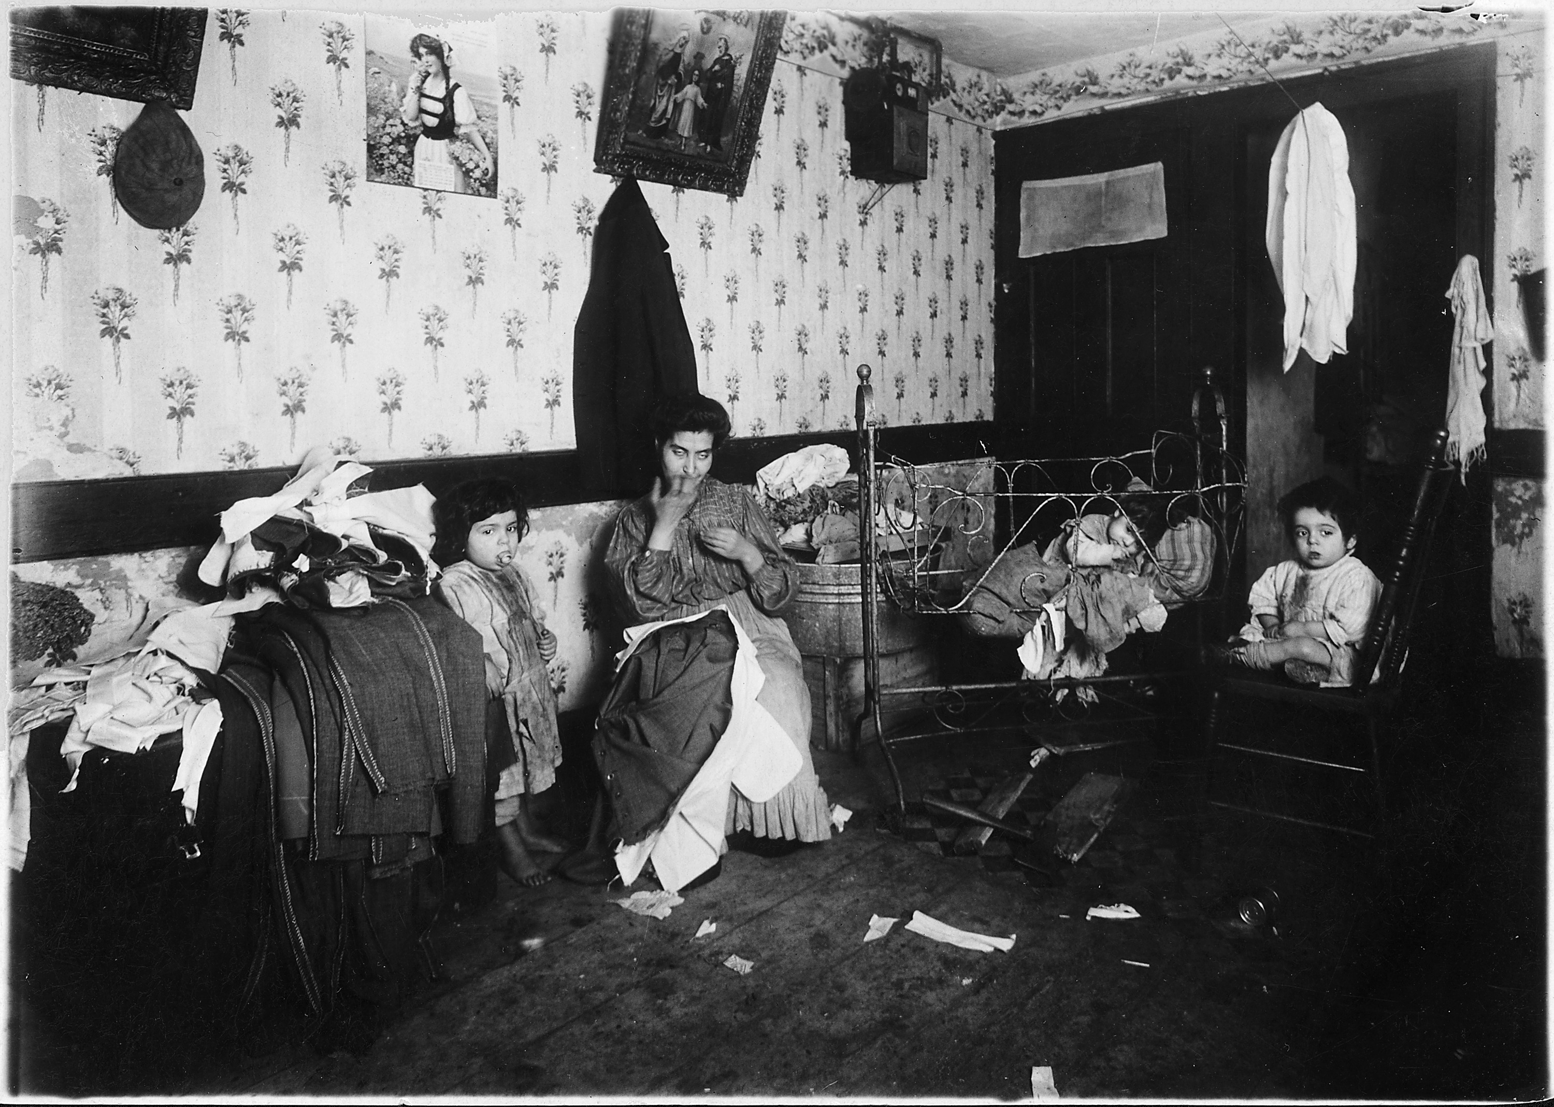
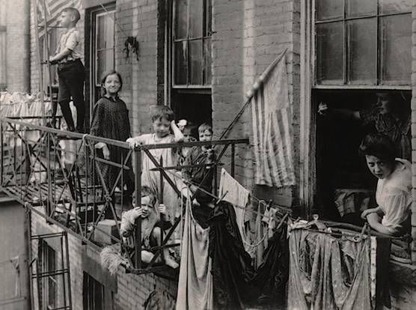
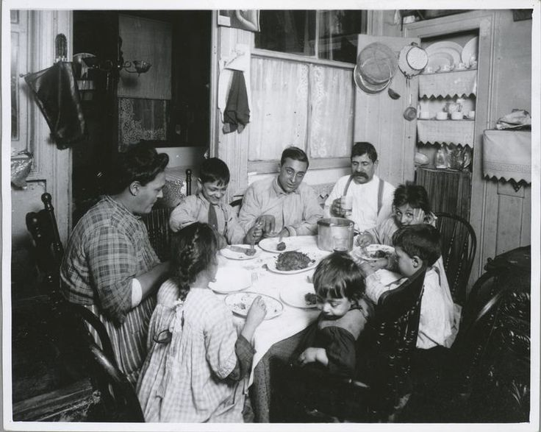
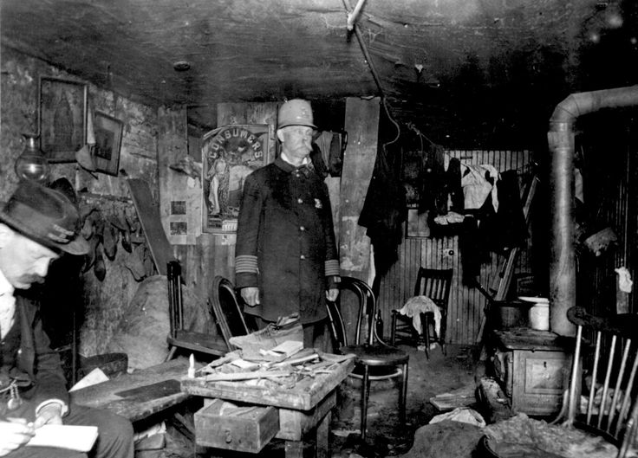

Slide 10
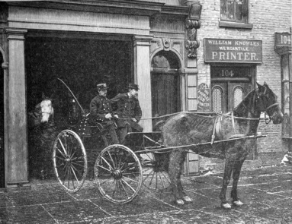
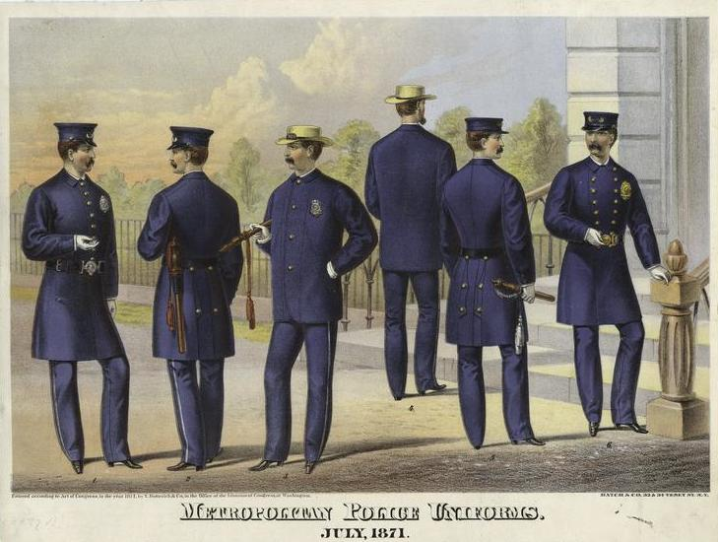
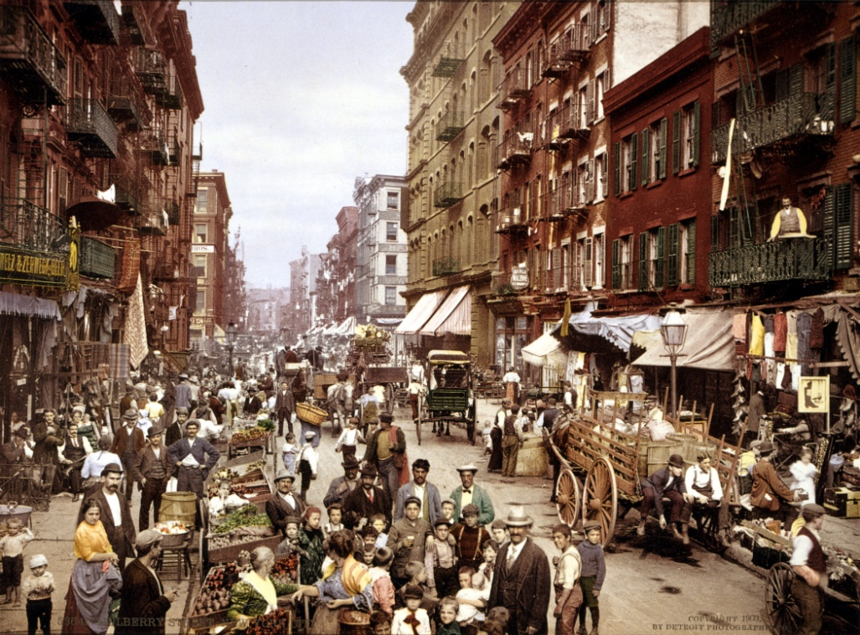
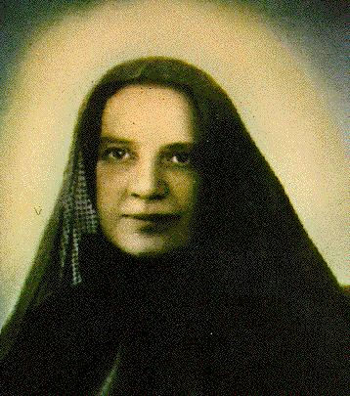
IMPROVING CITY LIFE
The Salvation Army was founded. It gave food, clothing, and shelter to the homeless.
In the 1880s, cities began to improve urban life.
Streetlights were installed.
How will this improve city life?
Fire, Sanitation, and Police Departments were set up.
Public health officials waged war on disease.
Religious groups served the poor. Mother Cabrini, a Catholic nun, set up hospitals and clinics for people who could not afford a doctor.

Slide 11
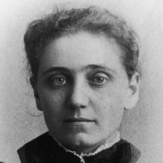
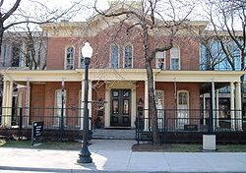
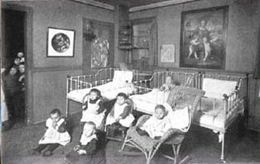
SETTLEMENT HOUSES
A settlement house is a center offering help to the urban poor.
At settlement houses, volunteers taught English to immigrants, sponsored music and sports for young people, and provided nurseries for children of working mothers.
Jane Addams opened her own settlement house called the “Hull House” in 1889.
The Hull House was located in the slums of Chicago.

Slide 12
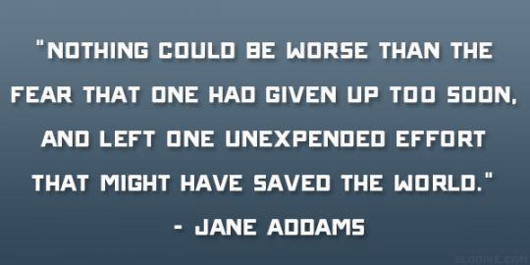
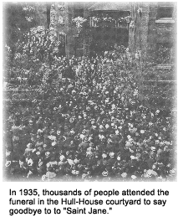

Slide 13
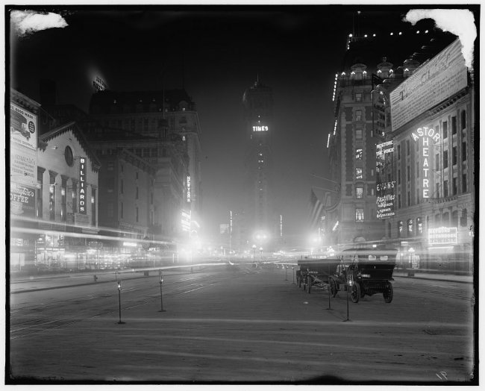
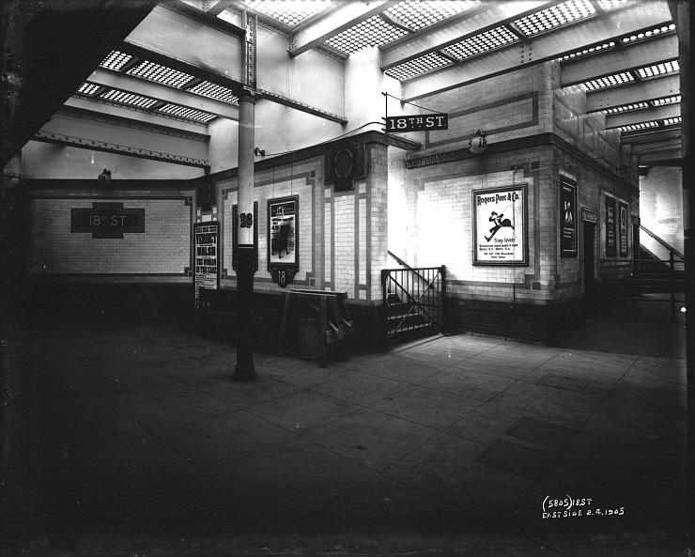
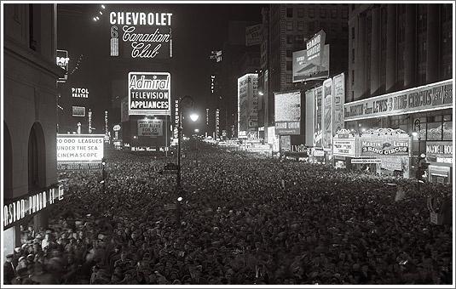
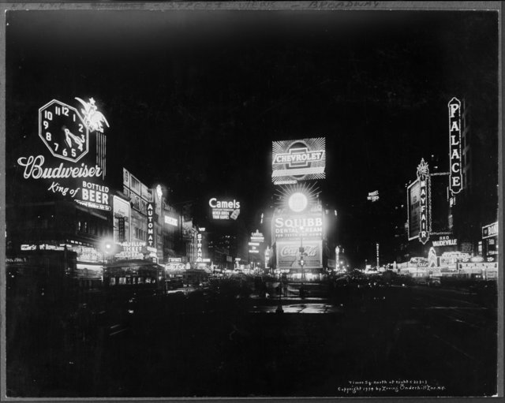
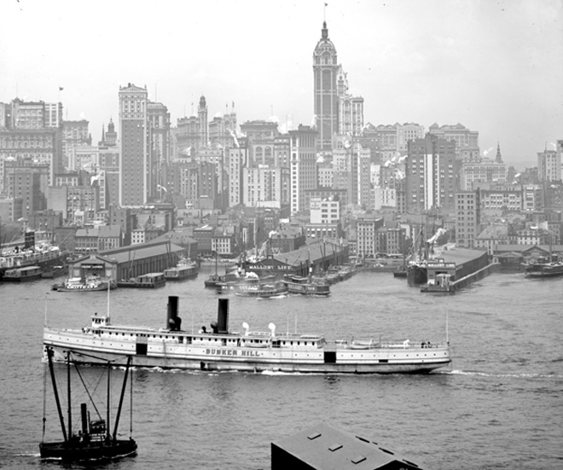
THE EXCITEMENT OF CITY LIFE
Despite hardships, cities offered attractions that were not available in the rural part of the country.
Newcomers were awed by
electric lights that turned night into day
elevated railroads that rumbled overhead
tall buildings that seemed to pierce the clouds

Slide 14
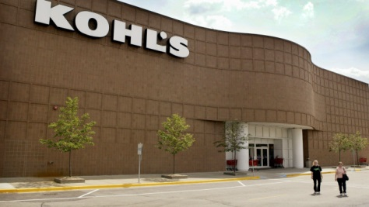
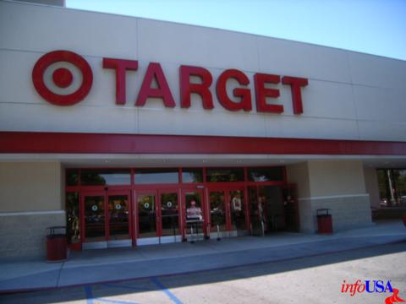
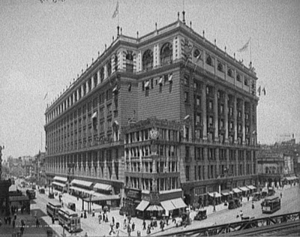
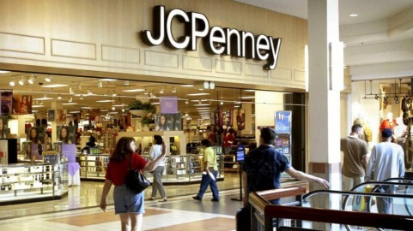
DEPARTMENT STORES
All in one shopping
What is a department store?
What is an example of a department store?
MACY’S

Slide 15
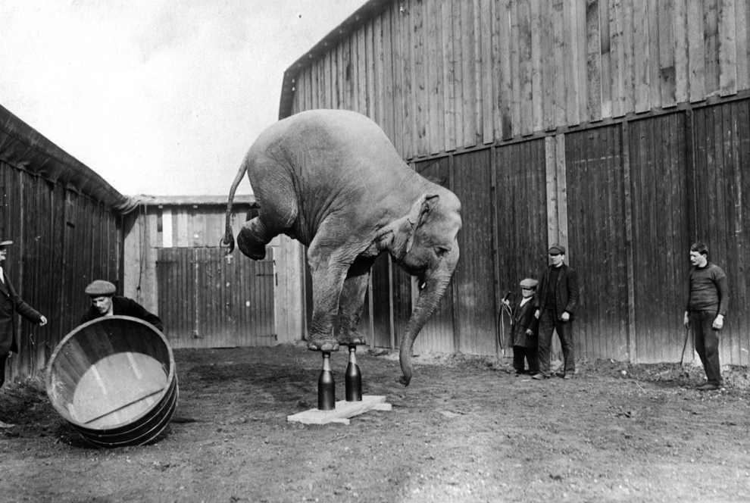
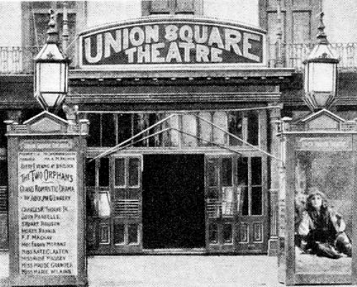
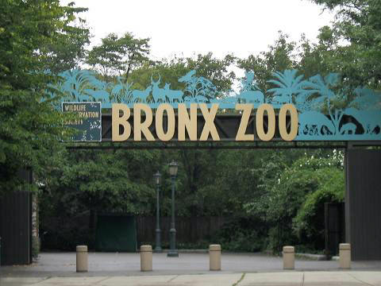
LEISURE ACTIVITIES
Long hours on the job made people value their free time.
Cities provided a wealth of entertainment.
Museum
Orchestra
Art gallery
Theater
Circuses
Zoos
Gardens
Shopping
Department stores

Slide 16
CENTRAL PARK (NYC)
Parks
In the 1850s, Frederick Law Olmsted designed Central Park in New York.

Slide 17
SPORTS
Professional sports teams begin to spring up in cities after the Civil War.
Baseball- The first professional team was the Cincinnati Red Stocking (1869). {The most popular sport in America}
African Americans formed their own league in the 1880s.
Basketball- In 1891, James Naismith invented this winter sport in Springfield, Massachusetts.
Football- It was brutal and dangerous, 44 college players died in a single season.

