Slide 1
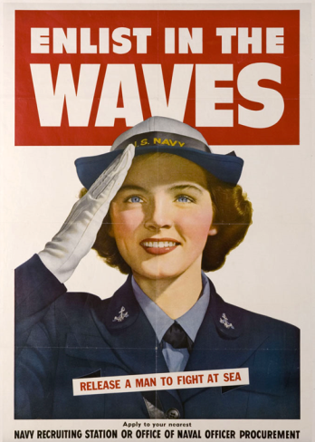
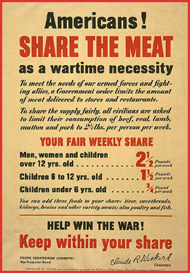
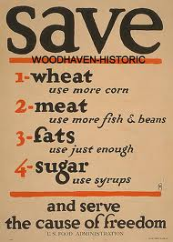
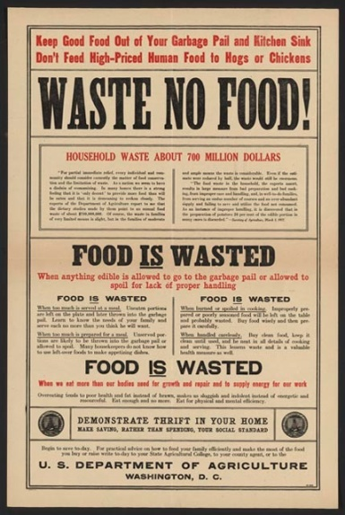
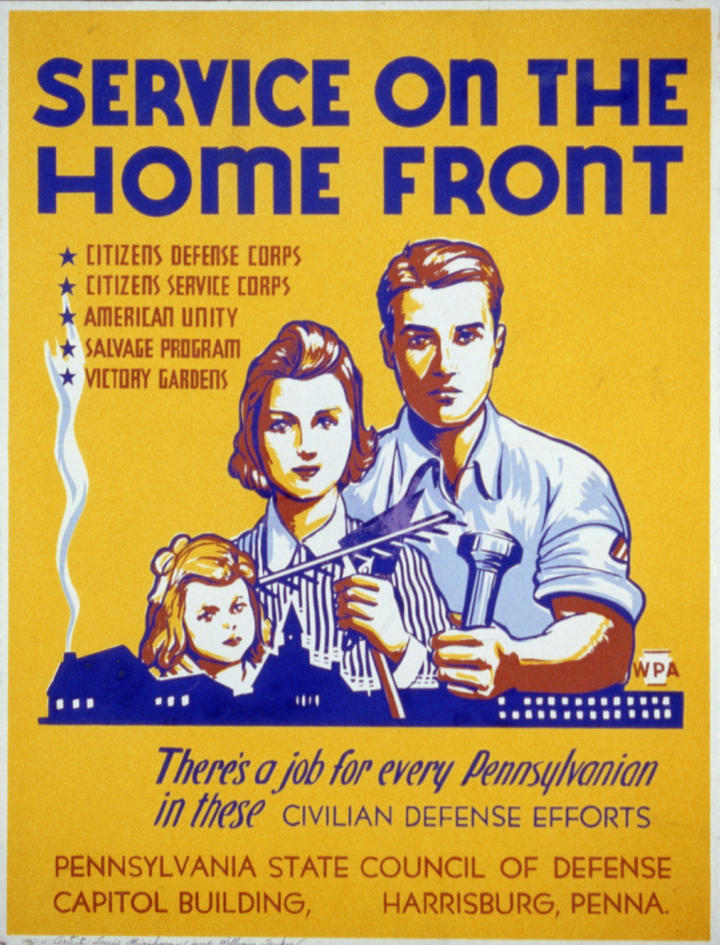
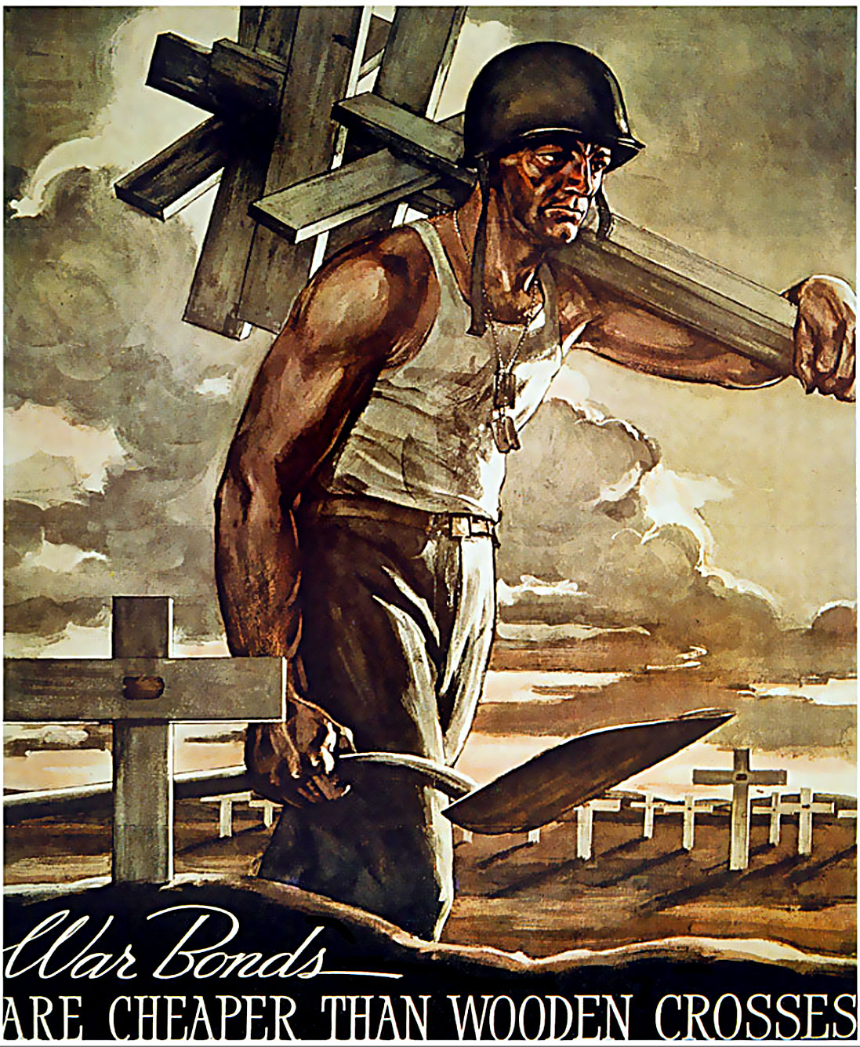
THE WAR AT HOME
24-2

Slide 2
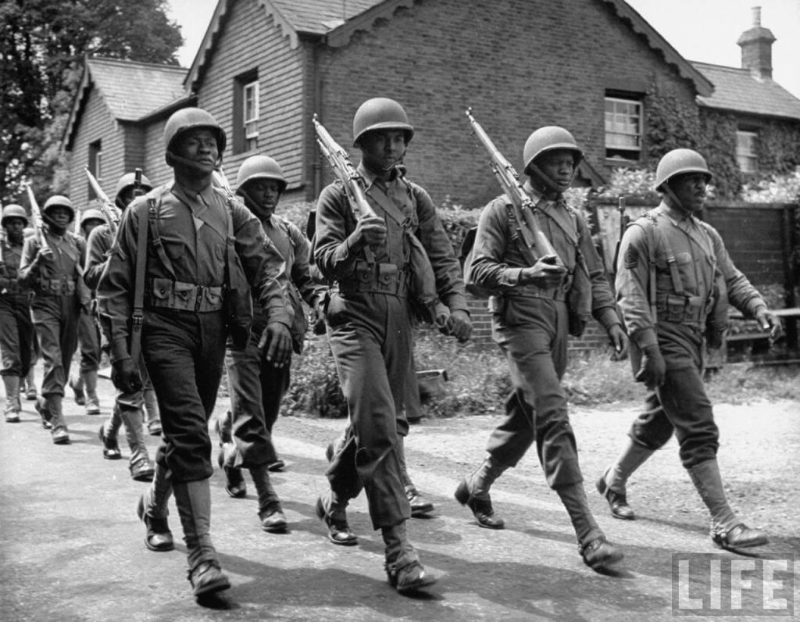
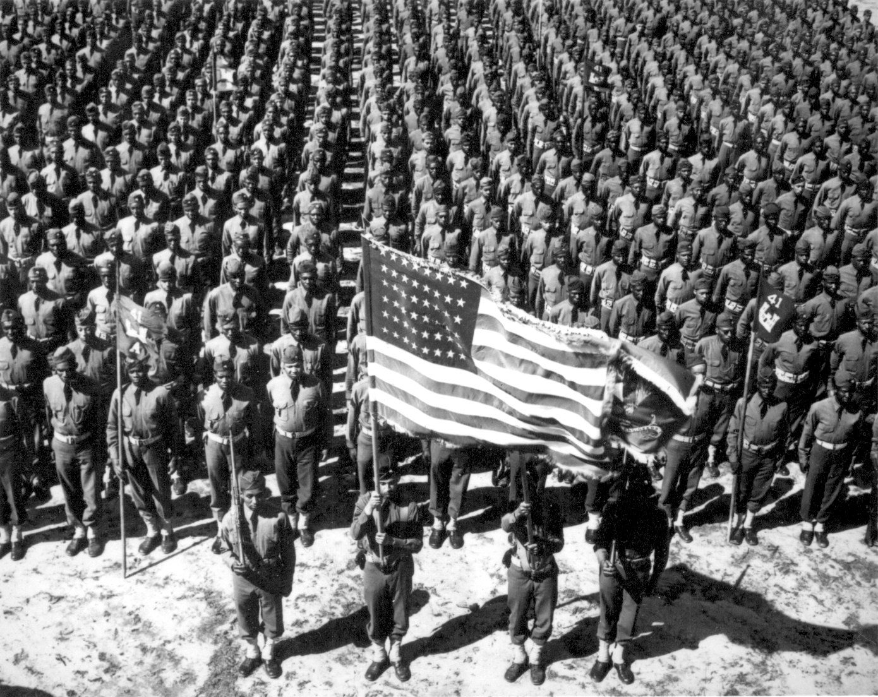
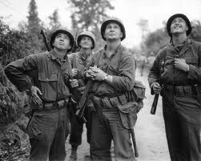
BUILDING THE MILITARY
15 million volunteers and draftees would wear the American uniform during World War II.
The number included Americans from every ethnic and religious group
Hundreds of thousands of American women were also in uniform during the war.

Slide 3
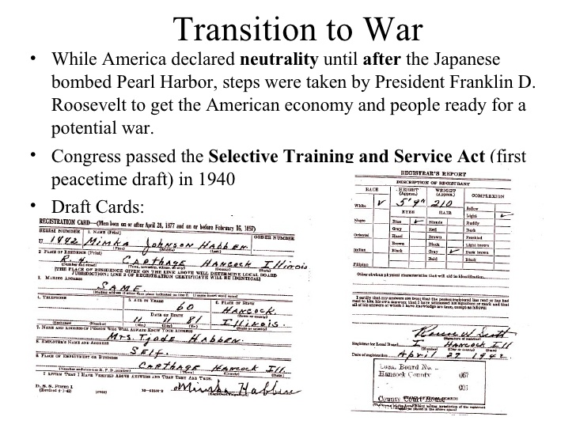
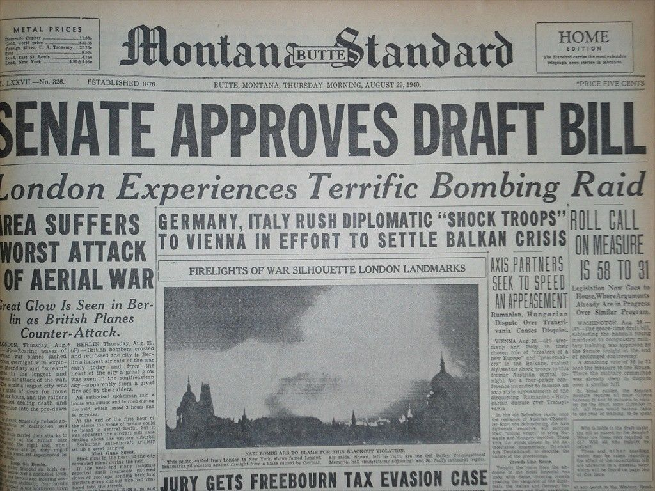
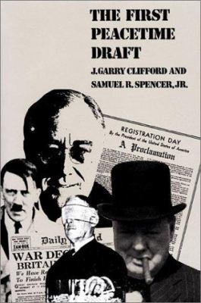
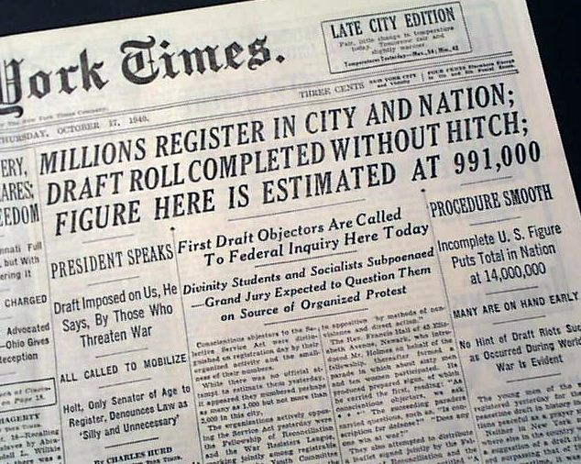
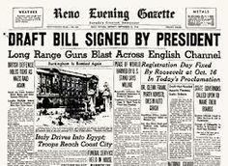

Slide 4
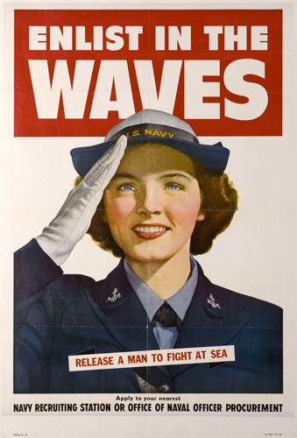
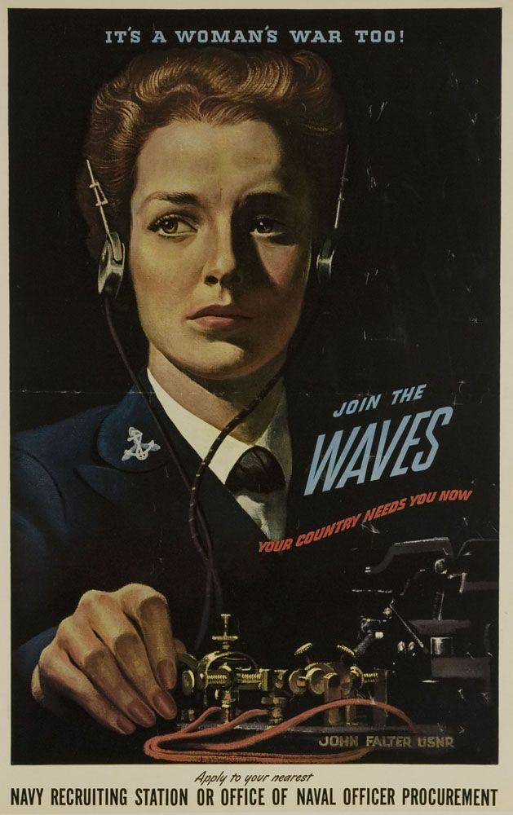
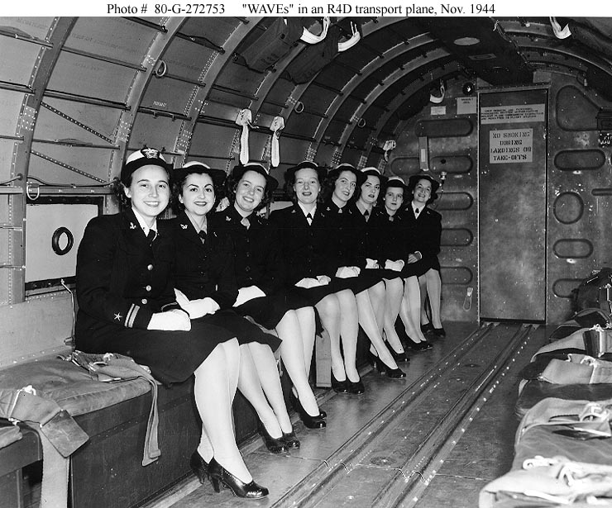
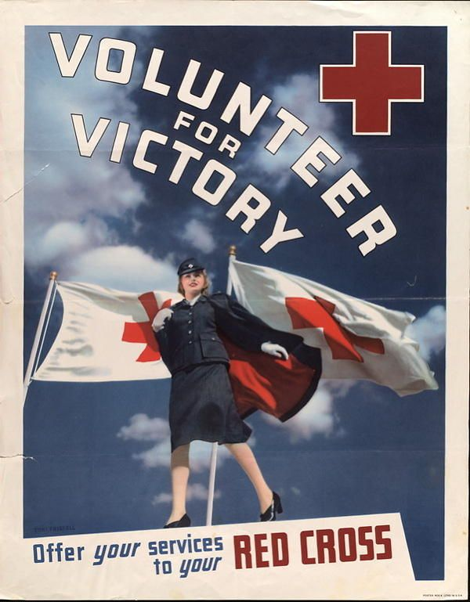
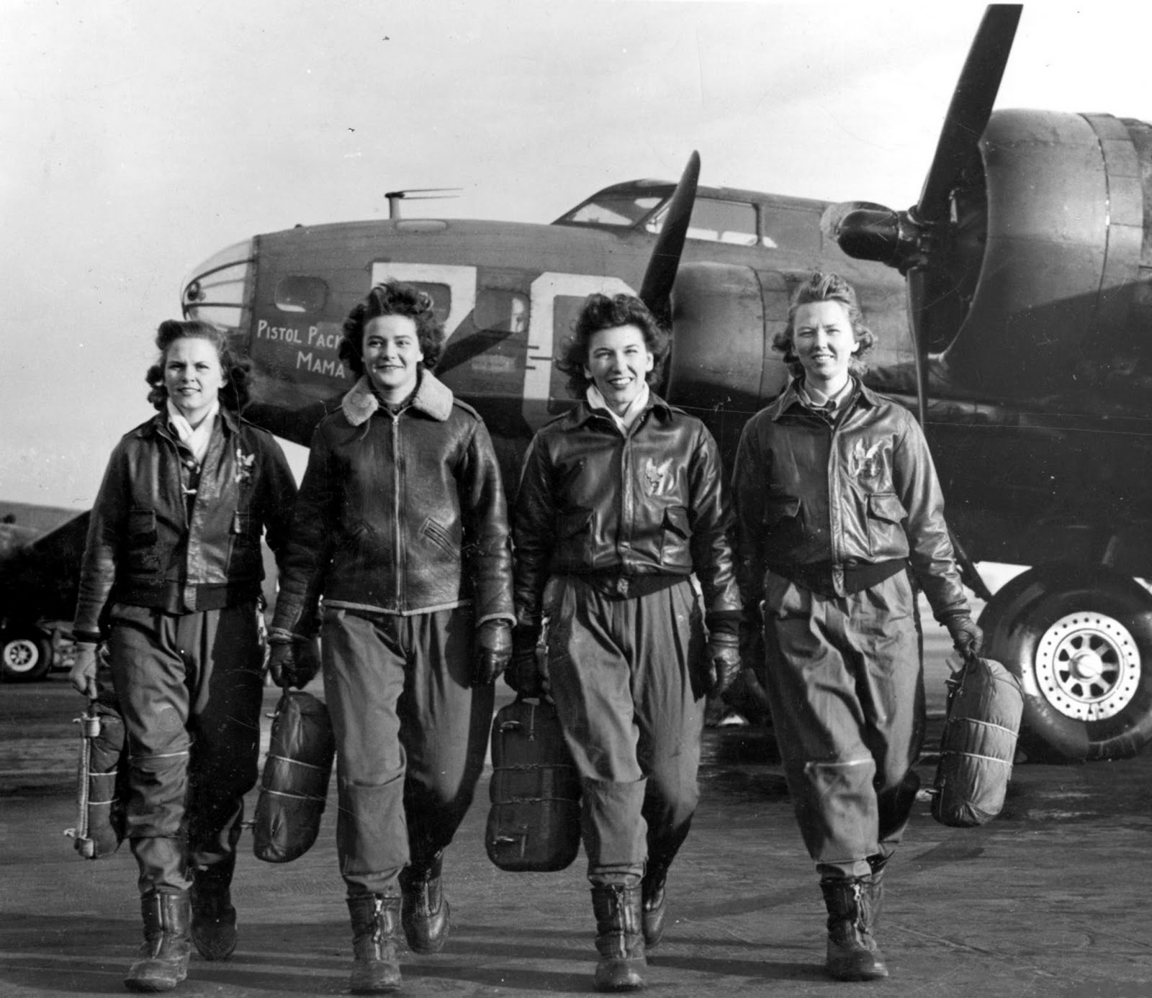
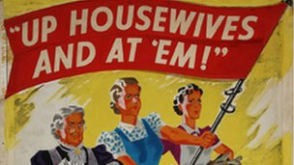
WOMEN VOLUNTEERS

Slide 5
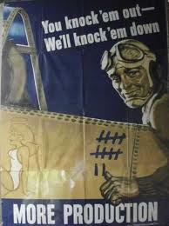
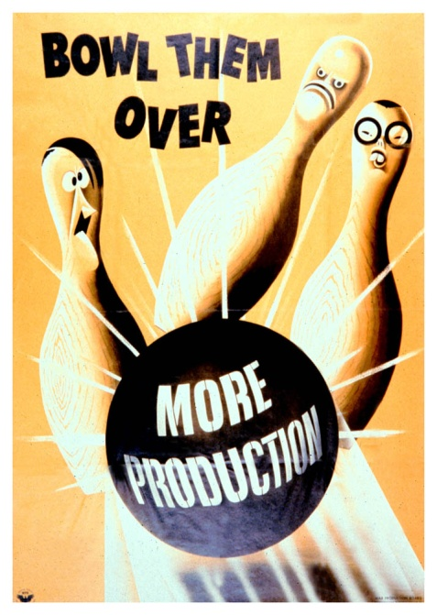
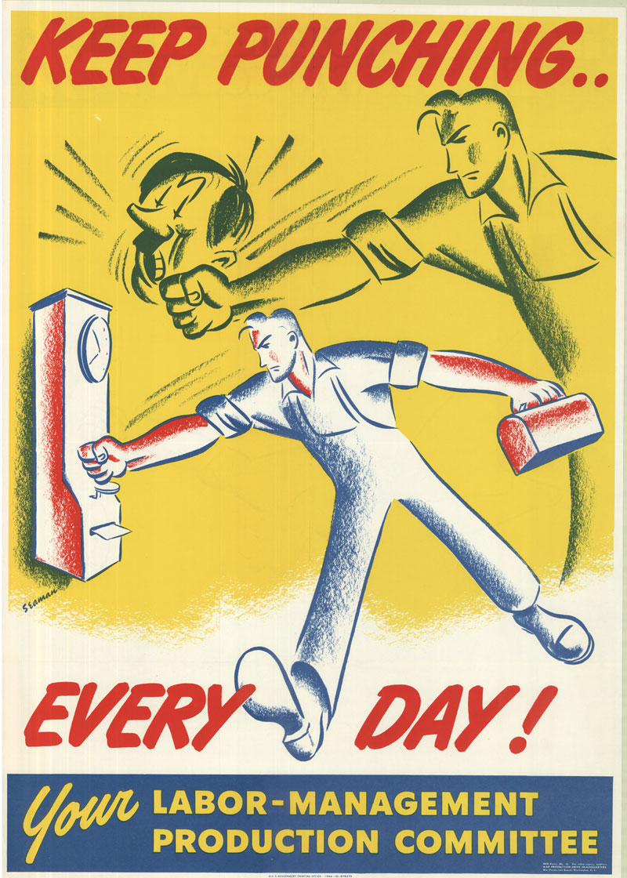
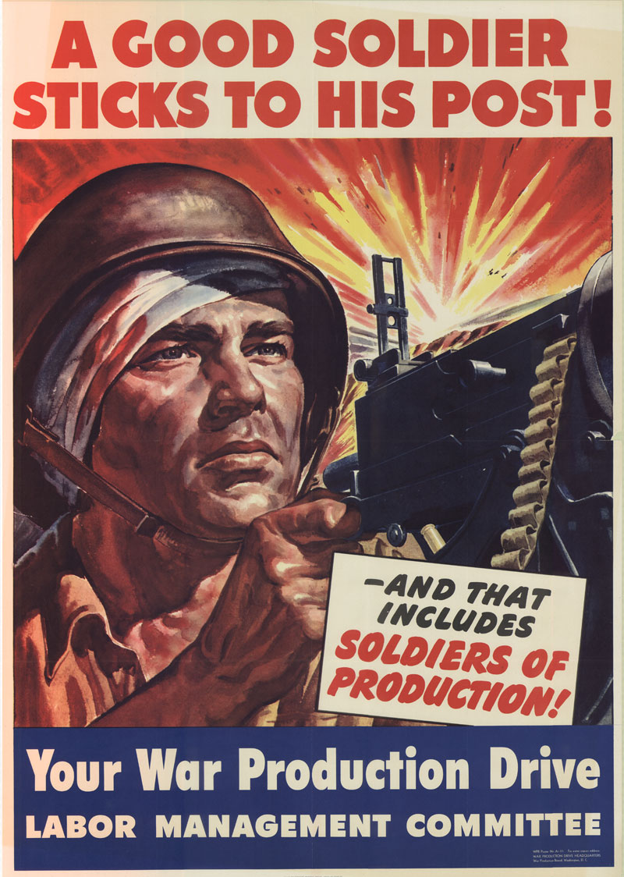
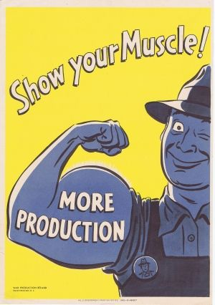
A WARTIME ECONOMY
Industry quickly converted its output from consumer to military goods.
War Production Board- established by the government to supervise the changeover and set goals for production.
helped factories shift from making consumer goods to making war goods

Slide 6
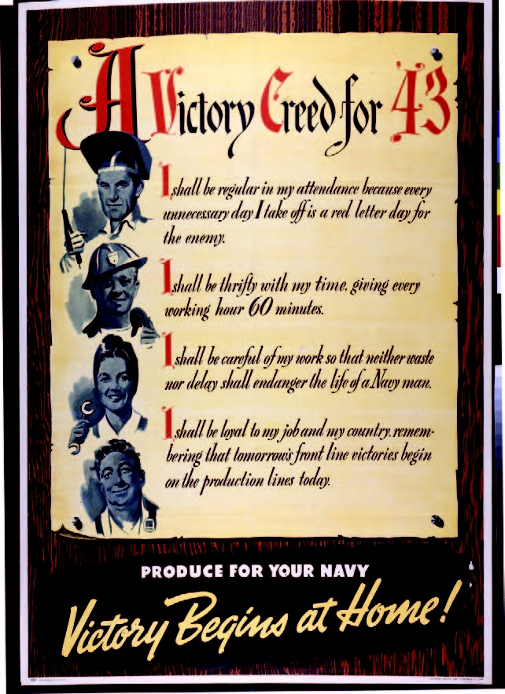

Slide 7
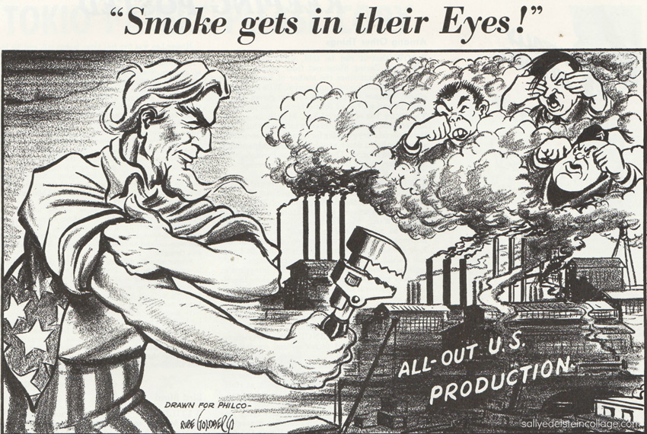

Slide 9
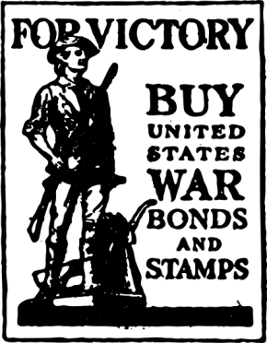
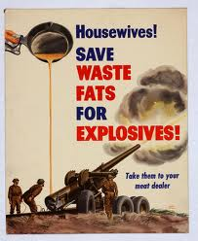
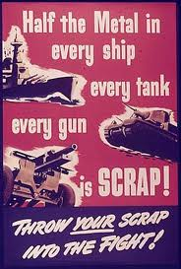
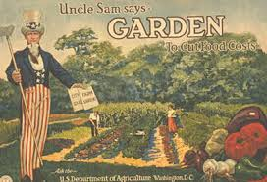
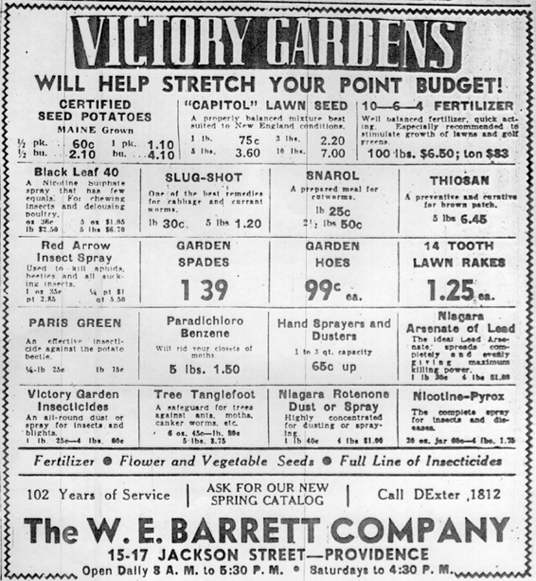
SUPPORTING THE WAR EFFORT
Rationing (Ration: a fixed and limited amount of something, especially food, given or allocated to a person or group from the stocks available, especially during a time of war.)
Ration coupons were used to purchase coffee, sugar, meat, shoes, gasoline, tires, and many other goods you needed to have these tickets in your possession.
Victory gardens
The government encouraged people to make and grow vegetable gardens to help prevent food shortages. Women were encouraged to can and preserve food from them.
Scrap drives (metal)
Conservation
Fat and grease for explosives
Metals for tanks, ships, and airplanes
War bonds

Slide 11
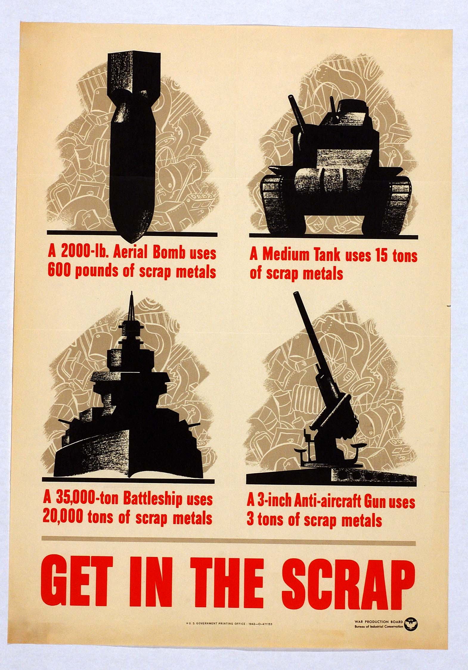
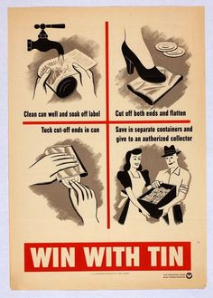
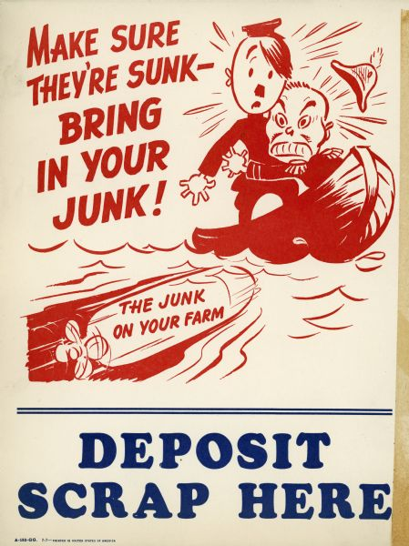
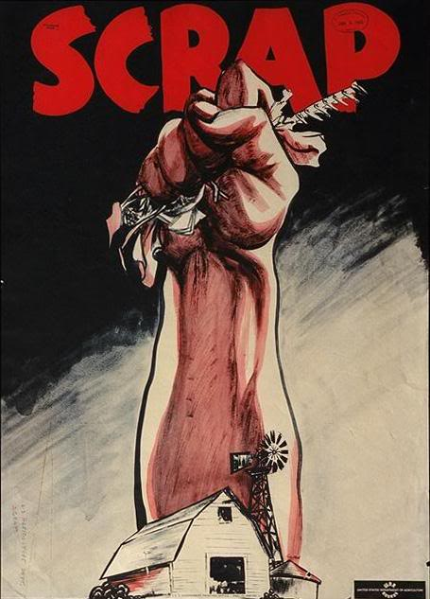
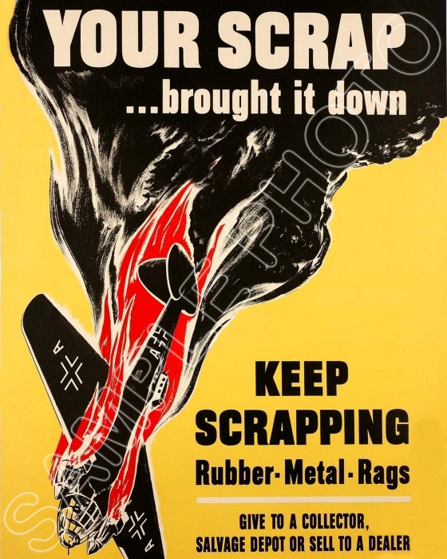
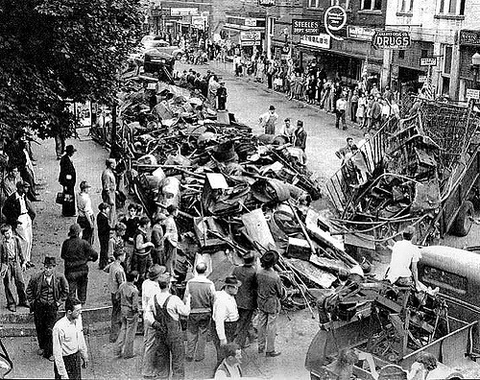
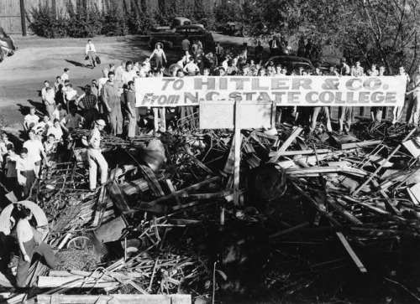
SCRAP DRIVES

Slide 12
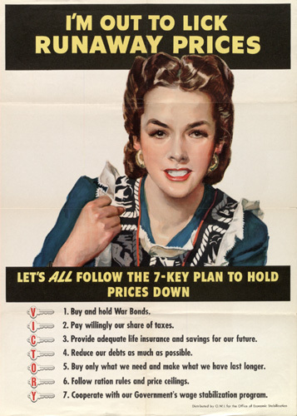
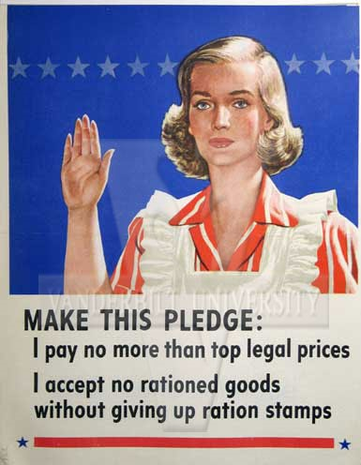
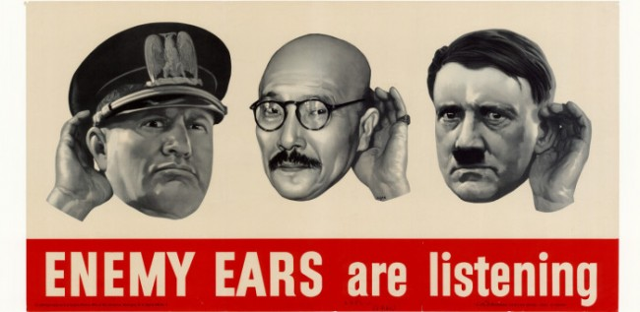

Slide 13
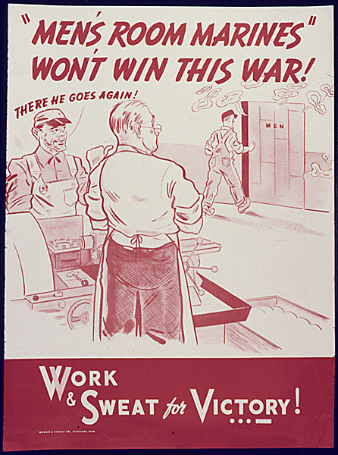
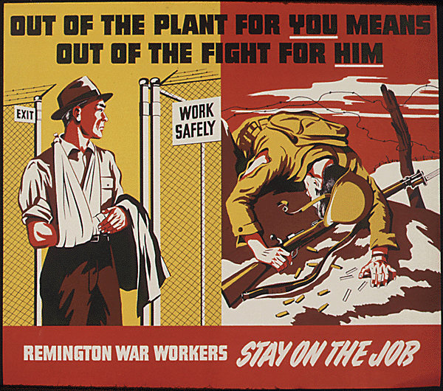

Slide 14
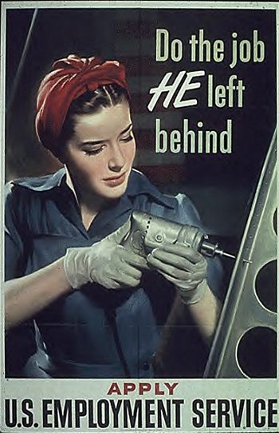
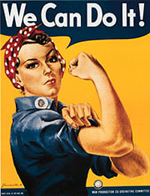
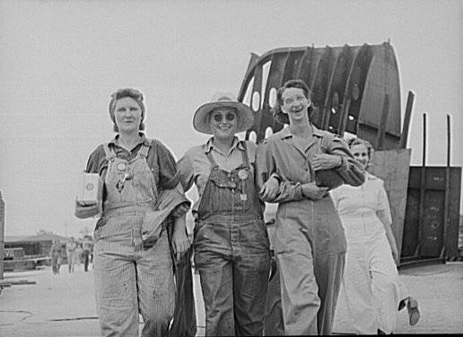
WOMEN IN INDUSTRY
About 6 million of women took over jobs in factories and shipyards while the men were off fighting.
Because women were needed in industry, they were able to gain better pay and working conditions.
Women joined the armed forces in non-combat roles.
Fashion changed due to the changing roles for women.
“Rosie the Riveter” became a popular symbol of all women who worked for the war effort.

Slide 15
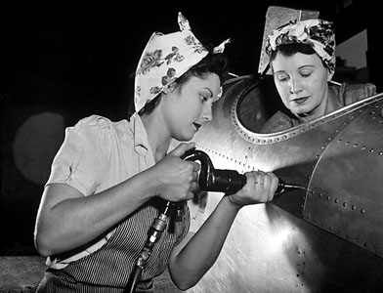
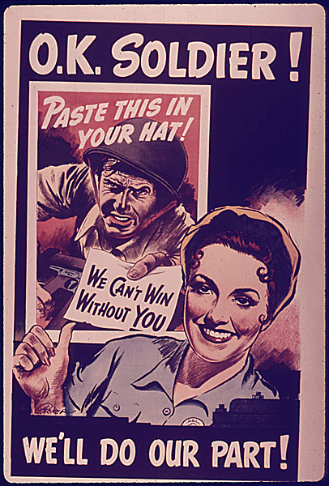
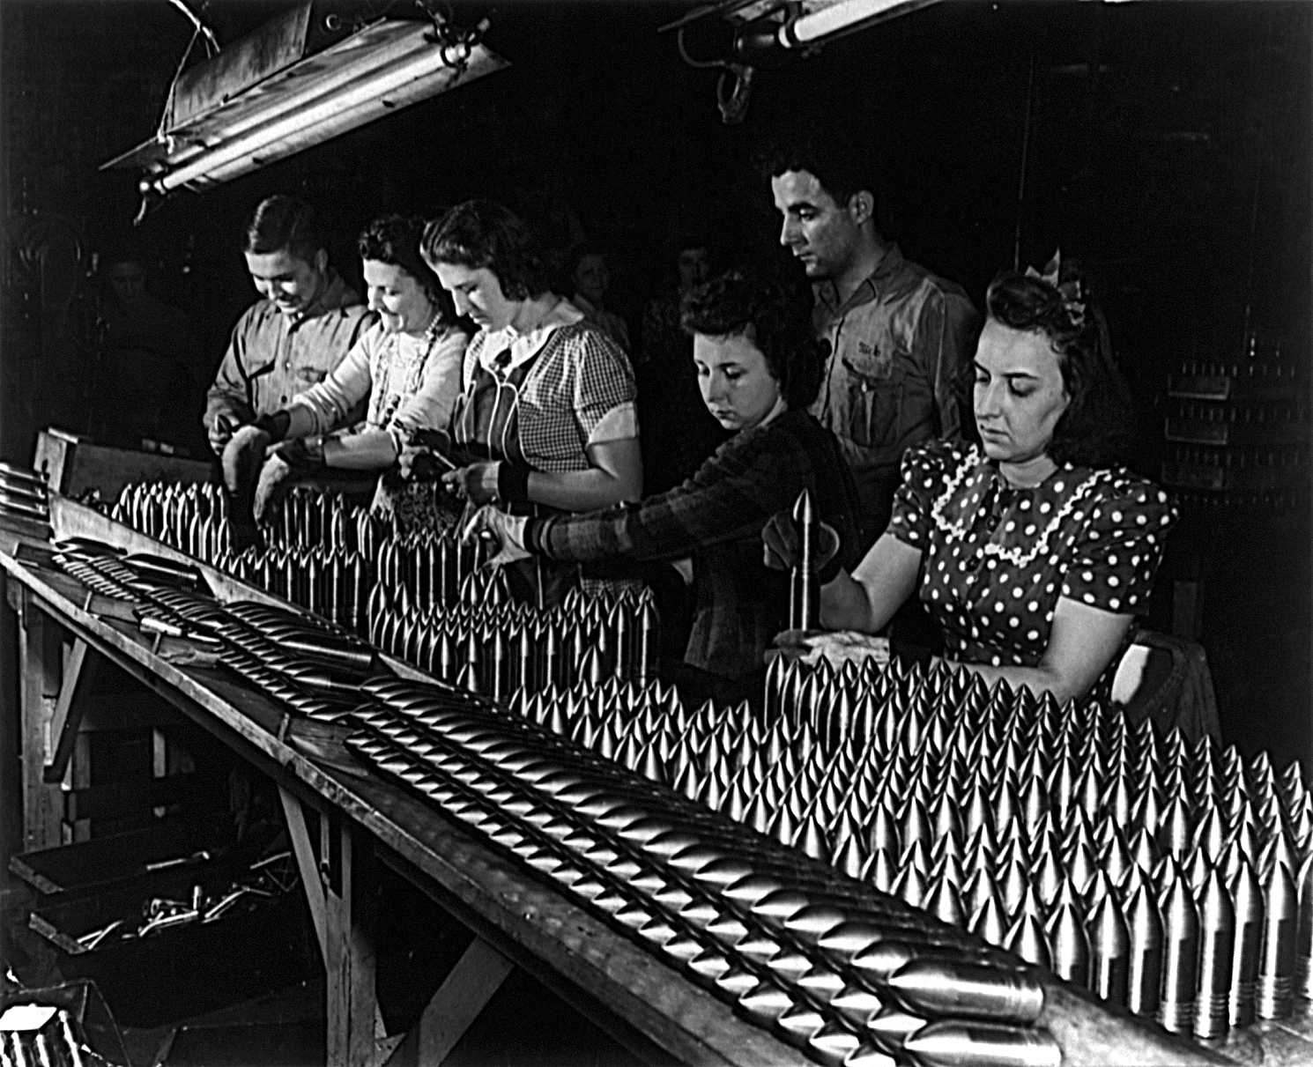

Slide 16
WAR BONDS
War bonds were investments that people would buy from the government in order to provide money to the government.
After the war was over, the government would pay back the money with interest.

Slide 17
CARELESS TALK
“Careless Talk” posters were created to prevent citizens from providing information about troop movements from where spies or saboteurs could listen in.

Slide 18
PROBLEMS FOR JAPANESE AMERICANS
Most Japanese-Americans lived on the West Coast.
After Pearl Harbor, the loyalty of Japanese Americans was questioned.
Many Americans feared that Japanese Americans would act as spies and help Japan attack the U.S.
Some believed vital information would be relayed to the enemy submarines, which would assist them in firing on military bases or coastal cities.

Slide 20
INTERNMENT
Executive Order 9066, issued by the President of the U.S. in February 1942, placed some 110,000 Japanese Americans in internment camps for the duration of the war.
In the 1944 case of Korematsu v. United States, the Supreme Court ruled that military necessity justified internment.

Slide 26
JAPANESE AMERICANS IN UNIFORM
17,000 Japanese Americans showed their loyalty by joining the armed services.
All-Japanese units fought in North Africa, Italy, and France.
442nd Regimental Combat Team became the most highly decorated military unit in U.S. history.

Slide 27
TENSIONS AT HOME
11,000 German Americans and several hundred Italian Americans were also held in government camps as “enemy aliens.”
Most were foreign-born residents who had NOT achieved citizenship.

Slide 28
AFRICAN AMERICANS
African Americans served in segregated units during World War II.
The Tuskegee Airmen were a famous group of African-American fighter pilots who fought in North Africa and Europe during World War II
African American leaders pointed out that while the nation was fighting for democracy overseas, it still permitted injustice at home.
Jim Crow laws
Discrimination continued to occur at the workplace.

Slide 30
MEXICAN AMERICANS
About half a million Mexican Americans served in the armed forces during World War II.
The U.S. signed a treaty with Mexico that allowed American companies to hire Mexican laborers.
Braceros – Mexican laborers
Zoot suit

Slide 31
BRACEROS

