Slide 1
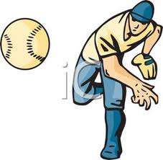
OVERHAND THROW

Slide 2
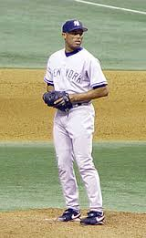
1 Side to target

Slide 3
2 bend throwing elbow

Slide 4
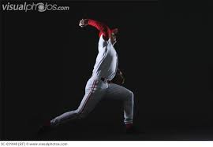
3 step & ROTATE

Slide 5
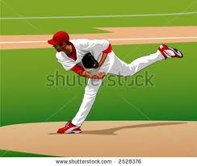
4 THROW & follow through

