Slide 1
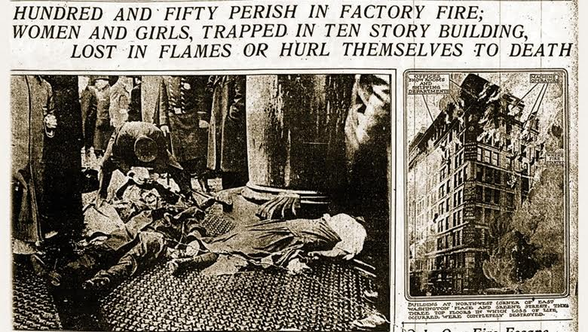
TRIANGLE SHIRTWAIST FIRE

Slide 2
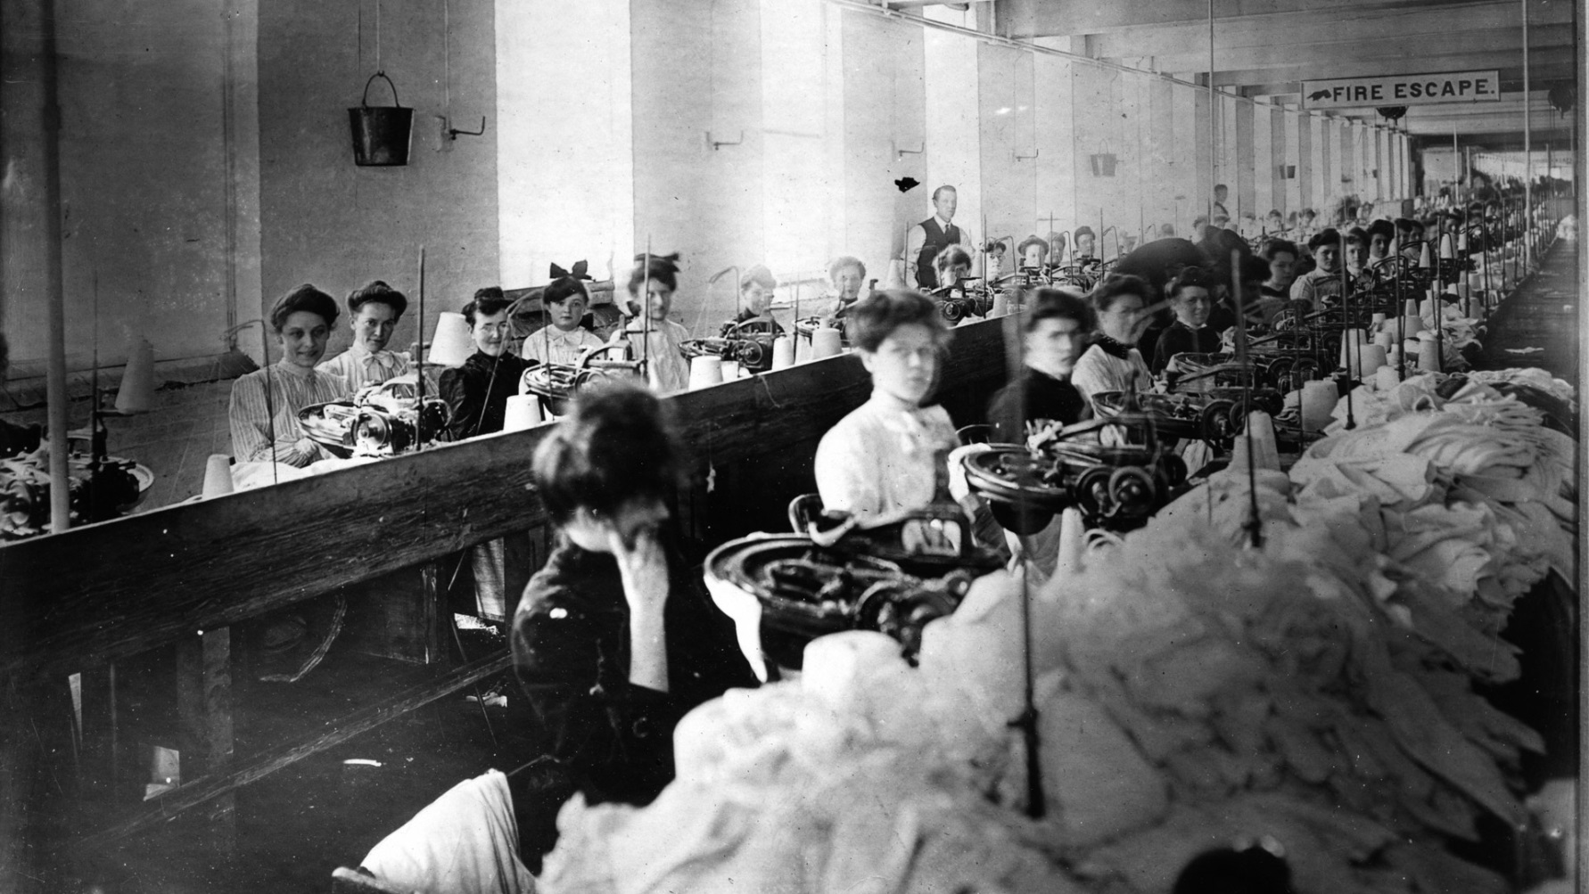
THE TRIANGLE FACTORY

Slide 3
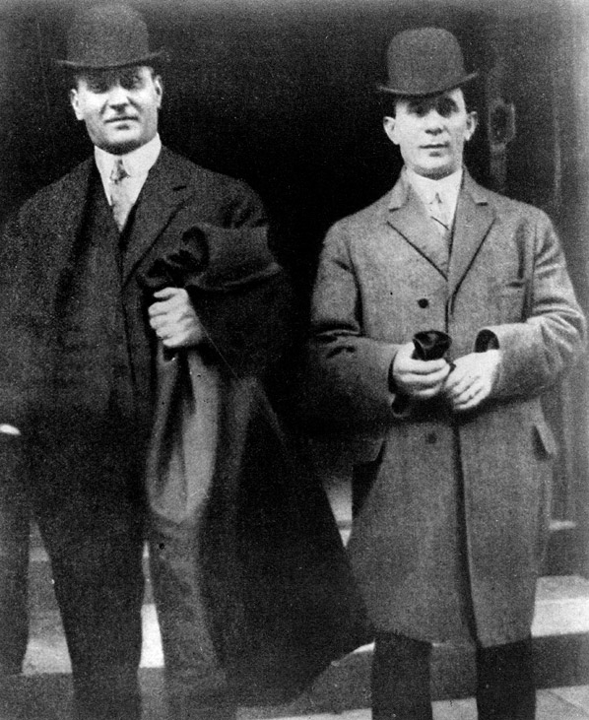
The owners of the Triangle factory, Max Blanck and Issac Harris

Slide 4
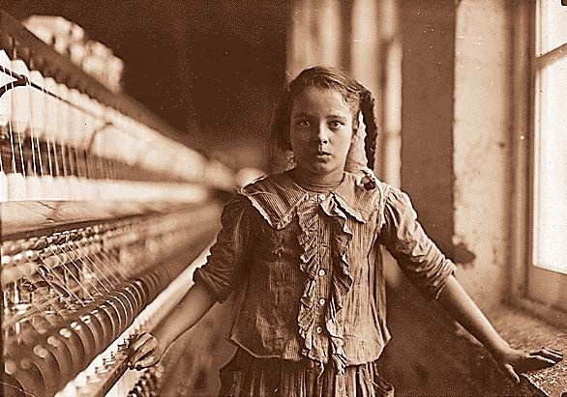
Nearly all the workers were teenaged girls who did not speak English. They worked 12 hour days, 7 days a week. They were paid a mere $15 a week, despite working 84 hours a week.

Slide 5
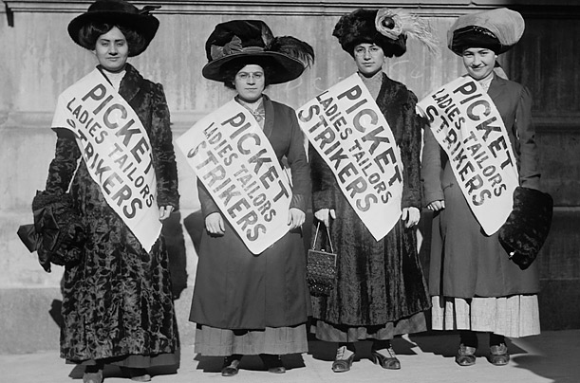
The International Ladies Garment Workers Union led a strike in 1909 demanding higher pay and shorter and more predictable hours. Blanck and Harris’ company was one of the few manufacturers who resisted, hiring police as thugs to imprison the striking women, and paying off politicians to look the other way.

Slide 7
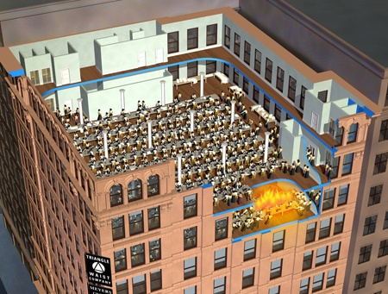
On March 25, a Saturday afternoon, thee were 600 workers at the factory when a fire began in a rag bin. The manager attempted to use the fire hose to extinguish it, but was unsuccessful. The hose was rotted and its valve was rusted shut. The elevator to exit the building only held 12 people. It made four trips back and forth before it broke down. In a desperate attempt to escape the fire, girls left behind waiting for the elevator plunged down the shaft to their deaths. The girls who fled via the stairwells also met awful demises-when they found a locked door at the bottom of the stairs, many were burned alive

Slide 8
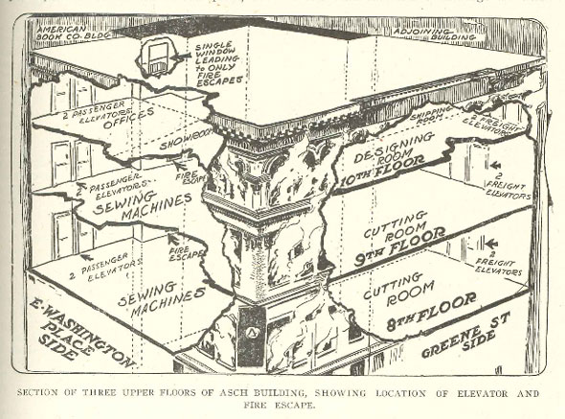
Those workers who were on floors above the fire, including the owners, escaped to the roof and then to adjoining buildings.

Slide 9
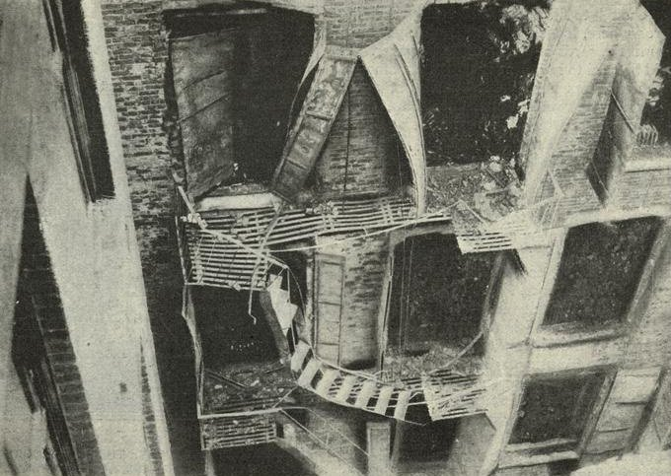
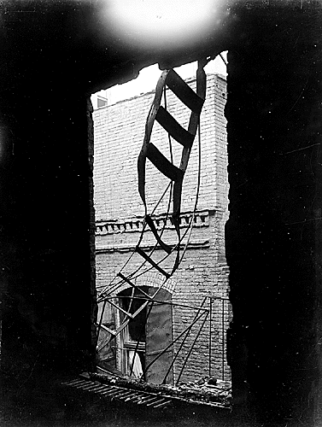
The fire escape was so narrow that it would have taken hours for all the workers to use it, even in the best circumstances.

Slide 10
The girls who did not make it to the stairwells or the elevator were trapped by the fire inside the factory and began to jump from the windows to escape it. The bodies of the jumpers fell on the fire hoses, making it difficult to begin fighting the fire. The ladders reached only seven floors high and the fire was on the 8th floors. A life net was unfurled to catch jumpers, but three girls jumped at the same time, ripping the net.

Slide 11
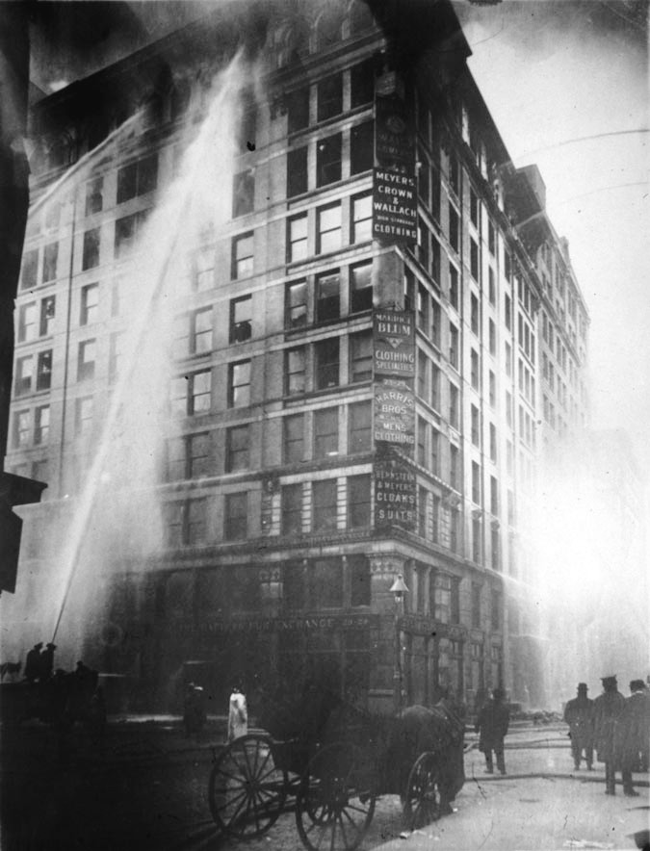
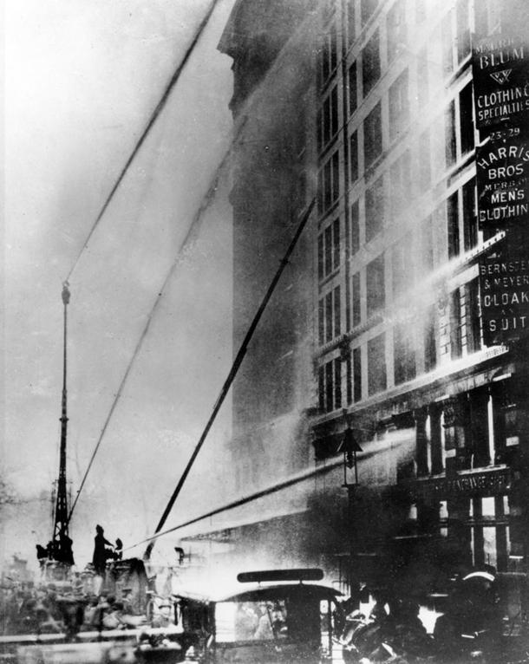
Within 18 minutes, it was all over. 49 workers had burned to death or been suffocated by smoke, 36 were dead in the elevator shaft and 58 died from jumping to the sidewalks. With 2 more dying later from their injuries, a total of 145 people were killed by the fire.

Slide 12
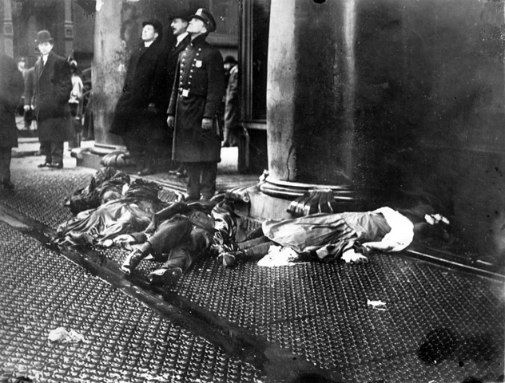
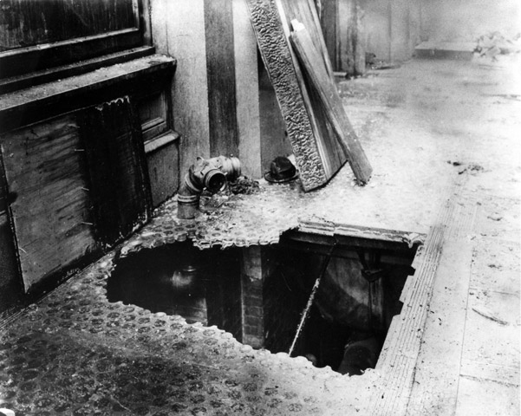

Slide 13
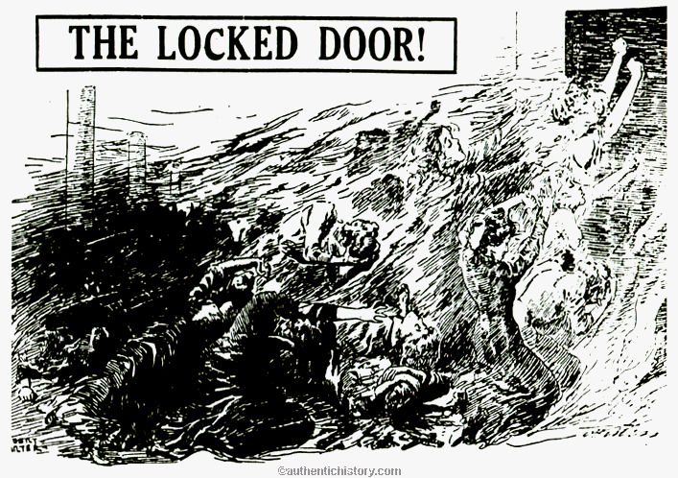
There were two stairways down to the street, but one was locked from the outside to prevent stealing and the other opened inward.

Slide 14
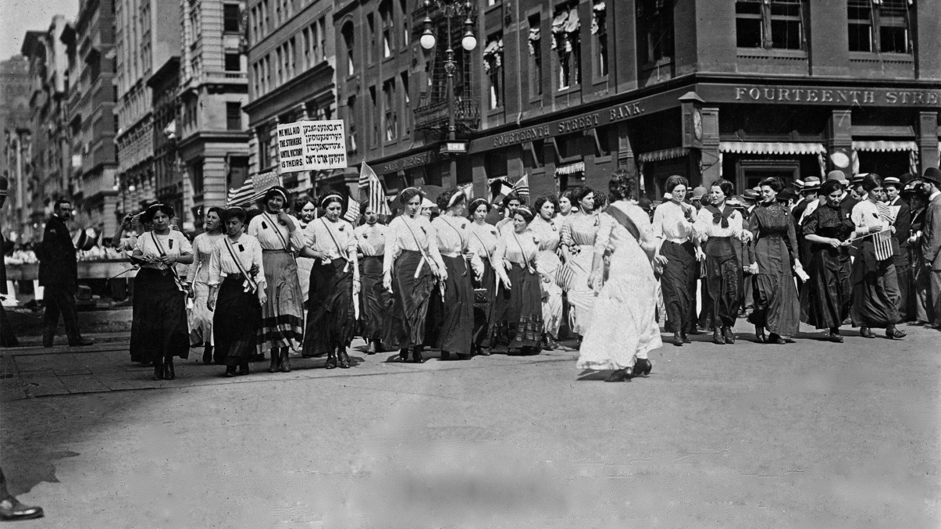
The workers set up a march on April 5 on New York’s Fifth Avenue to protest the conditions that had led to the fire; it was attended by 80,000 people

