Slide 1
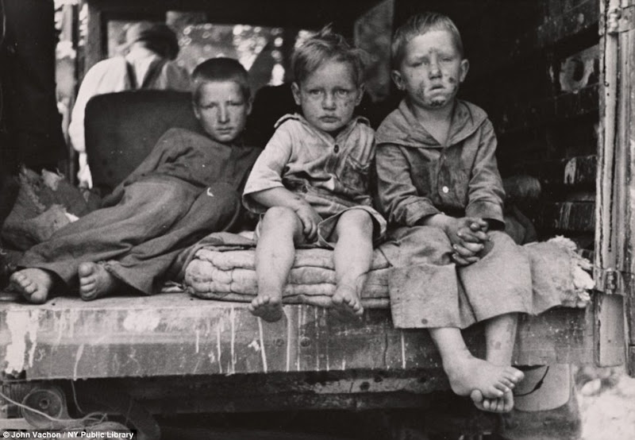
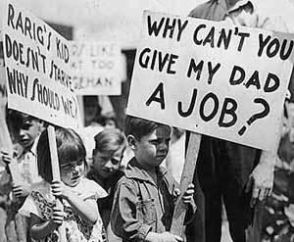
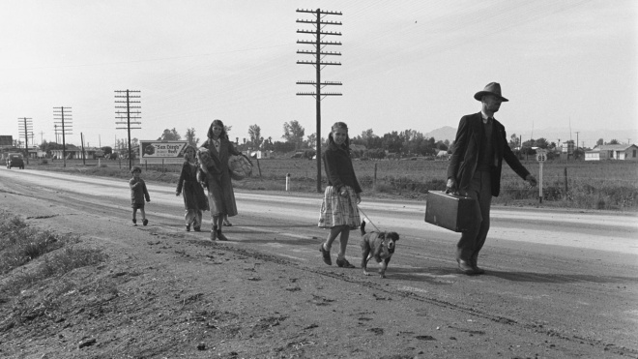
LIFE IN THE GREAT DEPRESSION
23-3

Slide 2
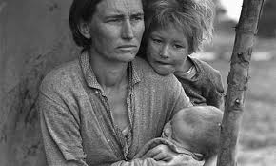
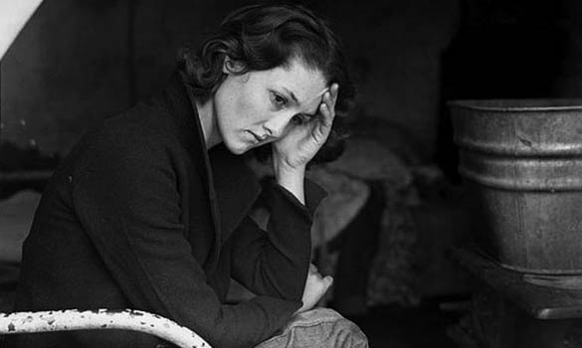
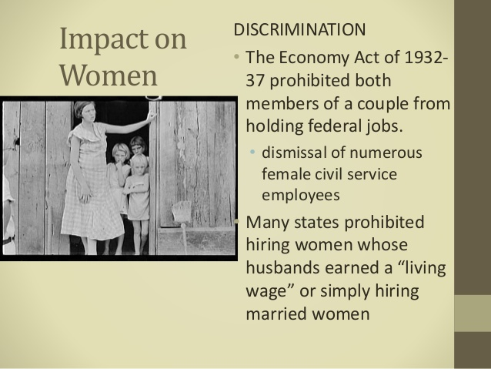
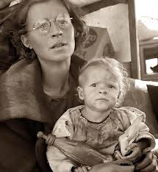
WOMEN IN THE DEPRESSION
With so many men out of work, many Americans felt that women should stay home.

Slide 3
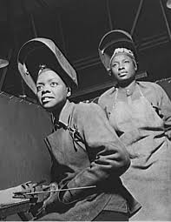
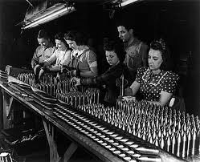
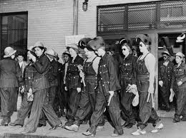
WOMEN IN THE WORKPLACE
Women enjoyed two small advantages in the workplace.
Female salesclerks and secretaries faced little competition from men.
In addition, such jobs were less likely to disappear than the factory jobs many men held.
Female factory workers were more likely than men to lose their jobs or to have their wages cut.
Many maids and housekeepers also lost their jobs because fewer people could afford domestic help.

Slide 4
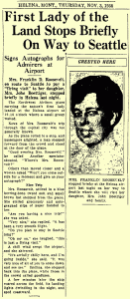
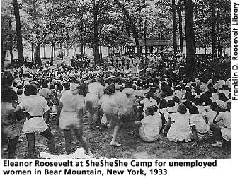
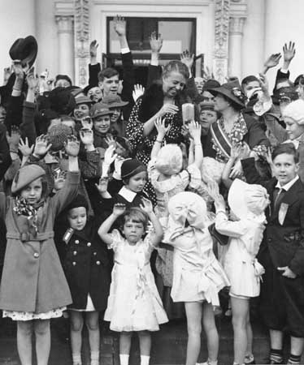
AN ACTIVE FIRST LADY
The most famous working woman in the country was FDR’s wife, Eleanor Roosevelt.
Eleanor Roosevelt helped transform the role of First Lady.
She served as the President’s “eyes and ears.”
In 1933 alone, Eleanor logged 40,000 miles.
She made frequent radio speeches and wrote a daily newspaper column.
Mrs. Roosevelt used her position to champion women’s right’s.

Slide 5
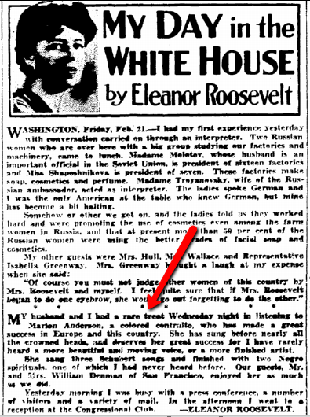
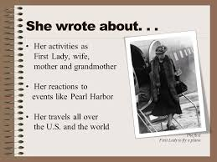
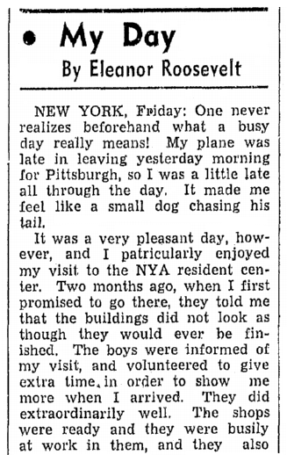
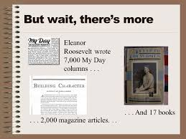

Slide 6
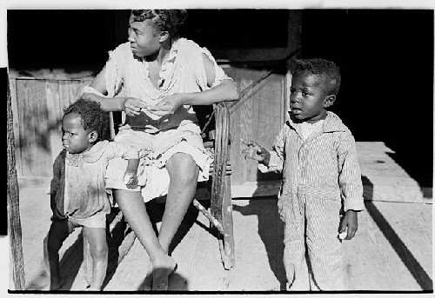
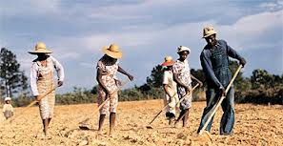
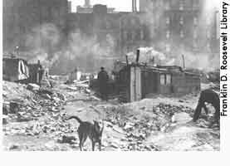
AFRICAN AMERICANS IN THE DEPRESSION
African Americans had been hit hard by the Depression.
They generally suffered more unemployment, homelessness, illness, and hunger than did whites.

Slide 7
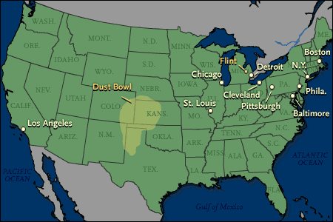
SOUTH AND NORTH
SOUTH
NORTH
Plunging cotton prices forced many African American sharecroppers off their land.
Moving to southern cities, they found that many jobs traditionally done by blacks, such as cleaning streets, were now filled by jobless whites.
By 1932, more than half the African Americans in the South were unemployed.
The Great Migration, which had started after World War I, continued at an even faster pace.
More black than white factory workers lost their jobs.
African Americans were usually last hired and first fired.

Slide 8
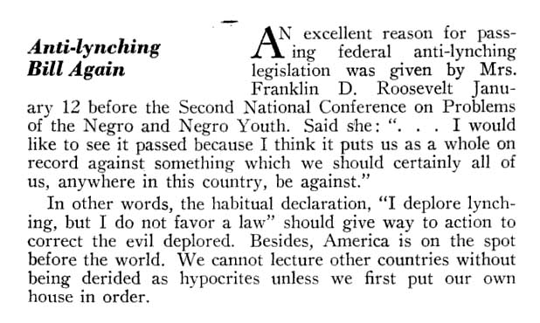
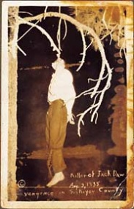
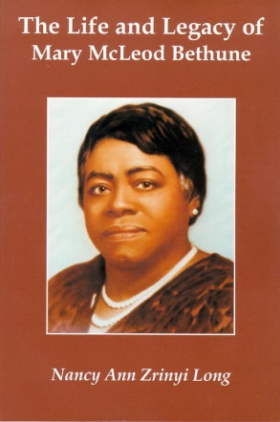
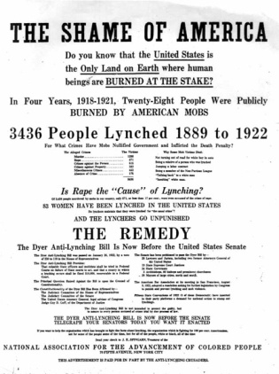
FDR’S MIXED RECORD
The majority of African American voters had backed Roosevelt.
Still, the President had a mixed record on civil rights.
Roosevelt failed to support a federal anti-lynching bill, which his wife strongly supported.
The President feared that he might lose the support of southern senators for his New Deal programs.
Still, in part due to his wife’s prodding, Roosevelt appointed at least 100 African Americans to government posts.
Mary McLeod Bethune became the top ranking African American in the government.
Black Cabinet
Federal Council of Negro Affairs or Black Brain Trust, was the informal term for a group of African Americans who served as public policy advisors to President Franklin D. Roosevelt and his wife Eleanor Roosevelt.
Advised FDR on racial issues surrounding Black America.

Slide 10
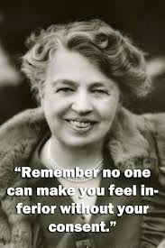
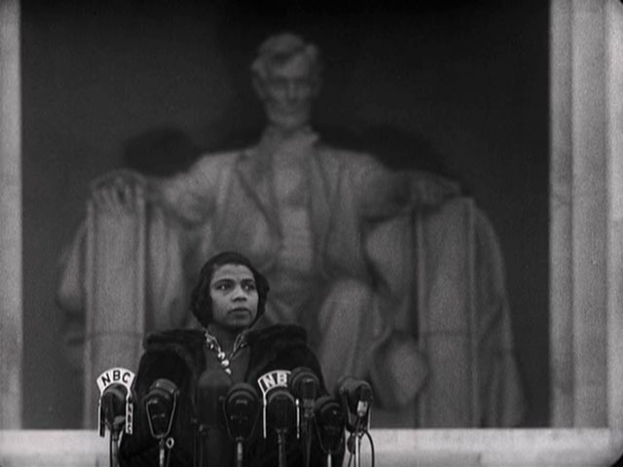
A SYMBOLIC MOMENT
In 1939, the Daughters of the American Revolution (DAR) refused to allow African American singer Marian Anderson to perform at their hall.
African American singer, one of the most celebrated performers of the 20th century.
Eleanor Roosevelt, a DAR member, resigned in protest.
She then arranged for Anderson to sing on the steps of the Lincoln Memorial on Easter Sunday.
Do you think that location was selected on purpose or randomly? EXPLAIN.

Slide 11
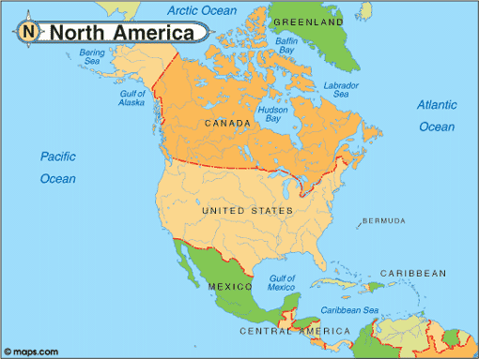
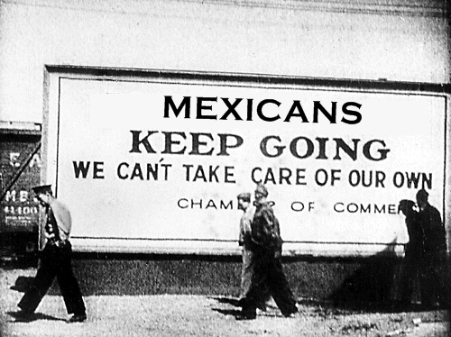
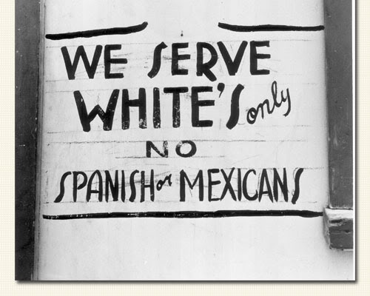
MEXICAN IMMIGRANTS ARE DEPORTED
Many Mexican immigrants lived in the Southwest as migrant workers.
During the Great Depression, many Mexican Americans were deported from the U.S.
Why?

Slide 12
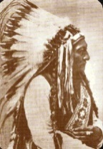
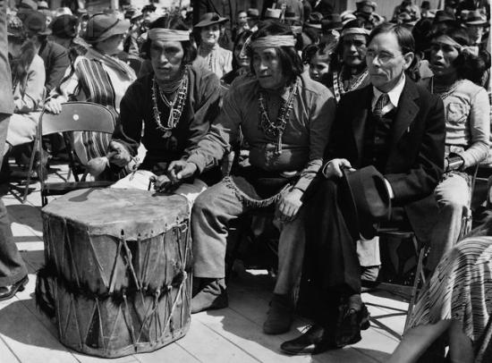
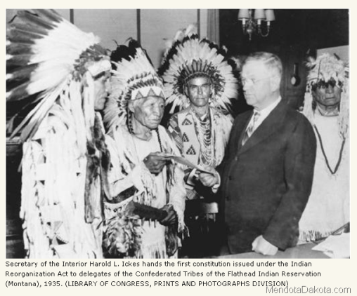
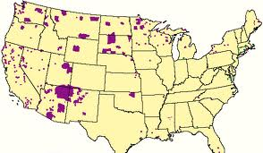
THE INDIAN NEW DEAL
Under FDR, John Collier became the Commissioner of Indian Affairs and embarked on an ambitious program that became known as the Indian New Deal.
With federal funding, he hired Native Americans to build needed schools, hospitals, and irrigation systems.
Collier hoped to put reservations under Indian control, stop sales of Native American lands, and encourage Indian schools to teach Native American history and the arts.
Colliers plan was approved by Congress in 1934.
The Indian Reorganization Act
The act failed to bring self government to the tribes or to promote education.

Slide 13
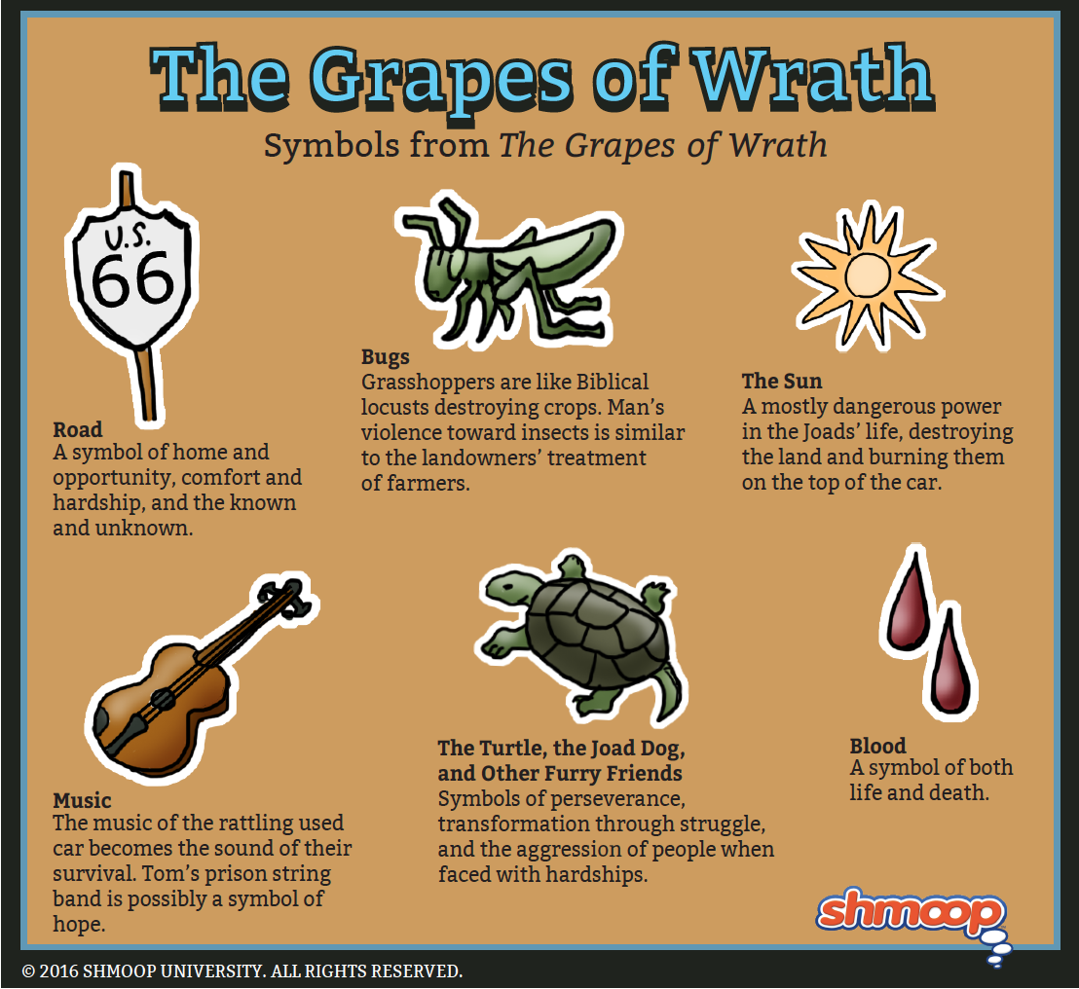
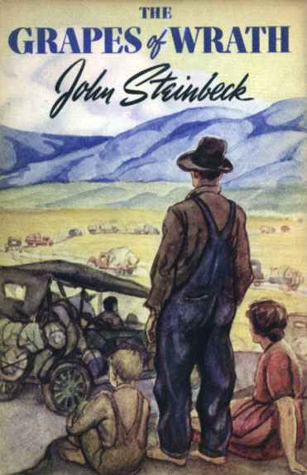
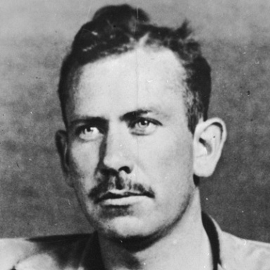
ARTS AND MEDIA OF THE DEPRESSION
In 1939, writer John Steinbeck captured the miseries of the Dust Bowl in The Grapes of Wrath.
Steinbeck’s novel became the classic example of how American writers and artists tried to cope with the human toll of the Great Depression

Slide 14
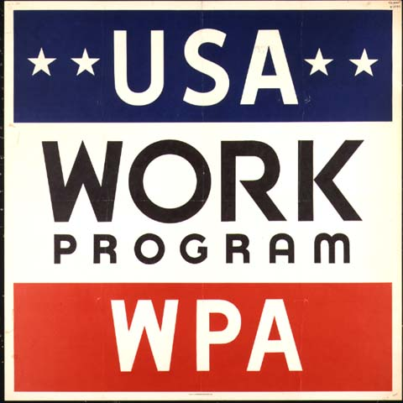
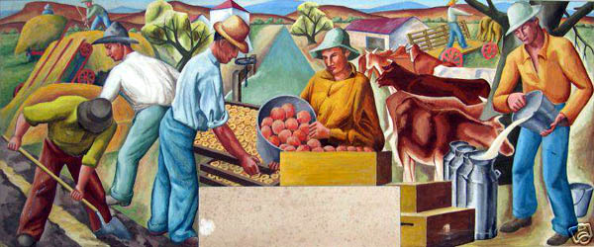
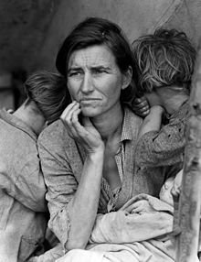
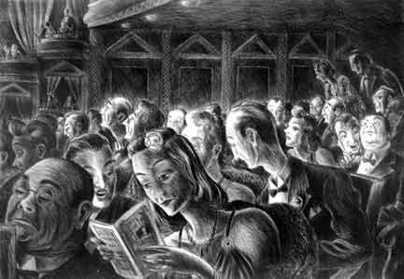
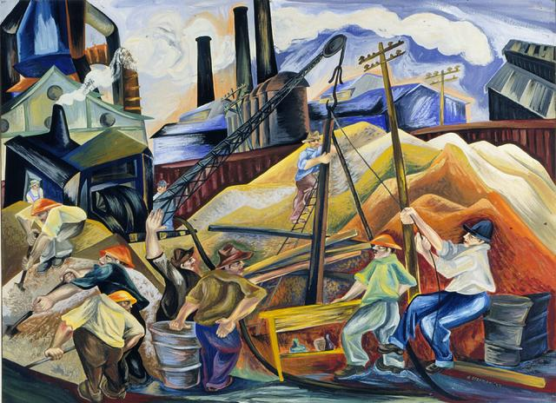
VISUAL ARTS
Photographers and painters used the Depression as a theme for their art.
Under a New Deal program called the Farm Security Administration, photographer Dorothea Lange recorded the experiences of Dust Bowl migrants.
WPA hired artists to paint murals on public buildings

Slide 15
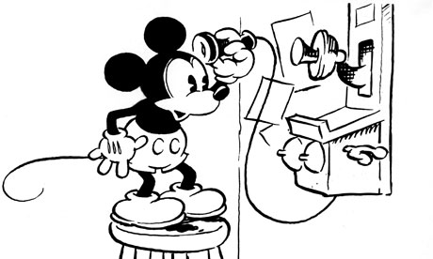
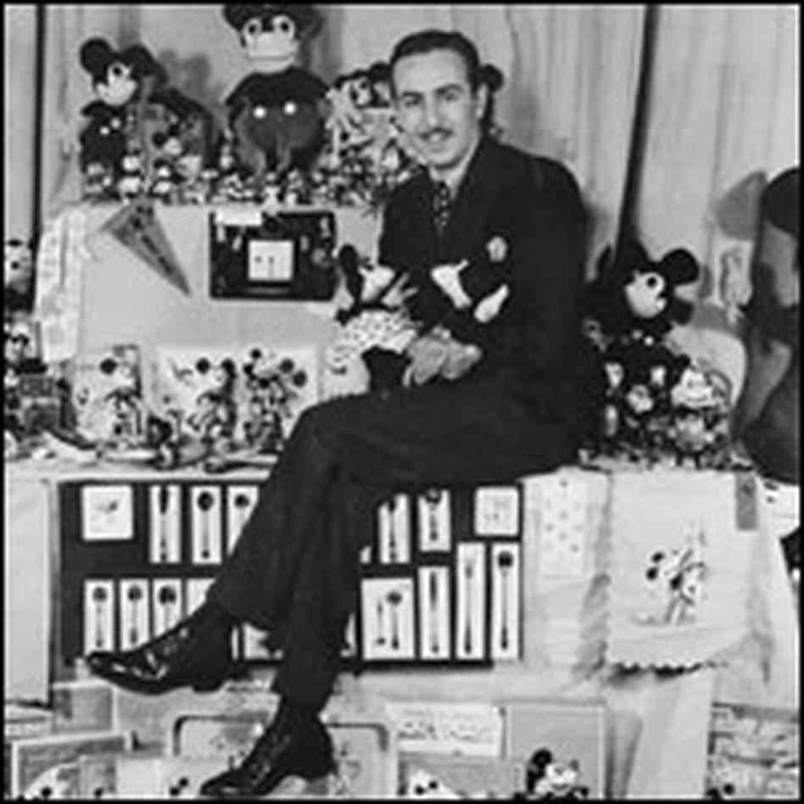
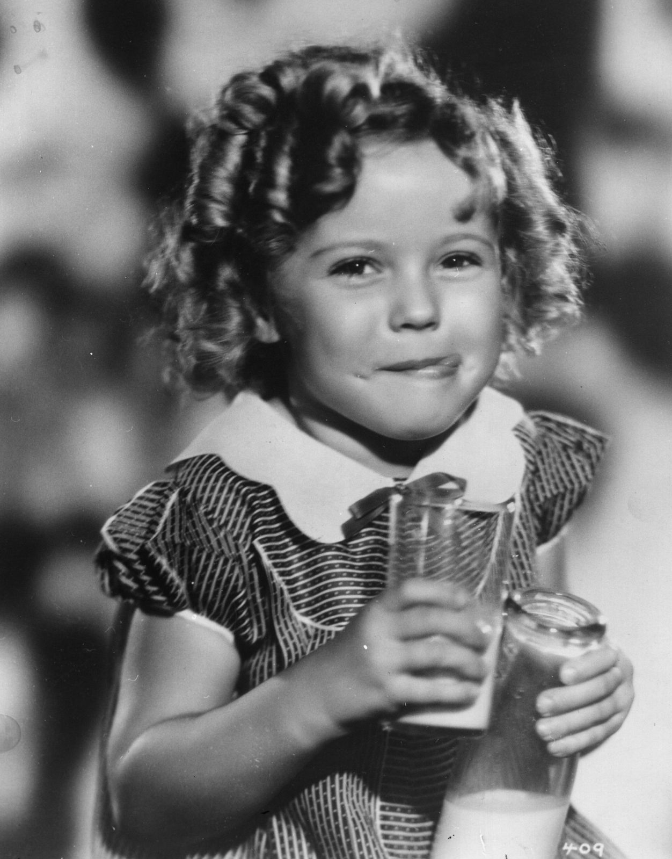
MOVIES
During the Depression, some movies dealt realistically with social problems.
1940 movie version of The Grapes of Wrath.
The Public Enemy-depicted the rise of organized crime in American cities.
Most movies of the era, however, were meant to help people forget their problems.
Mickey Mouse
King Kong
Wizard of OZ
One of the most popular stars was Shirley Temple, a little girl who symbolized optimism in the face of trouble.

Slide 16
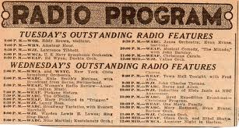
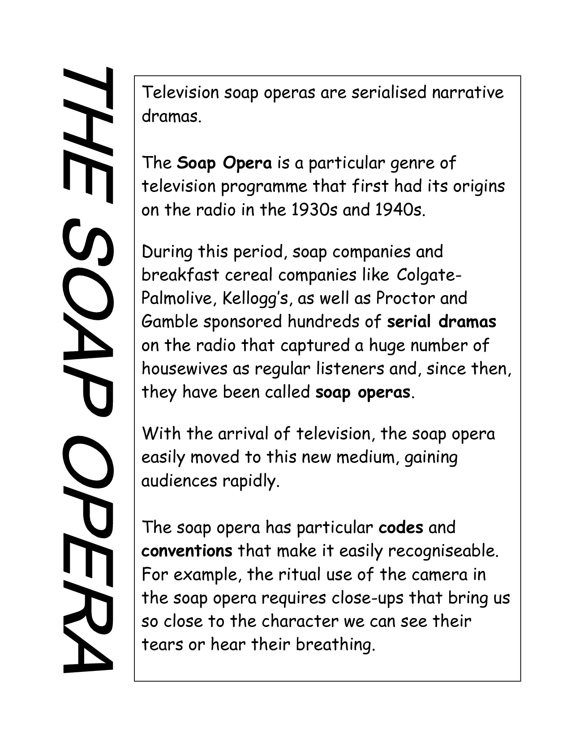
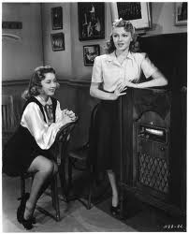
RADIO
The radio was an important part of everyday life.
Families gathered in the living rooms to listen to FDR’s fireside chats and entertainment (baseball, boxing, horse racing, news, shows).
During the day, many listeners tuned in to continuing dramas sponsored by soap companies.
Such serials are still known as soap operas.

