Slide 1
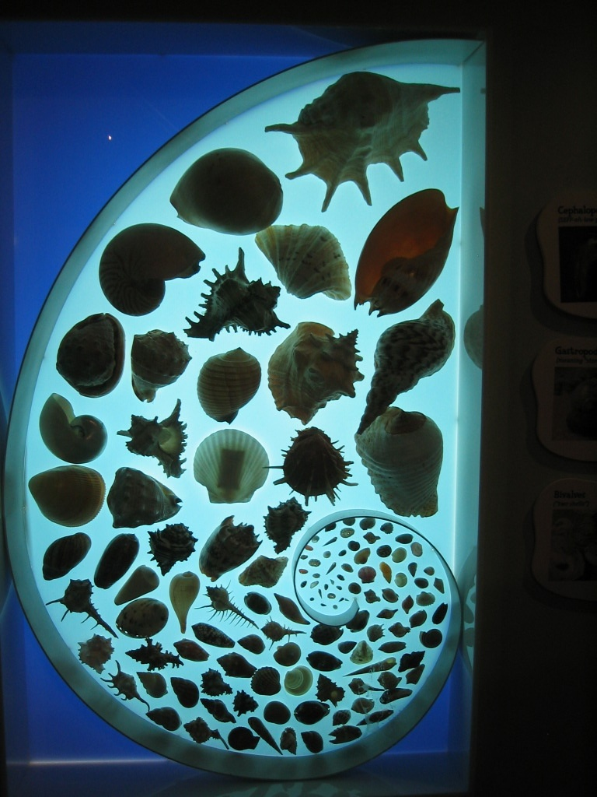
Chapter 9 - Soft Bodied Animals
Mollusks include:
Clams
Snails
Scallops
Mussels
Oysters
Squid
Octopus
Nautilus
CLICK MED

Slide 2
Mollusks have the following characteristics:
Soft, bilateral symmetry
Head, foot and coiled internal organs
They have a coelem (body cavity) and a brain
There are over 100,000 different species.

Slide 3
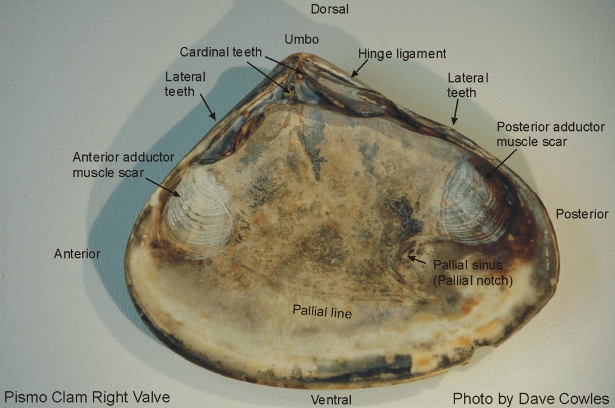
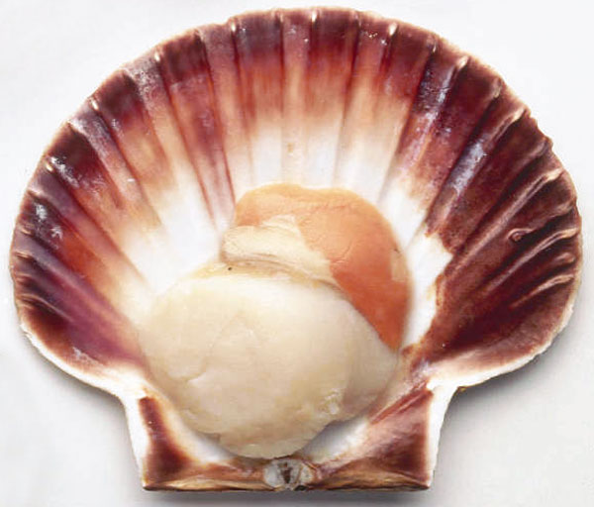
Bivalves - a large group of mollusks
Include clams, mussels, scallops and oysters.
Have 2 shells that are hinged together by an adductor muscle.

Slide 4
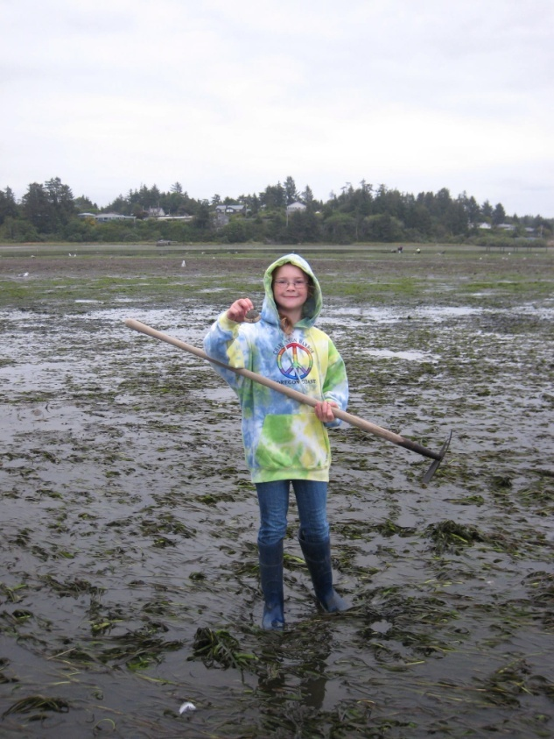
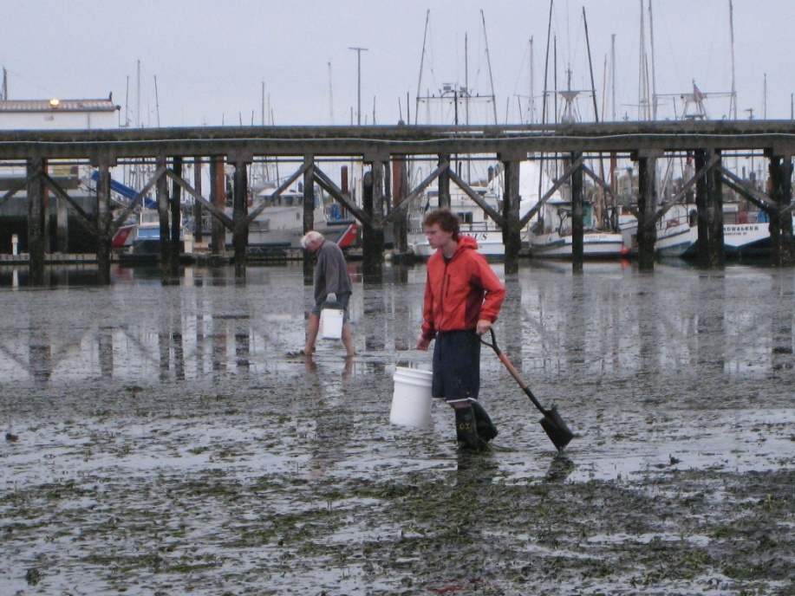
Bivalves….
Clams live in the intertidal zone, the mudflats.
There are over 15,000 kinds of clams.

Slide 5
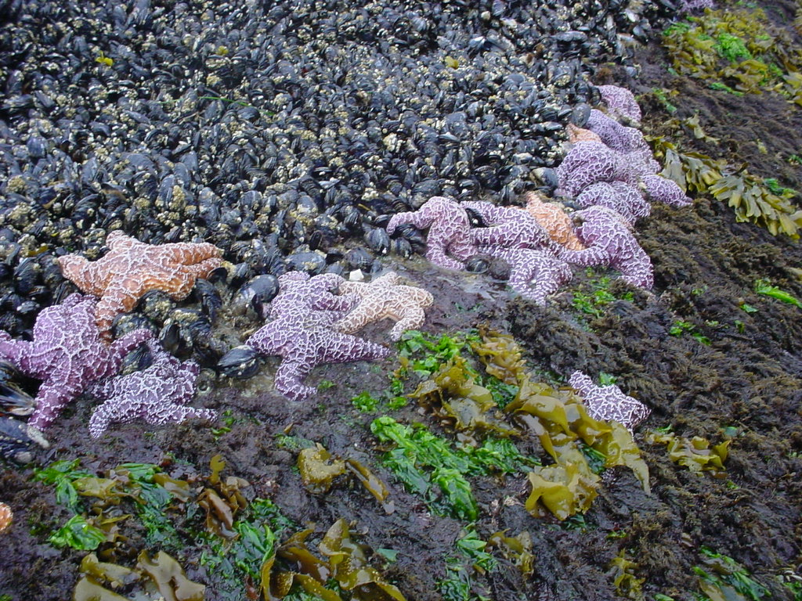
The Sea Star is a Common Predator of Bivalves
Clam Escape

Slide 6
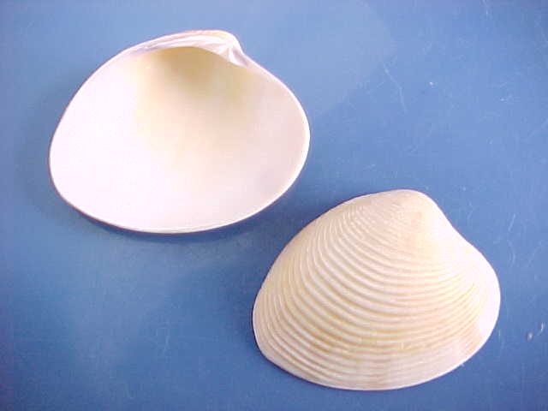
Every line on the bivalve represents one year of growth

Slide 7
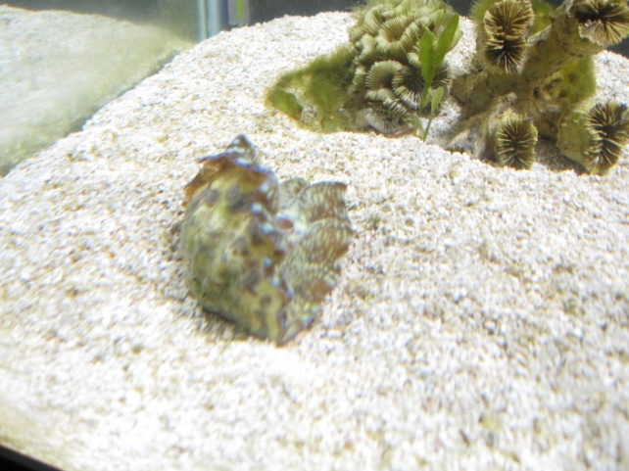
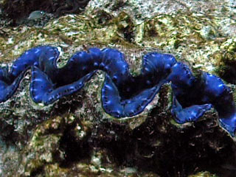
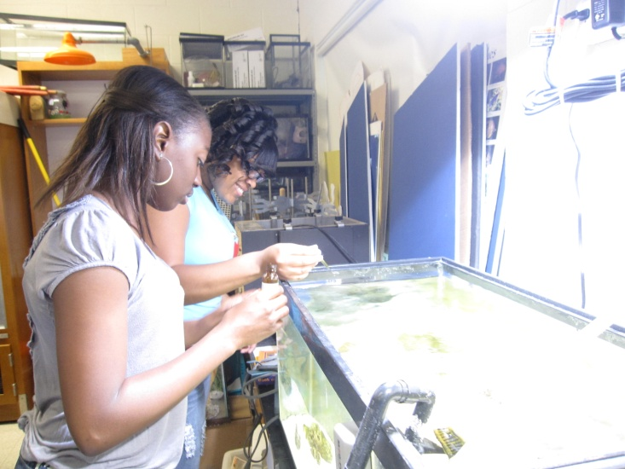
The largest clam in the world is the Tridachnid clam - we had one in the Nautilus

Slide 8
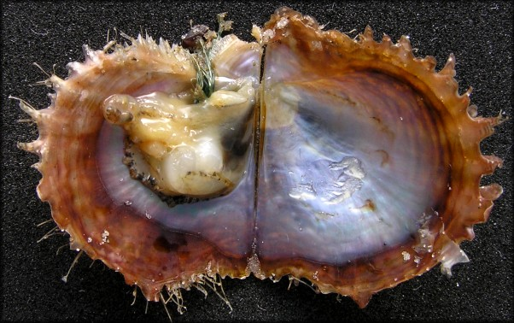
The Mantle is the lining of the shell of a bivalve and secretes calcium carbonate that produces the shell.

Slide 9
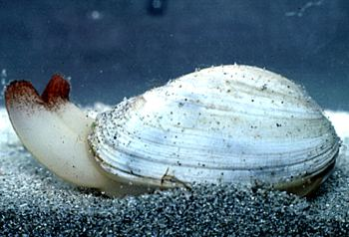
Bivalves have siphon tubes
Bivalves have incurrent siphon tubes for breathing and getting food and O2 (oxygen).
They have excurrent siphons for getting rid of wastes and CO2 (carbon dioxide).

Slide 10
Bivalves are filter feeders and sweep the water for food.
Zebra mussels did such a good job of filtering the water, they took all the food away from native mussels.
This is a picture of a rock scallop with its shell open filtering the water column.

Slide 11
Bivalves have gill membranes that are similar in function to our lungs.
Notice how feathery the gills are and how much surface area they take up. They have cilia that beat back and forth for gas exchange.
This is so the animal can get as much oxygen from the water as possible.

Slide 12
Bivalves have an open circulatory system and colorless blood.
Some people say we have blue blood. This is NOT true!!
Our blood is red and only appears blue in our blood vessels due to the low energy of red wavelengths of visible light.

Slide 13
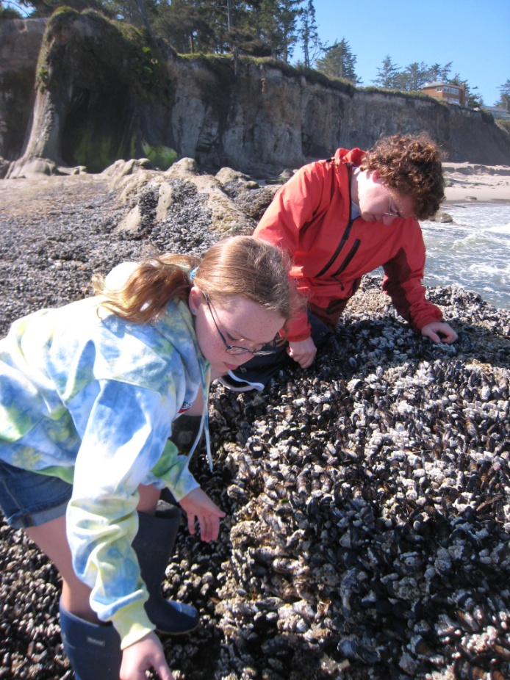
Many bivalves are attached to the substrate with tough threads called byssal threads.

Slide 14
Oysters are bivalves that secrete a cement that sticks to rocks very well.
Dentists are interested in this cement as a possible new material for filling teeth and building dental bridges.

Slide 15
Bivalves can produce jewelry known as pearls.
The beautiful jewels are produced by a sand grain that gets lodged in the shell and the animal responds to it by secreting a layer of mucus around it.
Over the years, it becomes a pearl.

Slide 16
Scallops are bivalves that are not attached.
In fact, scallops are the fasting moving bivalve. They move by scooting on the sand in sudden bursts by opening and closing their shells.
They also have eyes (blue spots) that can detect movement.
Clams, in contrast, move with a foot.

Slide 17
Gastropods - “stomach footed” animals
These are a diverse group of mollusks that are Univalves “one shell”.
Snails are the most common gastropod.

Slide 18
Snails have a one way digestive system.
This means that they have both mouth and anus and food flows in one direction.

Slide 19
They also have an open circulatory system.
They have colorless blood and they have a one chambered heart.

Slide 20
How do they get Oxygen?
They have a siphon tube for breathing and gills that remove oxygen from the water and gives off carbon dioxide.
The proboscis has the mouth-like structures.

Slide 21
Snail Senses
They have anterior tentacles that can sense things and they have posterior tentacles that have eyestalks for vision.
They have a small brain.
This is a moonsnail roaming with its large foot.

Slide 22
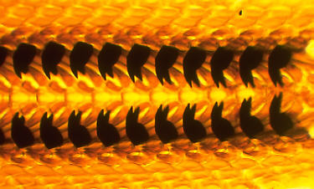
How do snails get their food?
Snails use a radula, a tongue-like structure, that scrapes algae off of rocks.
Some snails use the radula to drill holes into other animals to eat them.

Slide 23
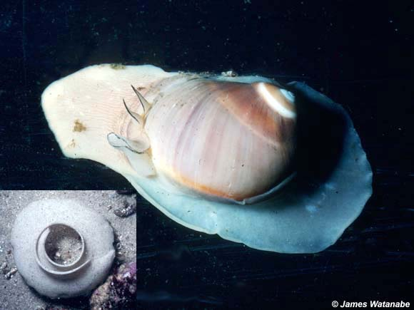
Some snails are carnivores
Moonsnails drill holes in clams and insert their mouth into the clam and digest it.

Slide 24
Cone snails
Cone snails are a type of snail that kill prey with a toxin.
They have tremendous medical potential
They are becoming endangered in the wild.

Slide 25
Flamingo Tongue snails, an olive snail and a large conch snail, Belize, Aug. 2009

Slide 26
How can snails escape predators?
When they are not moving or feeding, the snail retracts and the opening is covered by an operculum, a trapdoor covering that protects the snail.

Slide 27
Other Molluscs
Abalone is the biggest of the flat shelled gastropods. They live on the Pacific coast and people use them to make mother of pearl jewelry.

Slide 28
Other Molluscs
Crepidula fornicata or slipper shells can change their sex.
They are often stacked up on top of eachother and the upper one is a male and all below have become females.If another female lands on the male than that male will turn into a female and the one on top will change to a male.

Slide 29
Other Mollusks
Limpets live in the intertidal zone and graze on algae.

Slide 30
Other Mollusks
Nudibranchs, also called sea slugs, lack shells and breathe through their skin or fancy gill tufts on their backs.
Nudibranchs feed on hydroids or anemones and can store toxin from the stinging cells in their body.
They often have warning coloration that says, “Stay away!”

Slide 31
Cephalopods
These animals include squid, cuttlefish, Nautilus, and octopus.
The word Cephalopod means “head-foot” because they have a big head and many tentacles.

Slide 32
Swimming in Cephalopods
They swim using a kind of jet propulsion.
They have a streamlined body and no shell.
They draw water into the mantle, and expel it through the siphon or funnel. The animal moves in the opposite direction. It can move the siphon to change direction.

Slide 33
How do Cephalopods Capture Food?
They capture prey with tentacles and then kill it with a parrotlike beak.
Some octopus even have a paralyzing venom. The blue-ringed octopus is deadly to humans.

Slide 34
The blue-ringed octopus

Slide 35
Cephalopods have a one way digestive system and a closed circulatory system.

Slide 36
Trace the flow of food in one way digestive system of the octopus……

Slide 37
Octopus (“8 feet”- has 8 tentacles and suction cups that are used for grasping, holding prey, climbing and crawling.

Slide 38
Squid - has 8 tentacles and 2 arms (10 altogether)

Slide 39
How do cephalopods survive without a protective shell?
Squid have an internal shell (pen) that makes it faster.
Squid swim in large schools.
They can camouflage themselves with changing skin patterns and coloration with special pigmented cells called chromatophores.
They can also discharge a cloud of ink into the water.
In addition, the brain and eye is highly developed.

Slide 40
The Squid Pen - gives it an edge in swimming fast

Slide 41
The Ink - a natural “smoke screen” to escape predators

Slide 42
Chromatophores
The squid appear to change the patterns on their body.
These patterns are used in a complex communication between squid.

Slide 43
The Octopus - the most intelligent of all invertebrates!
The experiment in your book indicates that octopus can learn by watching others. This octopus escaped from his tank, ate the fish in another and then went back to his!
They have large brains that can be used for learning adaptive behaviors. This one predicted the winning World cup soccer team!

Slide 44
The Chambered Nautilus
Inhabits the South Pacific ocean.
Has a spiral shaped shell with compartments that it can fill with air to regulate its buoyancy.
It has 40-90 sticky tentacles to capture prey.

Slide 45
The Cuttlefish
Is a bottom dwelling cephalopod and feeds on invertebrates in the sand.
They have an internal shell, the cuttlebone.
They have 10 tentacles like the squid, with two of them longer.

Slide 46
The Giant Squid
The largest invertebrate in the world.
We have never captured one alive.
They can be up to 20 meters long.
They are prey for the sperm whale.

Slide 47
Giant Squid on the Beach and Sperm whale eating a squid

Slide 48
Reproduction in Cephalopods
Most breed in shallow water.
Fertilization is internal and development is external.
Most squid die after mating. Most female octopus die after protecting the eggs until they hatch.

Slide 49
Other Molluscs…Chitons
Chitons have no eyes or tentacles.
They hace overlapping shells that give them flexibility for moving on rocky shores.
It feeds with a radula, a scraping tongue.

Slide 50
Other Molluscs….Scaphopods
These scaphopods consist of the tusk shells, named for their tapering shell.
They burrow in the sand of tropical waters.
They have tentacles with sticky ends to capture worms and plankton.
Used as wampum (money) by the Native Americans.

Slide 51
Phylum Mollusca - a Diverse Phylum

